Slide 1


Implementing a Ballast Water Exchange Advisory Service Douglas Bancroft, Marty Taillefer, Amélie Byam, Jean Robert 10 February 2015

Slide 2
Presentation Outline
The challenge
Workshop vision and objectives
Workshop deliverables
Why do it?
Why us?
How could it be done?
Question and discussion

Slide 3
The Challenge
“One of the maritime industry’s greatest challenges is to find ballast water management solutions that are safe for both the ship and its crew, while reducing the risk of introducing exotic species. Invasive species are plants, animals, aquatic life and micro-organisms that, when introduced outside of their natural environment, out-compete native species and can disrupt the existing balance of that ecosystem.”
Green Marine: advancing environmental excellence, issues and criteria, aquatic invasive species. http://www.green-marine.org/program

Slide 4
Workshop Vision
Reduction of anthropogenic harm to oceans ecosystems by significantly reducing inadvertent marine alien invasive species transported into Canadian waters by marine shipping….
by the implementation of a complimentary measure to ballast water treatment systems, i.e. real time advice to shipping on highly optimum areas for ballast water exchange.

Slide 5
Workshop Objectives
Develop an achievable plan to implemented an operational ballast water exchange advisory service
Engage with stakeholders of ballast water exchange to:
Validate that such a system has scientific merit and technical feasibility; and
Generate industry and regularity support.

Slide 6
Workshop Deliverable
An actionable plan for implementing a robust real time system for delivery of optimised ballast water ocean exchange locations for marine shipping, that is:
Scientifically valid
Supported by the marine shipping industry
Addresses required resources for development
Addresses required resources for operations

Slide 7
Why bother doing it?
The current risk of AIS disruptions of ecosystems is real
The risk will increase on all three coasts
Especially in BC
Very special concerns in the Arctic
The need to be seen to be proactive as much as being proactive, especially in BC
Beyond due diligence

Slide 8
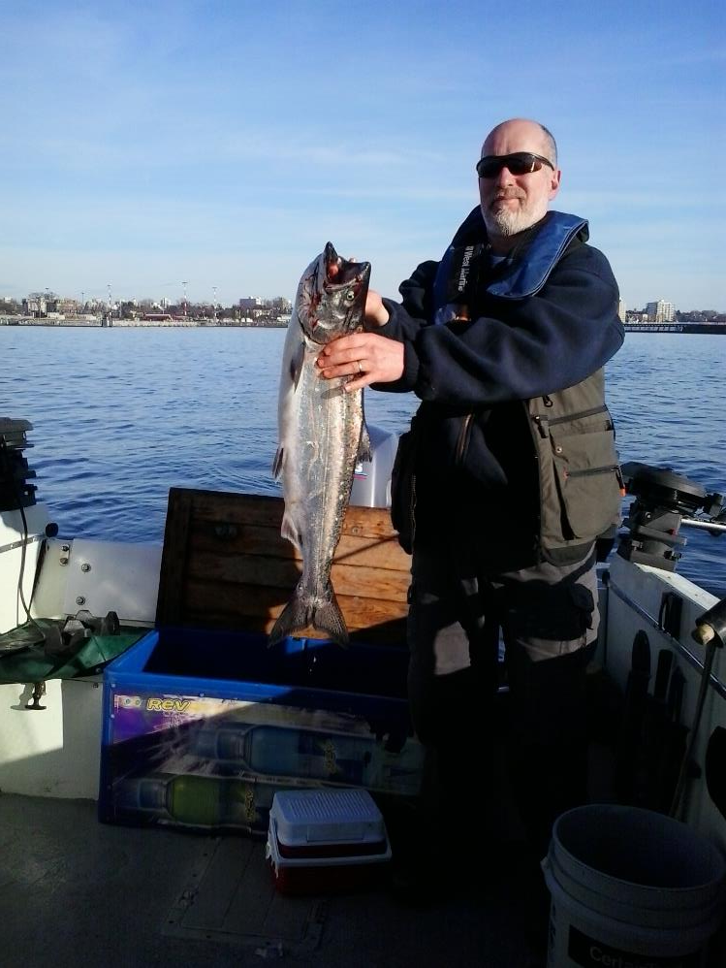

Slide 9
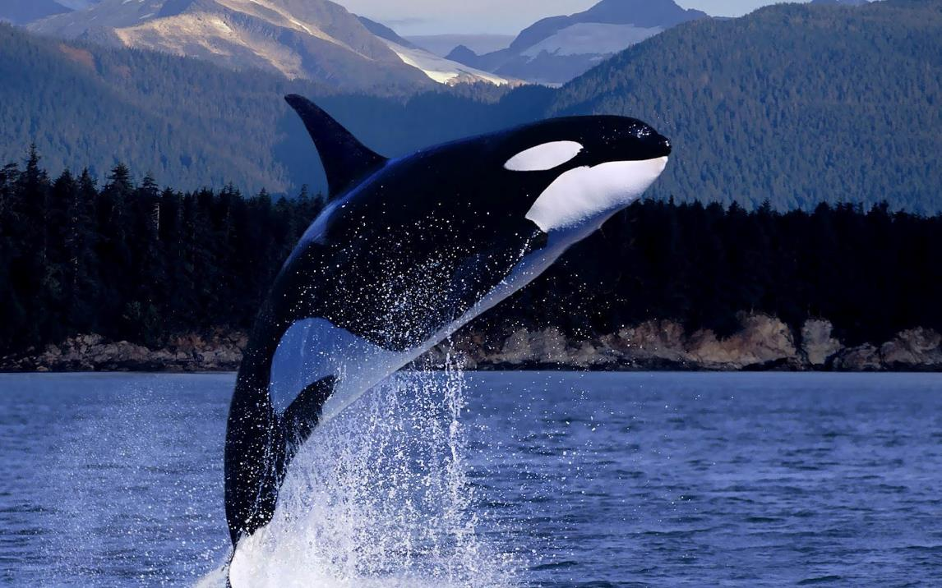

Slide 10
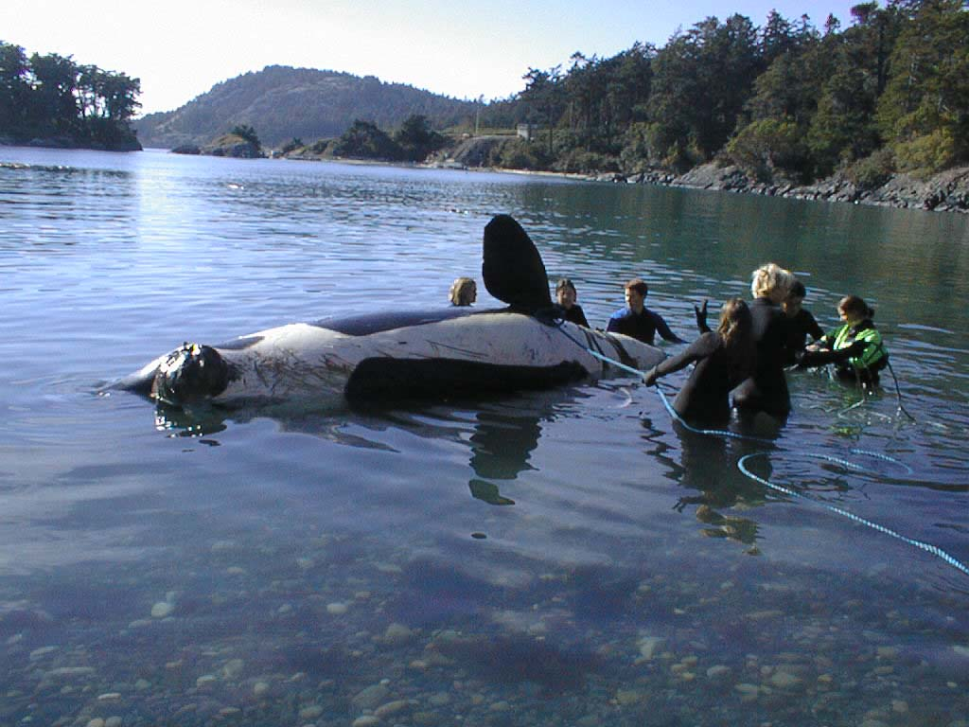

Slide 11
Why won’t treatment be enough?
Ballast water treatment will reduce the risk, but does not come close to eliminating it.
Neither would a ballast water exchange service
But the two are complimentary
“1-3 +1-2 = 2 – 5”
We could reduce risk by 1,000s

Slide 12
Why us? Why now?
Canada has taken on an international leadership role in ballast water exchange as a complimentary measure.
Canada has proven science leadership in these issues.
Operational ocean models now exist.
BC ports are readying for growth.
incoming ballast water will grow

Slide 13
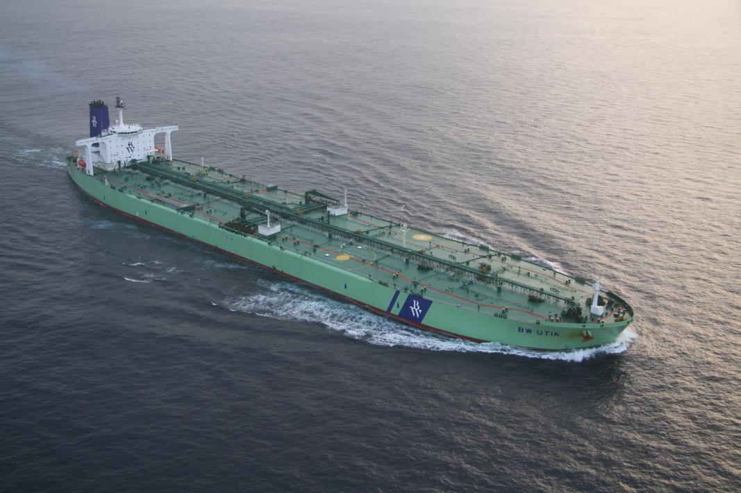

Slide 14
How could it be done?
A service that starts small, and grows
Initially, based on general shipping routes to the main ports, then evolving to individual ships, eventually to origin of the ballast water
Takes into account other factors (e.g. weather)
Geographically
BC, then the Eastern Artic, then Atlantic
possibly then the Great Lakes
Notes:
Eat the elephant one bite at a time

Slide 15
How does this get to the ships?
Must respect the mariner at sea
Need to work closely with Port Authorities and Shipping companies and agents
Dissemination by INMARSAT etc.
Formats should be designed for ease of use, e.g. S-57, KML, or proprietary
Easier now that we know where ships are

Slide 16
Why not DFO? Why MWS?
This is at the intersection of private gain and public good.
Sustained federal funding highly unlikely
Outside academic mandate.
MWS has great experience in operational oceanography.
And a long term passion
Notes:
Although both government and academic ocean science has a mandate to support it.

Slide 17
Maritime Way Scientific Ltd. has started the design, concept and development of the Ocean Data Integrator (ODI).
Part of the development is to build a forecast system for optimised ballast water exchange regions. This application builds directly on the pioneering work of Dr. David Brinkman
e.g. D. Brickman, P.C. Smith / Marine Pollution Bulletin 54 (2007) 863–874
Notes:
The intent of the ODI is to access a broad range of oceanographic, acoustic & hydrographic datasets on a single platform for real time analysis and forecasting of environmental features, which in turn will enable better decision making.

Slide 18
Clients

Slide 19
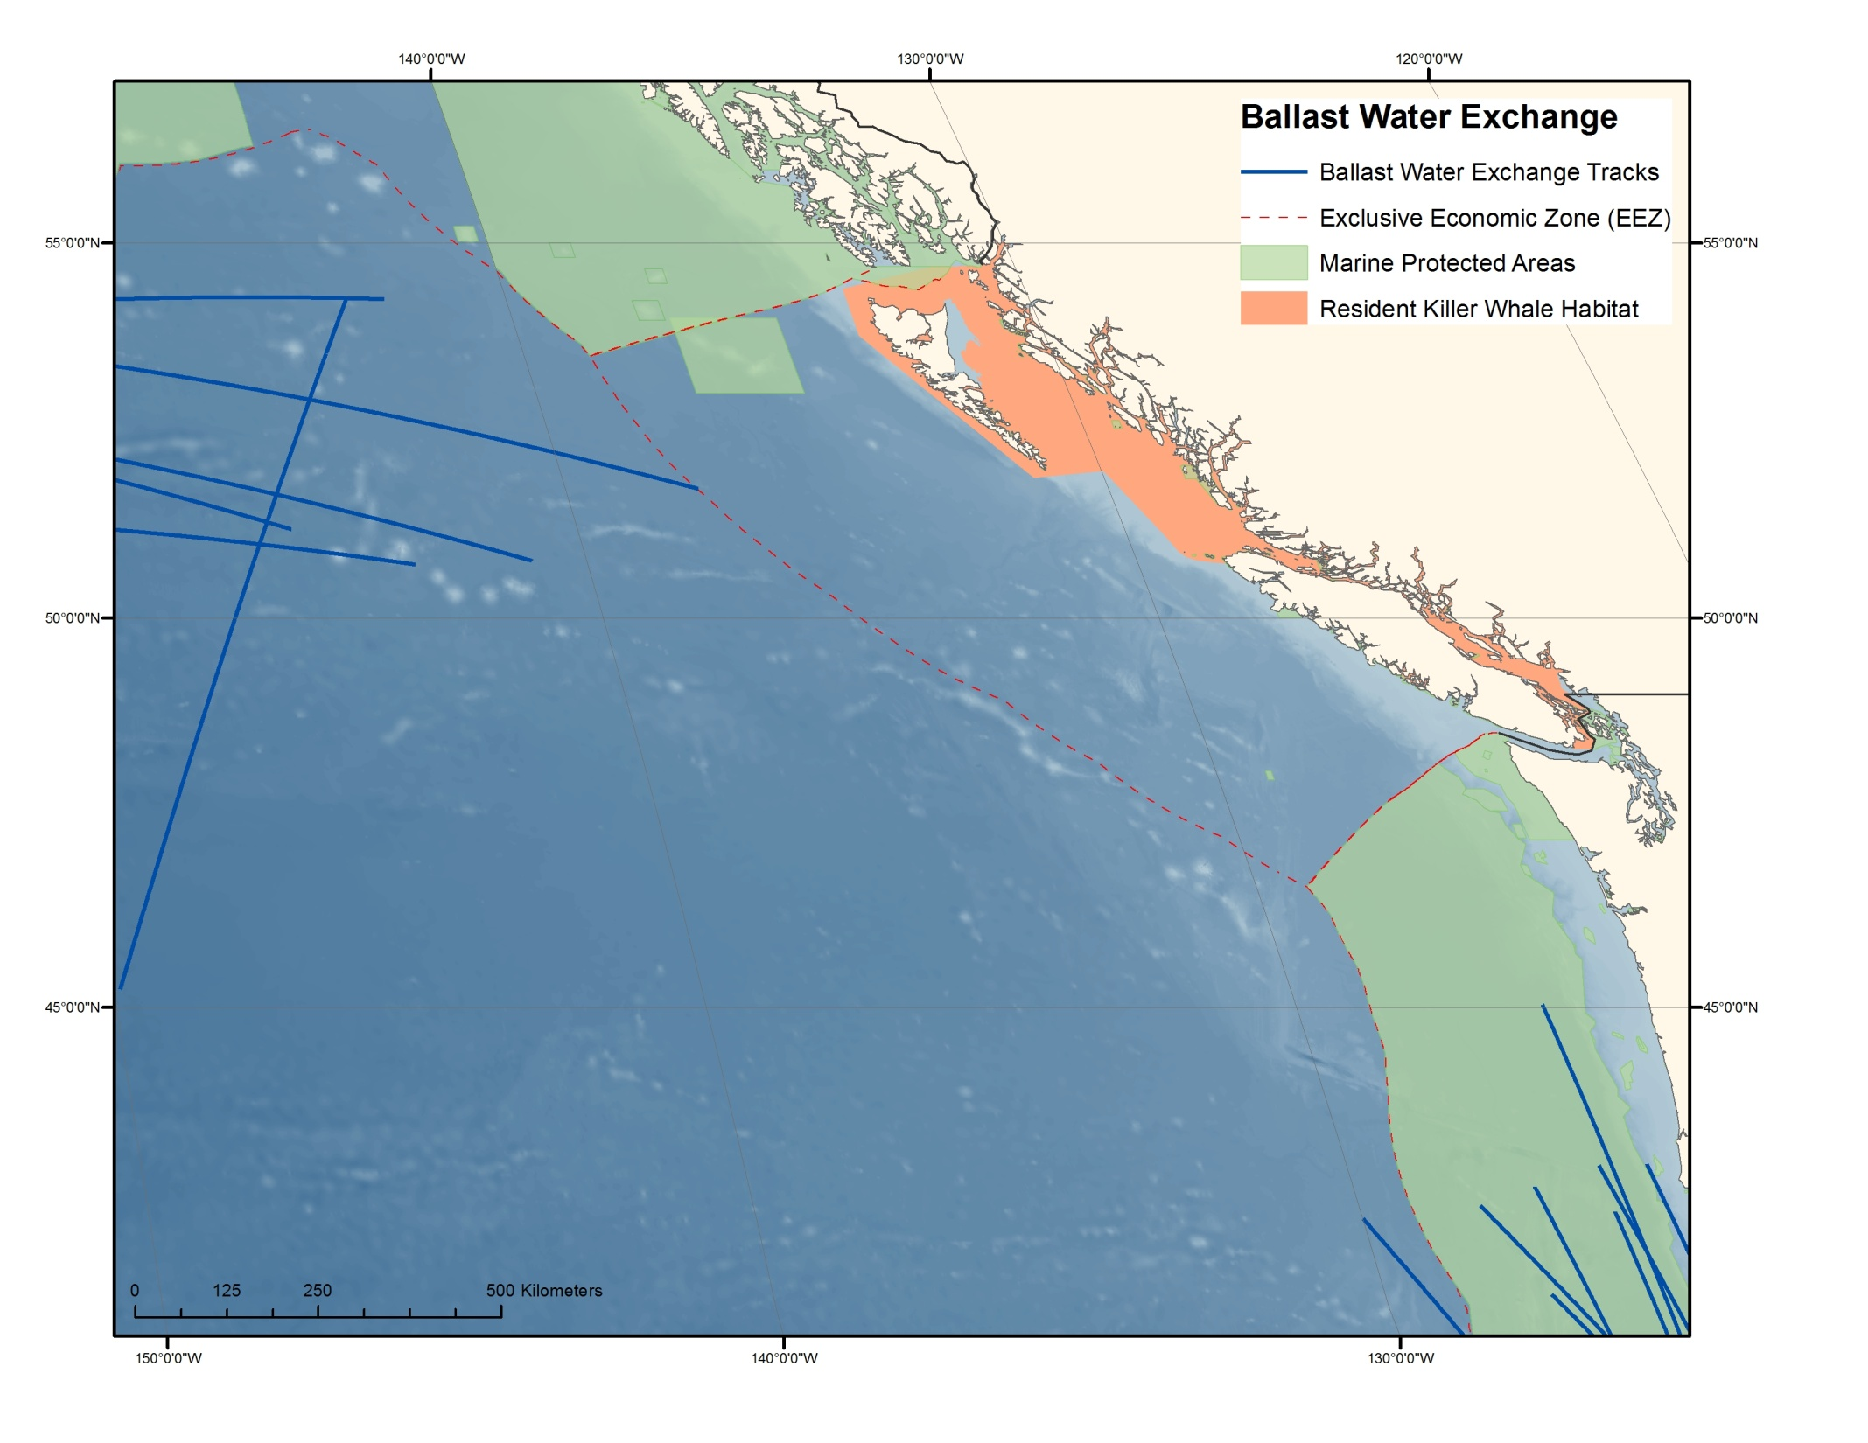

Slide 20
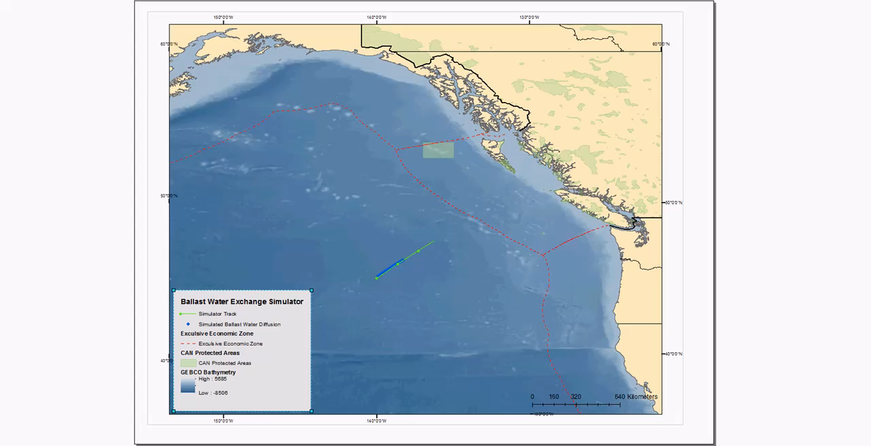
Build it and they will come
Notes:
You will see more after lunch

Slide 21
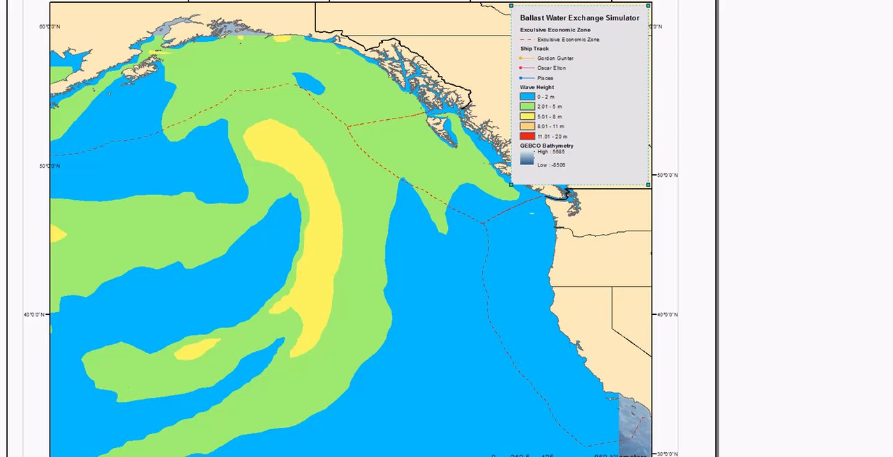
Build it and they will come

Slide 22
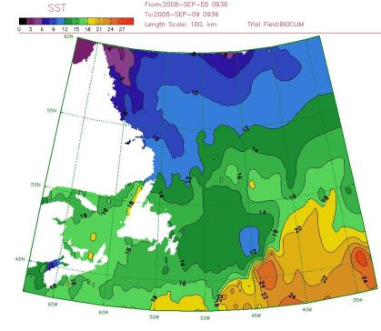
Questions & Discussions

Slide 23
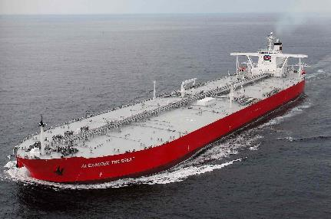

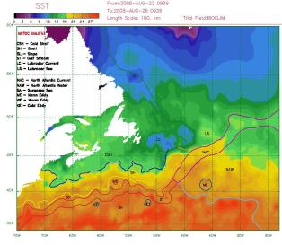
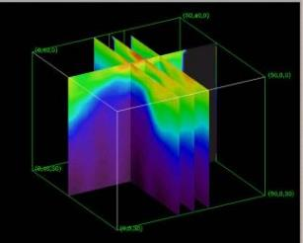
Thank you!

