Slide 1
Ocean Data Integrator Ballast Water Ops System SUCCESS THOUGH COLLABORATION “Building a Window to a Transparent Ocean” Martin Taillefer, CD, M.Sc., B.Sc. President & Managing Director Maritime Way Scientific Ltd.

Slide 2
Introduction
Background
Company Profile
A short history of Operational Oceanography at Maritime Way

Slide 3

Martin Taillefer
20 Years in the Royal Canadian Navy
Specialisation in UWW & modelling applications
Oceanographer of the Pacific Fleet working for Doug Bancroft
GD Canada – acoustic modelling systems
Installing Sonar Systems for the Swedish Navy
DFO - coupled modelling & ship self noises (CCG)
Maritime Way since 2010
Chair of CMOS Ottawa for 3 years
Chair of the ARCTIC SIG
Board Member of the CNC-SCOR
Board of Directors for CFFS (ROPOS)
Invited to run as VP and Pres of CMOS
OPERATIONAL OCEANOGRAPHY SINCE the Early 1990s

Slide 4
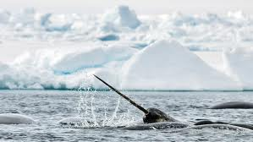
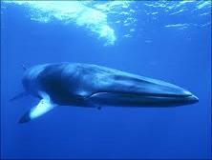
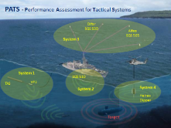
Operational Oceanography & Scientific Solutions
Maritime Way Scientific Ltd. specializes in providing consulting and scientific services to Marine Industry, Maritime Research and Development, Fisheries and Defence. Our team is composed of operational subject matter experts in the fields of theoretical oceanographic and acoustic propagation modelling, marine science, the application of Geographic Information Systems in the marine environment, Situational Awareness solutions and Tactical Decision Aids.
Target Markets
Oil & Gas
Dept. National Defence
Marine shipping
Academia
Government Depts.
Project of Opportunities
The Arctic!
CORE CAPABILITIES
Acoustic Modelling
Operational Oceanography
Hydrography: Seabed Classification

Slide 5
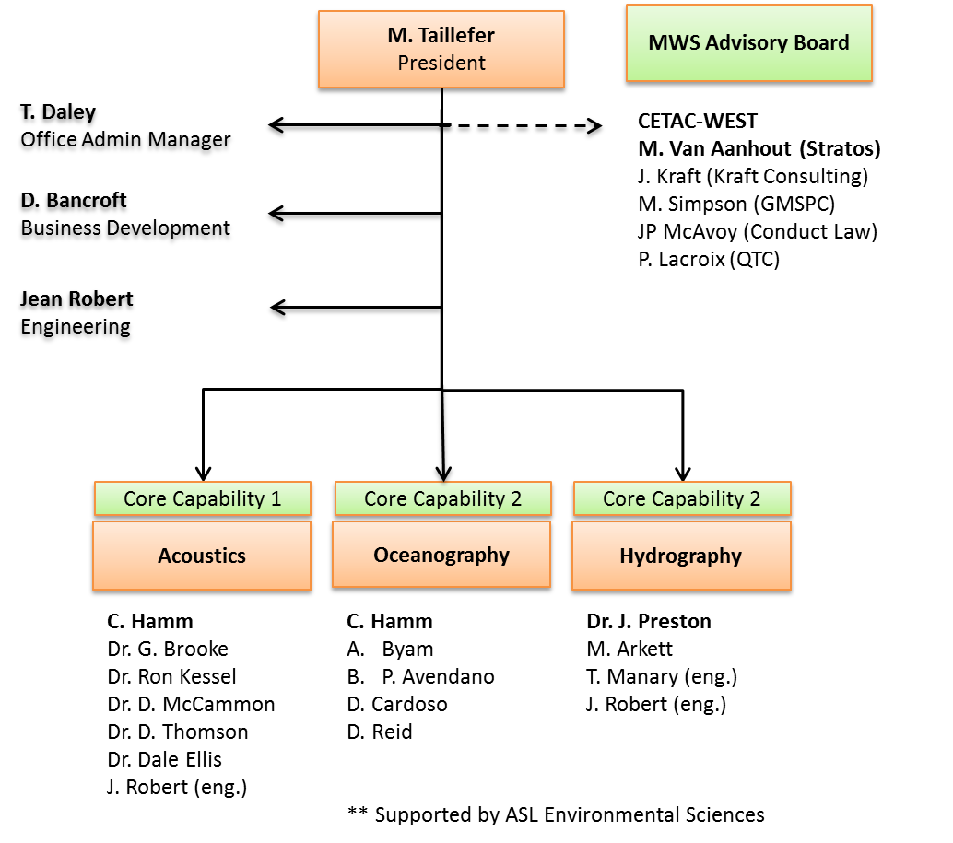

Slide 6
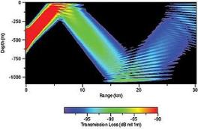
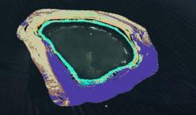
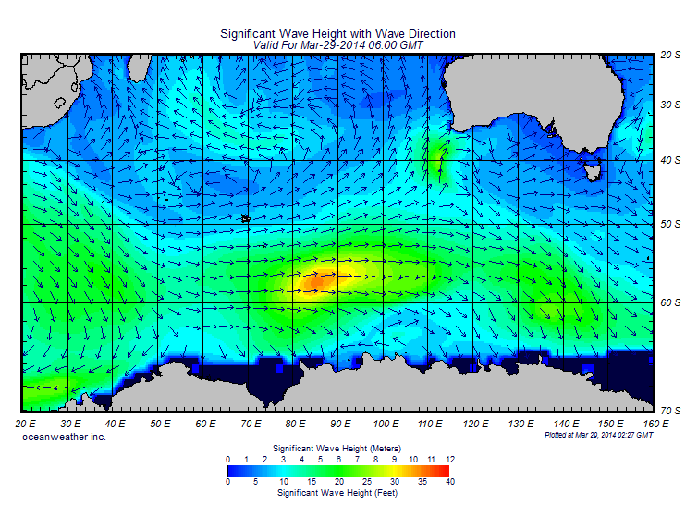
Ocean Acoustics
SPARTA
IRAP funded Modelling system (SPARTA)
Multiple DRDC Modelling Contracts inc. 5yr
OGP - Marine Mammal Mitigation
Multiyear Investment from Lockheed Martin
Hydrography
QTC Seabed Classification Acquisition (Aug 2014)
Multiple contract opportunity
Work w/ Atlas Electronix (Bremen)
Bowling Green U.
SEAPROD – Mexico
ABIMAR – Chile
Ian Hargreaves – Australia
PAN INDIA
Operational Oceanography
Operational Oceanographic support
Ocean Data Integrator (ODI)
Partnership w/ MEOPAR & ONC
Creation of a unique Ops Ocean system

Slide 7
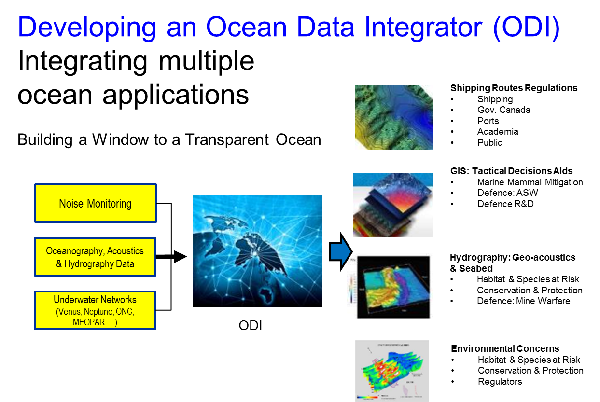
How do we get here ?
1990s - DND OWS
2015 - A need for a Commercial System
Significant Operational Experience
Taillefer & Bancroft
Operational Products
Client Solutions
Notes:
What are we up to?
Starting from a clean whiteboard.
Building something new, exciting, and useful to ourselves and others.
The ODI is a comprehensive commercial oceanographic applications suite allowing tailored support to management decision making.
The ODI will allow for:
data harvesting from hundreds of external oceanographic data bases (using a propriety meta data base, and internal data bases to support specific operational oceanographic applications, as well as automated and semi-automated scripts too update internal data bases);
fusion and visualisation of in-situ and remotely sensed environmental data with forecast model output; and
creation of additional layers of derived geospatial information to support marine decision making

Slide 8
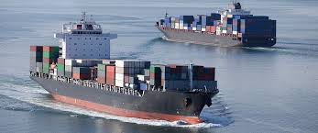
Operationalization VISION
CONCEPTS: The ODI will use the ocean model outputs that are the outcome of decades of investments by DFO and EC in systematic ocean observations and model output, i.e. CONCEPTS forecasts;
MEOPAR: As well as investments by key NCEs and other academic contributions and exploit them for Canadian SMEs and other potential international clients.
A NEW CLIENT: Commercial Shipping
Significance: to enable client organisations to further advance oceanographic capabilities and accommodate new developments in ocean modeling and forecasting.
Maritime Way strongly believes that this system (a suite of integrated tailored oceanographic applications) are most consistent with the vision and goals of many potential partners gathered here today ay CMOS.

Slide 9
PAIN: Transition BWE to BWT
SOLUTION: The Maritime Way ODI Program
VALUE PROPOSITION:
We intend on building an advanced and sophisticated Operational Oceanographic system to help solve the shipping industry's ballast water pain.
Operational Oceanography Experience
Astute Understanding of the problem
PASSION

Slide 10
Notes:
What are we up to?
Starting from a clean whiteboard.
Building something new, exciting, and useful to ourselves and others.
The ODI is a comprehensive commercial oceanographic applications suite allowing tailored support to management decision making.
The ODI will allow for:
data harvesting from hundreds of external oceanographic data bases (using a propriety meta data base, and internal data bases to support specific operational oceanographic applications, as well as automated and semi-automated scripts too update internal data bases);
fusion and visualisation of in-situ and remotely sensed environmental data with forecast model output; and
creation of additional layers of derived geospatial information to support marine decision making

Slide 11
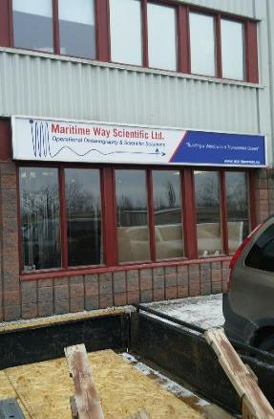
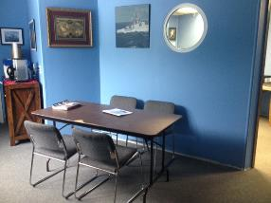
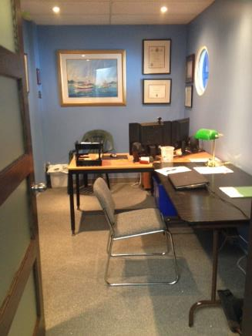
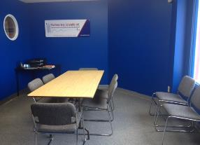
FUTURE OF MARITIME WAY

Slide 12
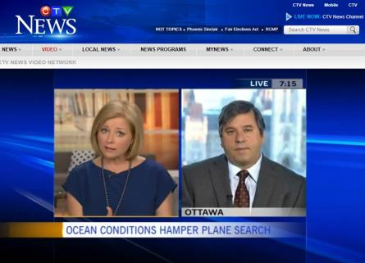
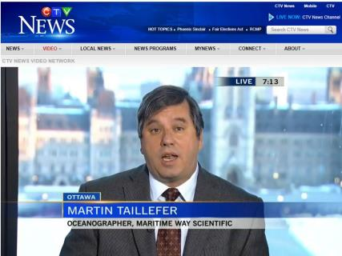
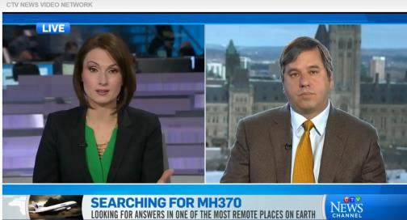

Slide 13

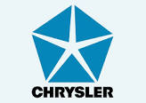


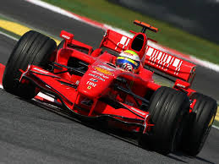
GD Canada
Lockheed Martin
McDonald Dettwiller
Ultra
Maritime Way Scientific

Slide 14
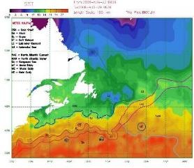
Always Interested in new ventures & partnerships
www.maritimeway.ca
Maritime Way Scientific - Integrating Ocean Applications
Building a Window to a Transparent Ocean
CONTACT US
Mailing Address Maritime Way Scientific Ltd 1420 Youville Drive Unit 5A Ottawa, Ontario K1C 7B3
Ottawa, Ontario Tel.: +1 613.841.0505
mtaillefer@maritimeway.ca
dbancroft@maritimeway.ca

