Slide 1
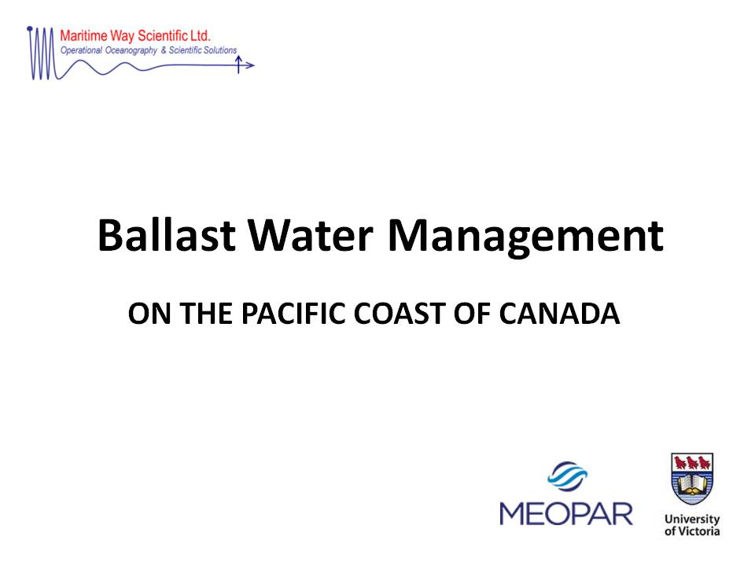

Slide 2
What is Ballast Water
Ballast water is taken aboard ships as cargo or consumables are removed to ensure the
vessel’s stability, manoeuvrability, and trim, as well as controlling structural stresses.
Untreated ballast water contains the many types of organisms naturally occurring in the area of ballasting, both planktonic organisms from the water column as well as disturbed benthic organisms.
The transport of ballast water has introduced and established hundreds of Aquatic Nonindigenous Species (NIS) worldwide.

Slide 3
Impacts of Aquatic Invasive Species
Environmental degradation
Ecosystem disruption
Population reductions
Species extinction
Reduced biodiversity
Fisheries depletions
Economic loss
Increased industrial operating/maintenance costs
Expensive mitigation programs
Degradation of recreational areas

Slide 4
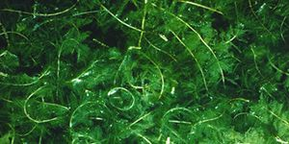
West Coast Marine Invaders
Almost 100 documented Aquatic NIS have become established on the coast of BC.
Linley et al. 2014
Eurasian Watermilfoil (originally native to Europe, Asia and North Africa)
Displaces native species, reduces biodiversity, degrades fish and waterfowl habitat
Impacts fishing, boating, swimming and industrial water intakes

Slide 5
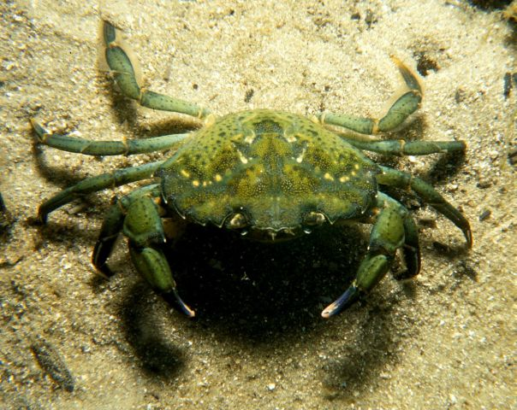
European Green Crab (originally native to Northeast Atlantic and Baltic Sea)
An omnivore that feeds on plants, oysters, mussels, clams, worms and other crustaceans
Impacts fisheries and disrupts the ecosystem

Slide 6
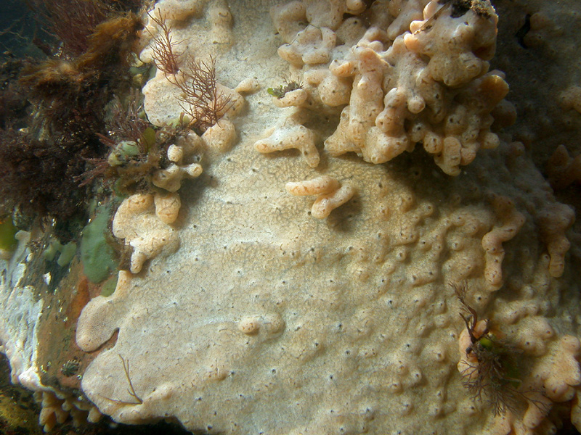
Carpet Seasquirt; Marine Vomit (believed to be originally native to Japan)
A colonial tunicate that can cover large areas of gravel, rocks and other hard substrate
Can overgrow mussels, oyster beds, cables, docks, ship’s hulls and aquaculture equipment
Impacts fisheries, disrupts the ecosystem and raises aquaculture operating costs

Slide 7
Brief History of BW Regulations
in North America
1988 - Zebra Mussels discovered in the Great Lakes
1989 - Voluntary ballast water control guidelines introduced in Canada for vessels entering the Great Lakes- St. Lawrence Seaway System
1990 - U.S. Nonindigenous Aquatic Nuisance Prevention and Control Act to reduce the introduction of Aquatic NIS to the Great Lakes
1993 – USCG mandated ballast water exchange for Great Lakes-bound vessels
1996 – U.S. National Invasive Species Act extended ballast water management to all U.S. waters

Slide 8
2000 - Voluntary ballast water control guidelines expanded to all Canadian waters
2004 - USCG mandated ballast water reporting in all U.S. waters
2005 - USCG mandated ballast water management in all U.S. waters
2006 - Ballast Water Control and Management Regulations established under the Canada Shipping Act (since 2006, no new AIS have been documented in the Great Lakes)
2010 - Canada ratified IMO’s Convention for the Control and Management of Ships’ Ballast Water and Sediments
2012 – USCG Final Rule came into effect implementing the IMO D-2 Discharge Standard (USCG is allowing Alternate Management Systems and compliance date extensions)

Slide 9
STATUS OF THE INTERNATIONAL CONVENTION
FOR THE CONTROL AND MANAGEMENT OF
SHIP’S BALLAST WATER AND SEDIMENTS (2004)
AS OF 6 JANUARY 2015
NUMBER OF CONTRACTING STATES
43 (30 REQUIRED)
PERCENTAGE OF WORLD MERCHANT FLEET
32.54% (35% REQUIRED)
THE REQUIRED 35% OF THE WORLD FLEET
COULD BE ACHIEVED AT ANY TIME

Slide 10
IMO D-2 Ballast Treatment Performance Standard
Plankton >50um <10/m3
Plankton >10<50um <10/ml
Indicator microbes
Vibrio cholera <1 cfu/100ml
E. coli <250 cfu/100ml
Intestinal enterococci <100 cfu/100ml

Slide 11
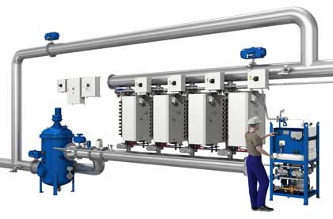
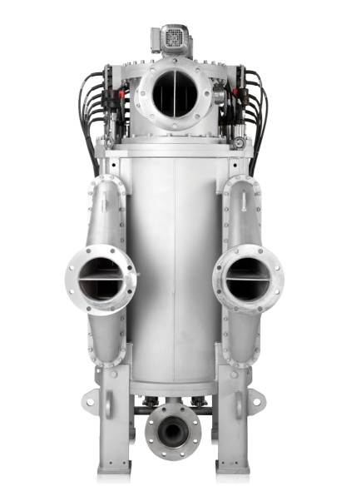
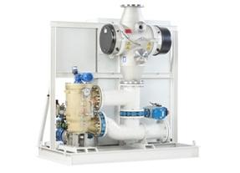
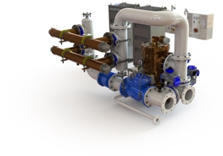
Filtration and UV BWTSs

Slide 12
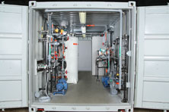
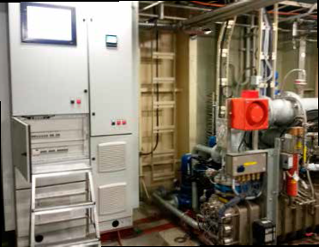
Active Substance BWTSs
Filtration and Electrochlorination
Filtration, UV and Ozone

Slide 13
Ballast Water Treatment System Estimated Costs (World Fleet Estimated to be ~60,000 Vessels)
 | Retrofit Vessels | New Construction
Purchase | $750K - $1.25M
Installation | $75K - $175K | $25K - $75K
Annual Operation and Maintenance | $15K - $150K
Treatment Cost/MT (Over 25yr) | $0.10 - $1.00
Treatment Cost/Year (10 trips/Year; 25,000 MT BW/Trip) | $25K – $250K
Note: some installations may require 2 BWTSs, doubling all cost estimates.
(revised from King et al. 2012)

Slide 14
Concerns Regarding BWTSs
There is general concern that in practice, even approved BWTSs may not meet the D-2 discharge standard under all conditions at all times.
Environmental
Temperature
Salinity
Turbidity
Dissolved Organics
Suspended Solids
UV Transmittance
Operational
Reliability of complex mechanical, electrical, hydraulic, chemical systems; backup systems not usually an option
Worldwide availability of parts and maintenance; Integrated Logistics Systems

Slide 15
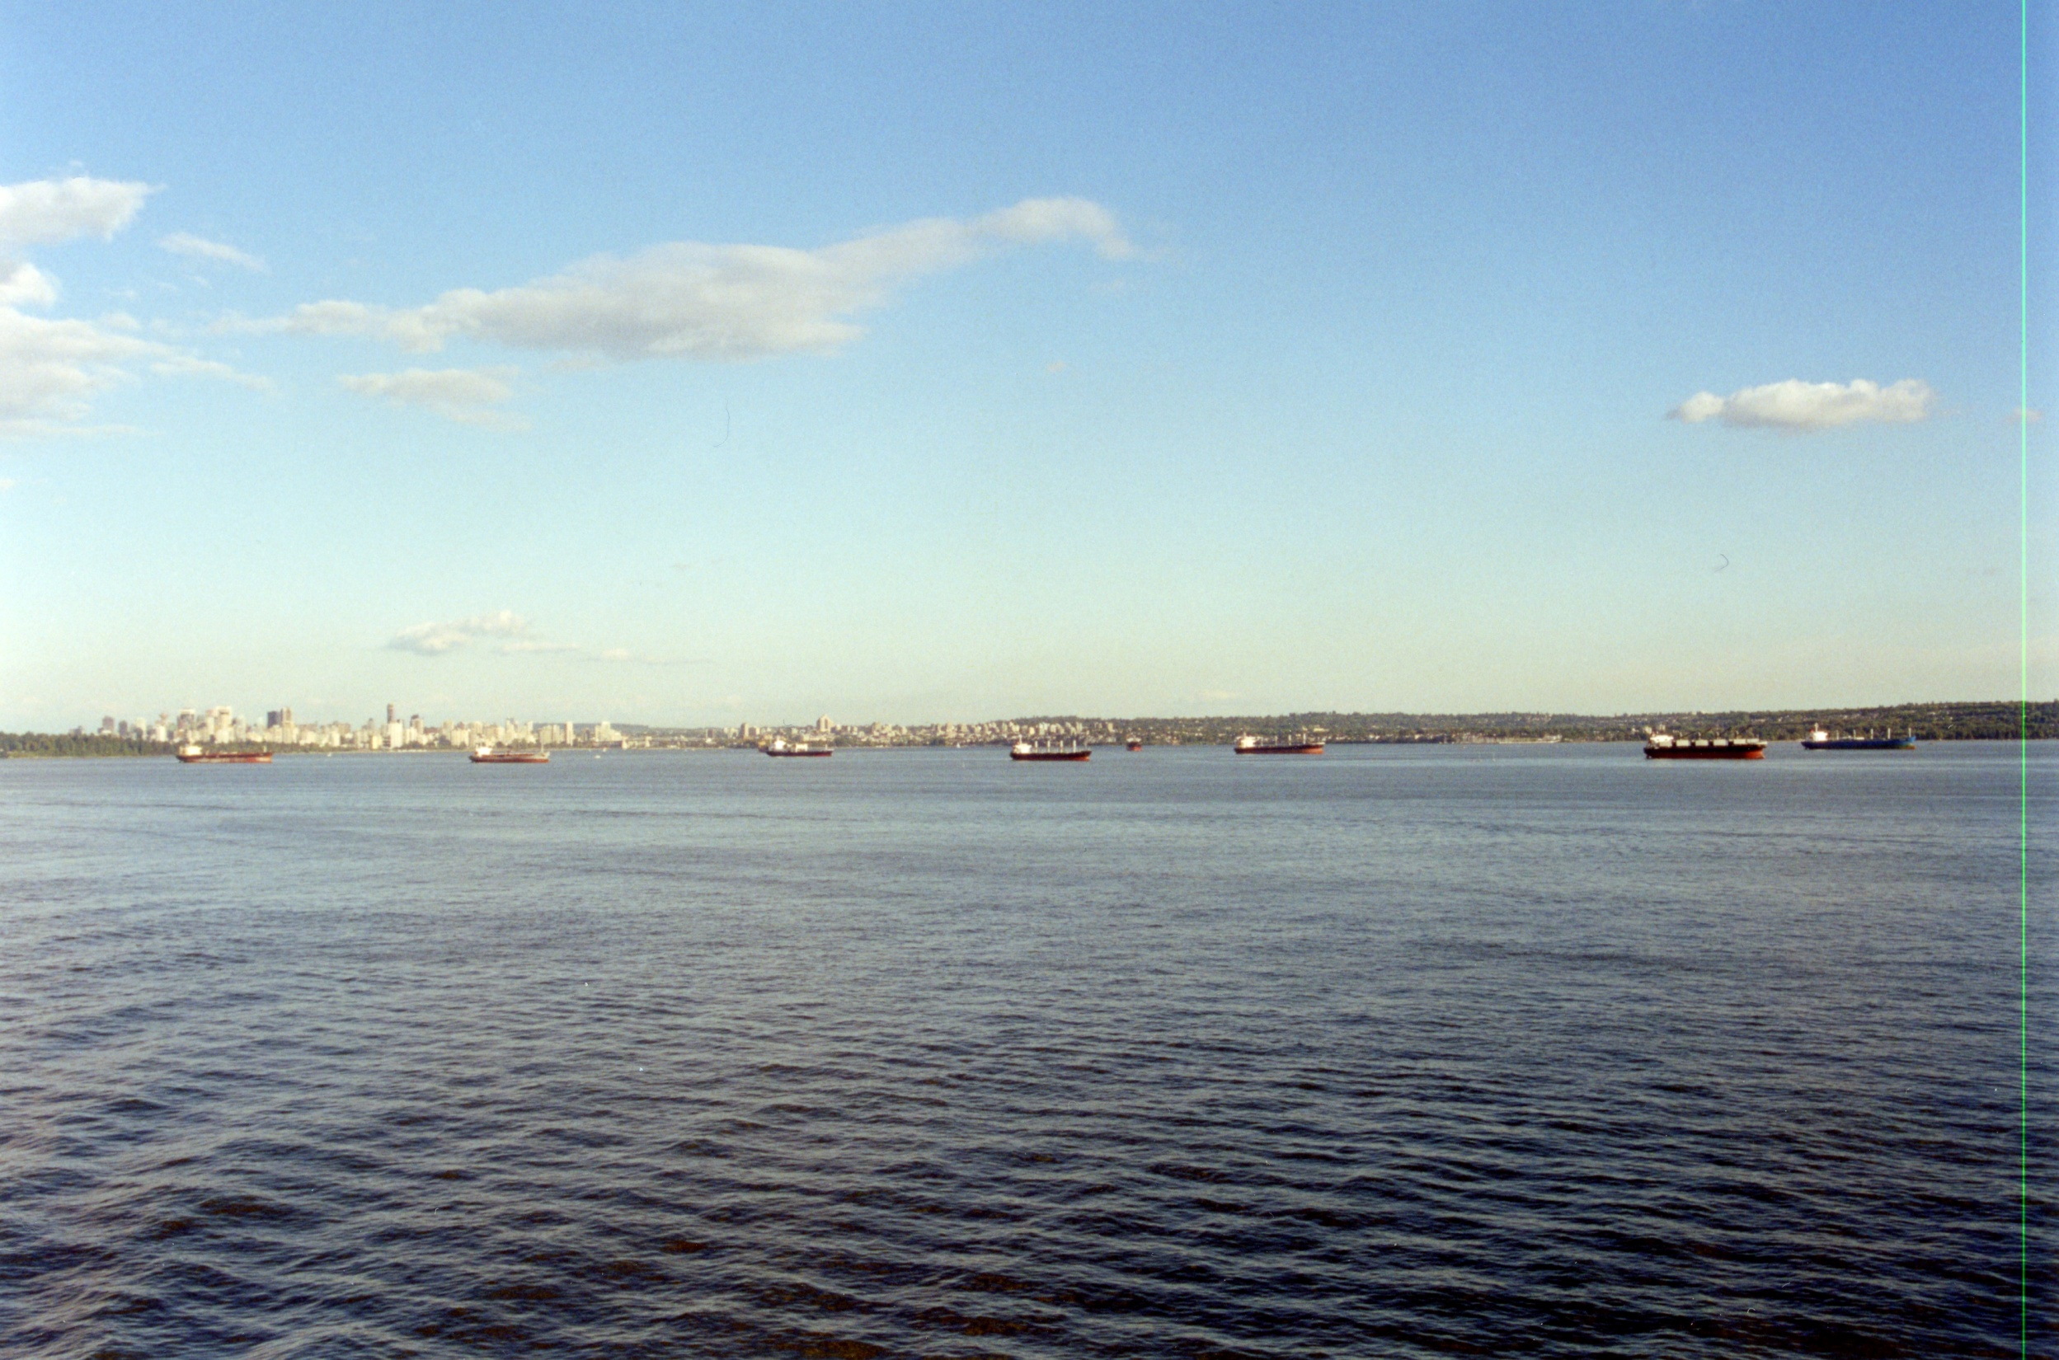

Slide 16
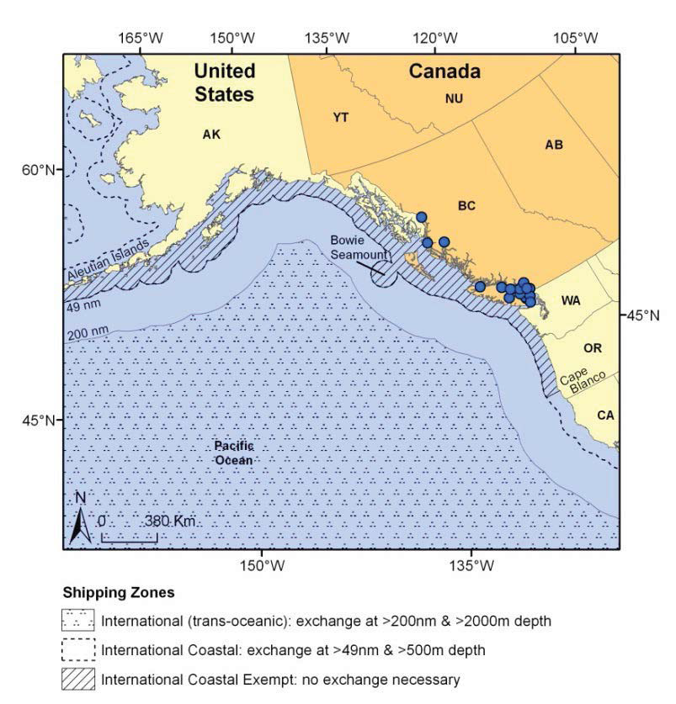
PACIFIC BALLAST WATER EXCHANGE ZONES
(Cassus-Monroy
et al. 2014.)

Slide 17
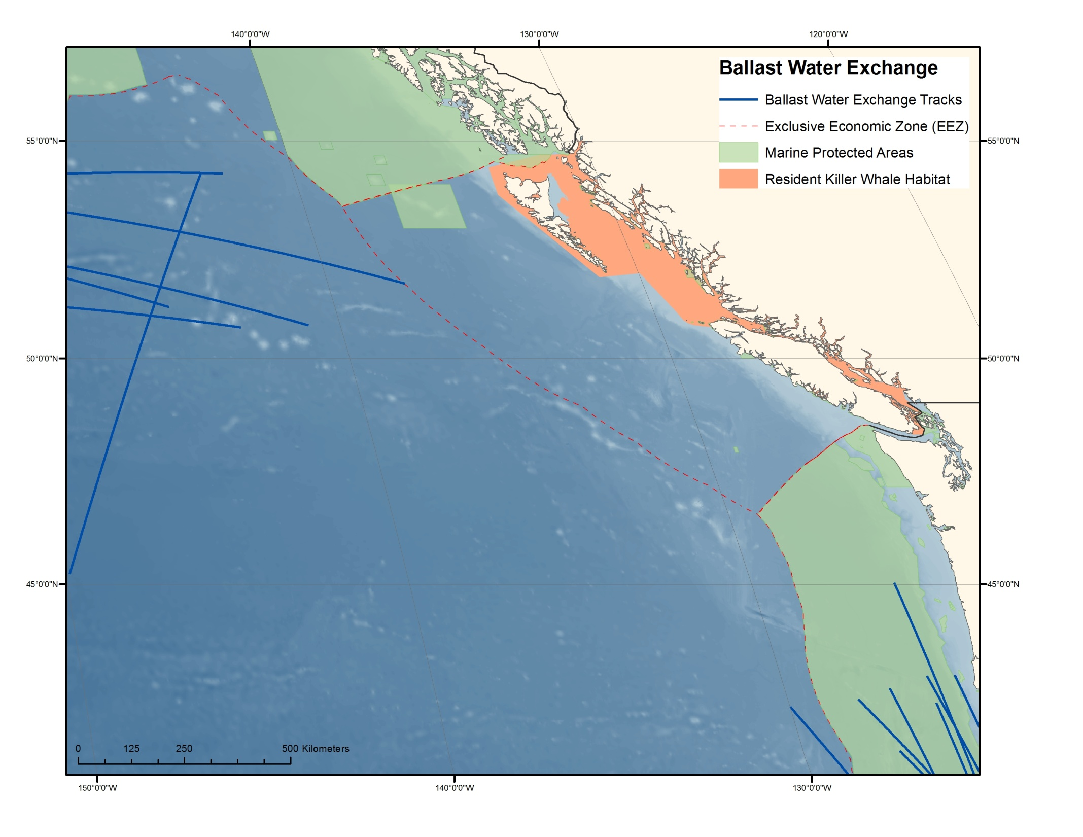

Slide 18
CONCERNS WITH BALLAST WATER EXCHANGE
Additional work loads on officers and crew, personnel safety.
The effects of free surface area in partially filled ballast tanks on stability and structural loads, which should be maintained within permitted values.
The production of longitudinal and torsional stresses, which should be maintained within permitted values.
Fore/aft trim, bridge visibility, propeller and rudder immersion, slamming, maintaining minimum forward draft.
Open ocean BWE may in some cases increase the numbers of potential Aquatic NIS being carried that can survive in saltwater ports, either by adding new species, supplementing numbers of current species, or by “fresh” ocean water stimulating resting stage emergence. (Chan et al. 2015)
Internal structures in ballast tanks may allow “refuges” of unexchanged ballast water retaining Aquatic NIS.

Slide 19
BENEFITS OF BALLAST WATER TREATMENT AND BALLAST WATER EXCHANGE COMBINED
A recent study has shown that BWE combined with BWT can significantly reduce the abundance of most organism groups compared to BWT alone.
Briski et al. 2013
TC has proposed continuing the requirement for BWE in combination with BWT.
IMO is considering retaining BWE as a ballast water management method in combination with BWT.
BWE may also be retained as an acceptable backup option in case of BWTS malfunction.

Slide 20
Risk Assessment
As vessel traffic volume increases, the risk of AIS increases.
Biological surveys of ballast water indicate that the density of AIS remains high after BWE. Risk projections indicate that ballast water management at the level of the IMO D-2 standards will dramatically reduce arrival potential for zooplankton, but will have a lesser effect on arrival potential for phytoplankton.
Pacific International Exempt vessels currently pose the highest Aquatic NIS invasion risk. Despite the low volume of ballast water discharged and the relatively low vessel traffic, the abundance and survival potential of AIS/vessel is high, with a very high magnitude of consequences. The BWM exemption appears to be liberally applied in the Pacific region, being granted based on vessels’ last port of call rather than only to vessels which operate exclusively in the exemption areas.
Proposed requirements for vessels arriving in Canadian freshwater ports, which combine BWE with BWT to the IMO D-2 standards, are expected to result in very low survival potential of AIS.
Additional research should be conducted to evaluate the risk of ballast-mediated Aquatic NIS introductions by domestic vessels in the Pacific region.
(Cassus-Monroy et al. 2014)

Slide 21
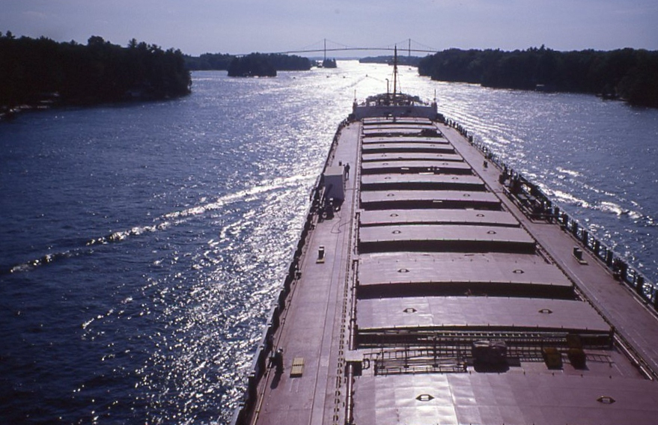

Slide 22
What Next
BWT Systems will be generally required within 1 year of ratification of the IMO Convention.
Production will have to ramp up from hundreds of systems/year to tens of thousands of systems/year.
Some IMO member states may wait for certainty of the availability of BWT Systems before committing to the enforcement of BWT regulations.
Investors may wait for more certainty as to IMO member states enforcing BWT regulations; potentially resulting in a considerable lag between when BWT Systems will be needed and when they’ll be available.
BWT Systems will considerably reduce the risk of Aquatic NIS introductions at considerable cost; but lower risk does not mean zero risk.
BWT technologies are continuing to be developed and improved.

Slide 23
Best Practice + Due Diligence = Risk Reduction = Social Licence
The implementation of a complementary measure to BWE, i.e. real time advice to vessels on highly optimum areas for Ballast Water Exchange could further reduce the risk of Aquatic NIS introduction at a very low cost.
The selection of optimum BWE locations would avoid regions where currents would carry the ballast discharge into the 200nm limit and MPAs, as well as guide vessels away from the known presence of harmful Aquatic NIS organisms (e.g. algal blooms, nursery/hatching areas), avoid ballast uptake at night when many plankton approach the surface, and also select opportune BWE timing so that vessels can conduct exchanges in areas of best available sea-state conditions, improving vessel safety.
The combination of these two measures would be seen as substantive due diligence for Aquatic NIS risk reduction.

