Slide 1


Potential Structure of a Ballast Water Exchange Advisory Service Douglas Bancroft, Marty Taillefer 10 February 2015

Slide 2
Workshop Deliverable
An actionable plan for implementing a robust real time system for delivery of optimised ballast water ocean exchange locations for marine shipping, that is:
Scientifically valid
Supported by the marine shipping industry
Addresses required resources for development
Addresses required resources for operations

Slide 3
Clients

Slide 4
Proposed Structure
Generation of products will be at MWS Ottawa
Information flow to MWS from
Port Authorities
Shipping Companies
Shipping Agents
Dissemination of products to ships
Dissemination to other users

Slide 5
Information flow to MWS
Weather and Ocean
Port Authorities
Shipping Companies
Shipping Agents
ExactEarth/Maerospace
Biological hot spots
What else?

Slide 6
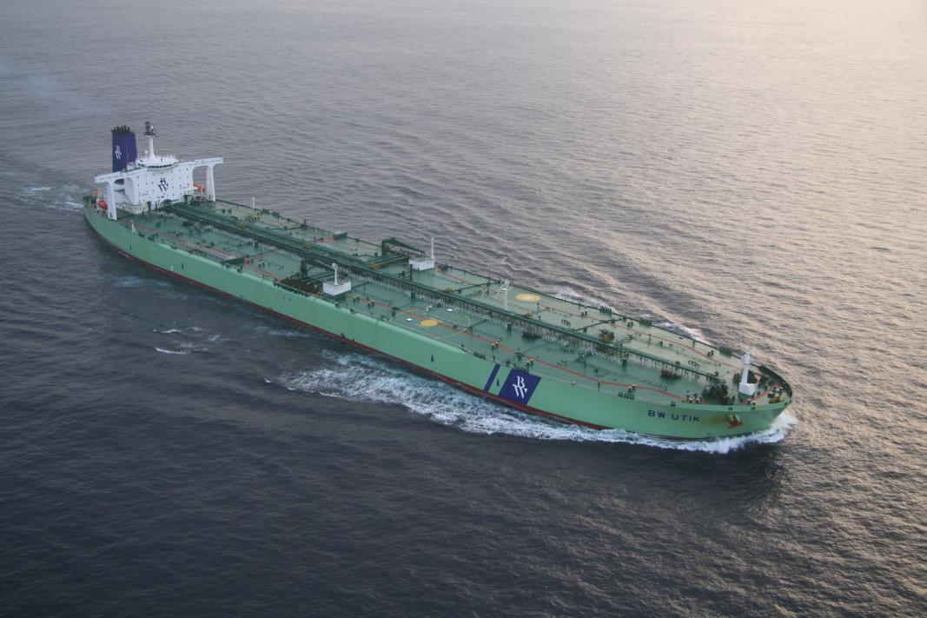

Slide 7
Dissemination of Products
How best to work with mariners?
What is the role of Port Authorities?
What is the role of shipping companies and agents?
What is the role of BC Chamber of Shipping?
What formats should?

Slide 8
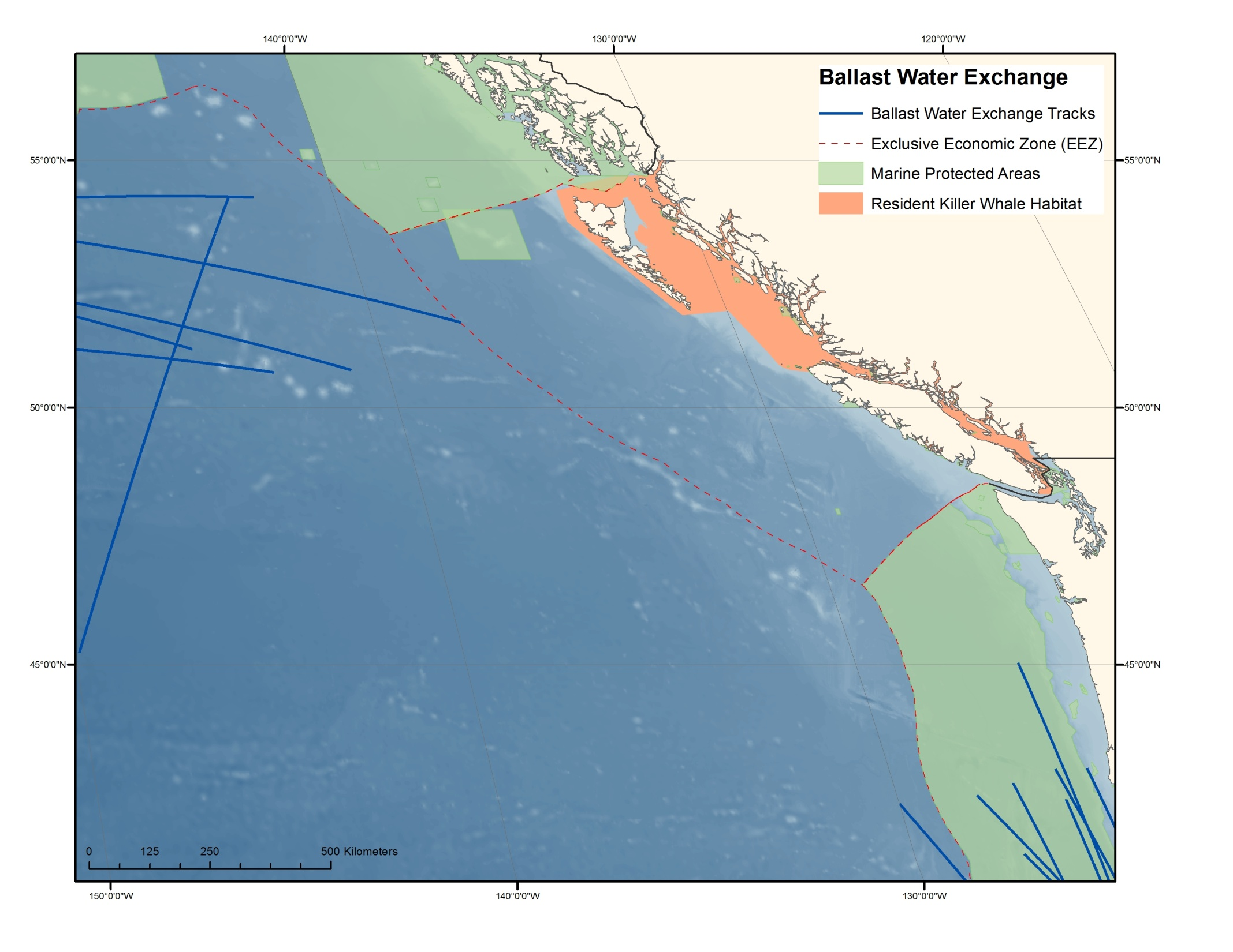

Slide 9
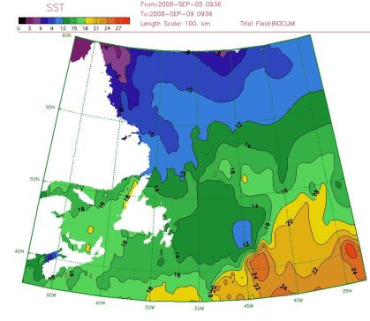
What have we overlooked?

Slide 10
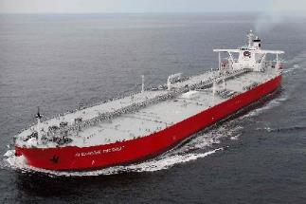


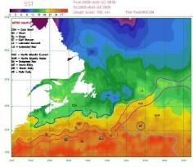
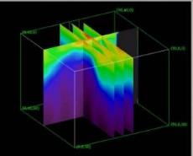
Thank you!

