Slide 1
Ocean Data Integrator Ballast Water Ops System SUCCESS THOUGH COLLABORATION “Building a Window to a Transparent Ocean” Martin Taillefer, CD, M.Sc., B.Sc. President & Managing Director Maritime Way Scientific Ltd.

Slide 2
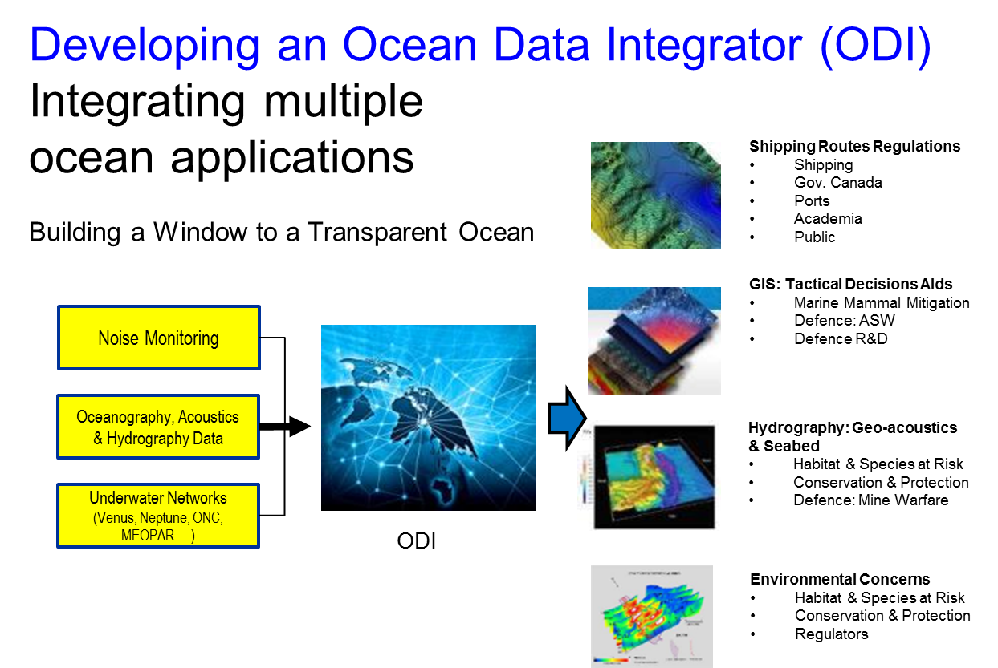
Notes:
What are we up to?
Starting from a clean whiteboard.
Building something new, exciting, and useful to ourselves and others.
The ODI is a comprehensive commercial oceanographic applications suite allowing tailored support to management decision making.
The ODI will allow for:
data harvesting from hundreds of external oceanographic data bases (using a propriety meta data base, and internal data bases to support specific operational oceanographic applications, as well as automated and semi-automated scripts too update internal data bases);
fusion and visualisation of in-situ and remotely sensed environmental data with forecast model output; and
creation of additional layers of derived geospatial information to support marine decision making

Slide 3
TWO STREAMS OF ACTIVITIES
Development
OPERATIONS

