Slide 1


CONCEPTS MOU Project Structure
CONCEPTS MEOPAR Discussions
Fraser Davidson on behalf of CONCEPTS Team

Slide 2

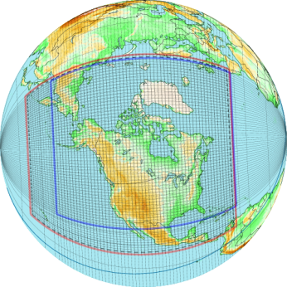
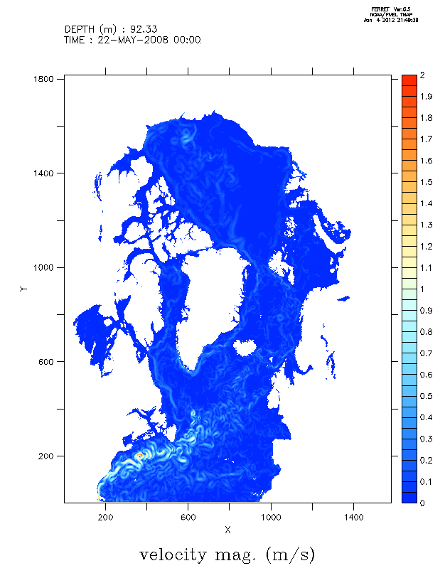
CONCEPTS
A collaborative Vehicle for Research & Development +Operations
of Government of Canada Environmental Forecast
& Renalysis
Systems

Slide 3
ANNEX1 GIOPS
GP1: Global ice-ocean forecasting model
GP2: Analysis system
GP3: Global ocean validation and monitoring system
GP4: Global ice-ocean reanalysis
GP5: Coupled global atmosphere-ice-ocean forecasting system

Slide 4
ANNEX1 RIOPS
RP1: Regional ocean model
RP2: Regional ocean analysis system
RP3: Regional ice model
RP4: Regional ice reanalysis system
RP5: Regional ice validation & monitoring system
RP6: Regional ocean validation & monitoring system
RP7: Arctic-North Atlantic 1/12° ice-ocean reanalysis
RP8: Coupled regional atmosphere-ice-ocean forecasting system

Slide 5
ANNEX1 CONCEPTS Products and Client Product Validation
PP1 Assemble pre-operational delivery system for CONCEPTS validations and products
PP2 Develop interaction with CONCEPTS end users
Notes:
5

Slide 6
ANNEX2 Monitoring
3.1 Investigating Collaborative Monitoring Efforts
3.2 Argo Canada
3.3 Barrow Strait Observatory
3.4 Canadian Ranger Ocean Watch (CROW)
Notes:
6

Slide 7
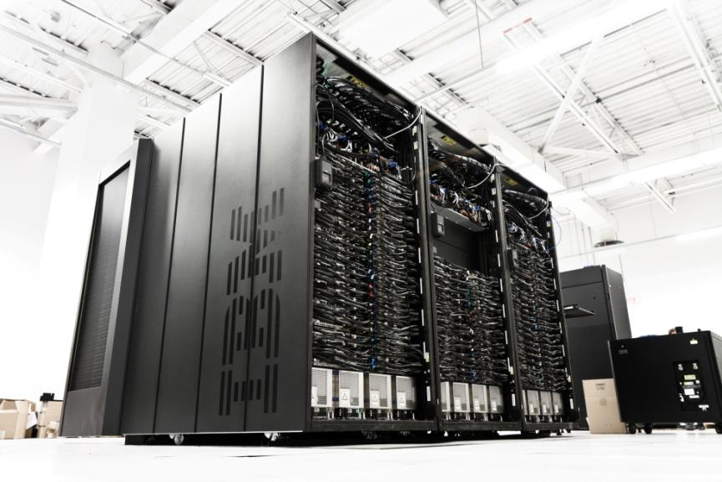
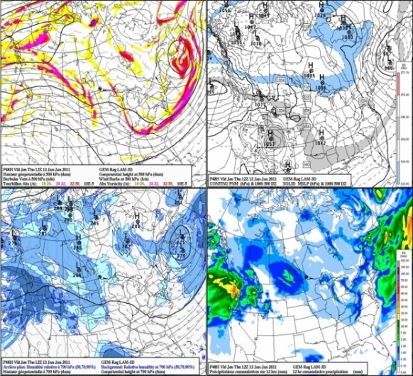
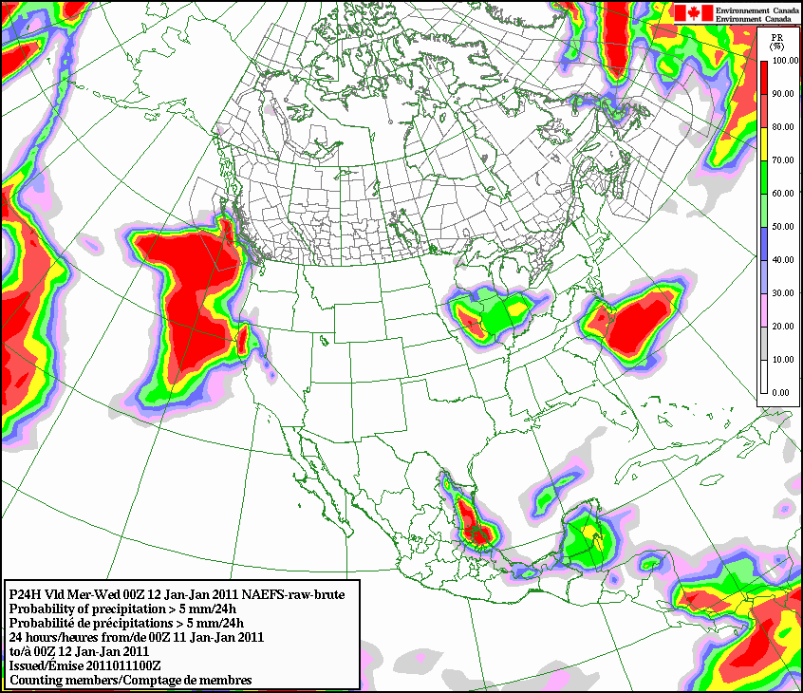
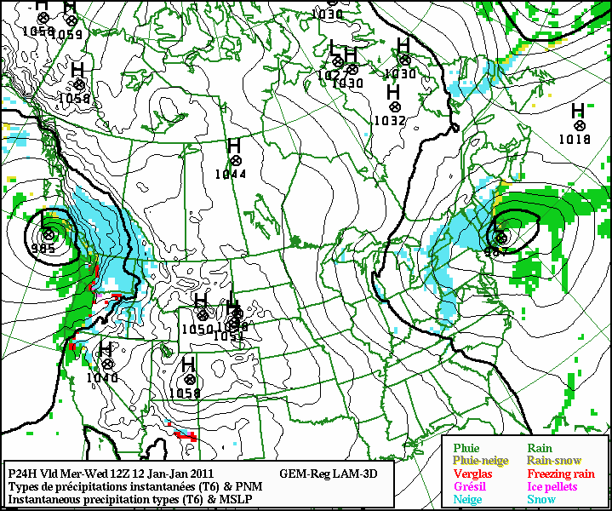
A meteorological Service highly dependant on High Performance Computing
Critically dependent on Supercomputing and Modelling expertise
  Huge number of hard deadlines daily
  Need very reliable IT processing (24/7)
  Very complex computing environment
  Model forecast performance dependents:
    Fast real time global data acquisition and QC to collect as much as possible data before the start of numerical model predictions
    State-of-the-art numerical data assimilation and forecast algorithms, adapted and optimized for the HPC environment
    On the available HPC power to resolve as accurately as possible the atmosphere behavior

Slide 8
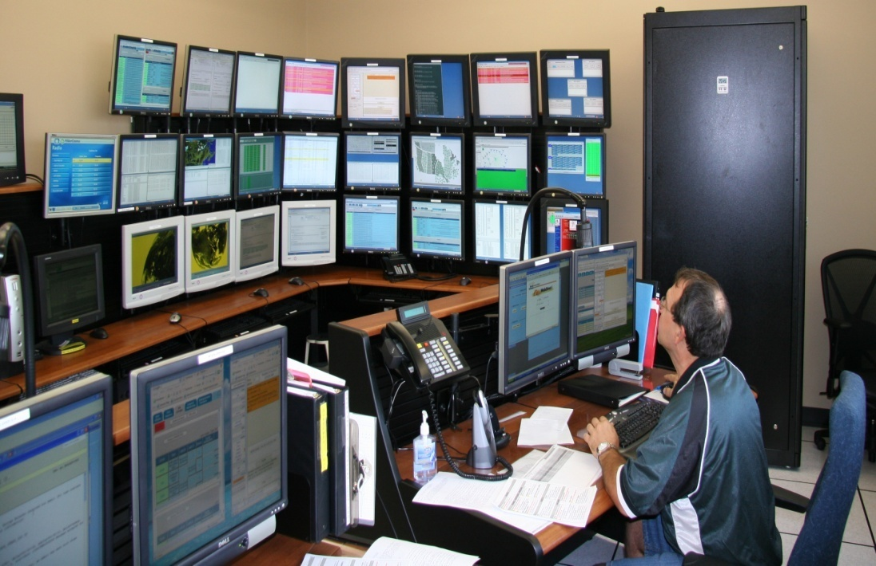
Environment Canada’s
High Performance Computing (HPC) Centre
Nerve centre for all IT functions and
supports 100% of EC’s government wide mission critical applications. It is a unique site in Canada
and one of only a few in the world.
  24/7 operations
  Supercomputing infrastructure
  Wide area network
  Reception of met. data Dissemination of data
  >20 PB of near line data storage

Slide 9
Technology transfer project at CMC
  1) How portable is this system to run on other platforms?
  2) Is the code optimized to run as efficiently as possible? How about notifications errors?
  3) What are the computing resources required to have it run daily to obtain a meaningful result in a timely fashion?
  4) How can the performance of the system be verified ? What are the methods used?
  5) How does it serve the Canadian public and the industry? What are the client requirements?
What are the displays needs and how are they produced? What is the required format of the data ? What is the required frequency of data to be outputted? The space and the durations of the data and the archives?
  6) What type of on going technical, scientific and educational supports can be provided on this system by your group?
  7) What are the future plans and developments on this system?

Slide 10
CONCEPTS tech transfer to CMC operations
EC’s Canadian Meteorological Center in Dorval hosts a unique 24-7 operational supercomputing infrastructure
Efficient Research-Development-Operations technologcial transfer process is key to success and sustainability/maintenance of operational systems
CPOP framework manages the tech transfer process under strict scientific oversight
Planning well ahead is a critical factor to ensure efficient tech transfer process…

Slide 11
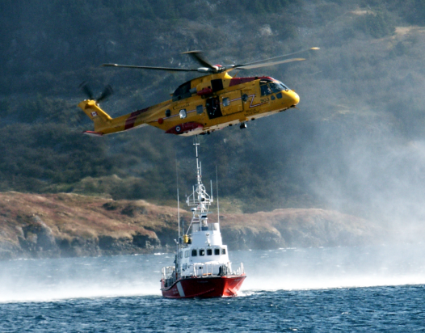
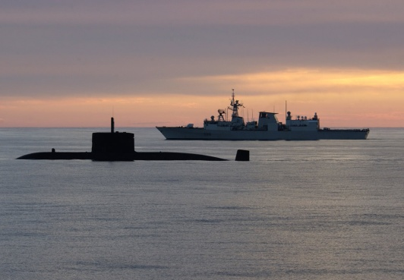
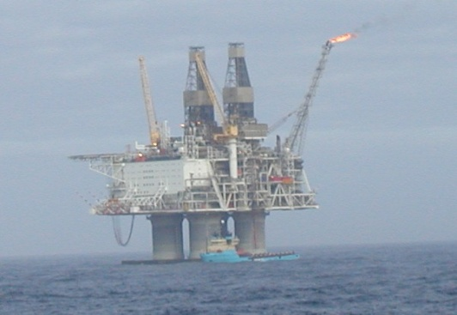
The Need for a Canadian Ice-Ocean Forecasting Capability
Canada requires ice-ocean forecasts and information services for:
Weather prediction (days to seasons)
Sea ice prediction
Coast Guard Operations, e.g.: seal hunt, navigation
Fisheries and aquaculture management
Increased understanding of biological field observations
Attribution and mitigation of regional climate change impacts
Risk assessment for extreme events (sea level, waves, currents)
Emergency response: Search and Rescue, dispersion of pollutants
Provide initial and boundary conditions to regional ice-ocean forecasting system for METAREAs
Surface currents for emergency reponse (e.g. oil spill)
Initial conditions for monthly-seasonal coupled forecasts
Surface BC and IC for GDPS and coupling
Specific Applications:
Notes:
CONCEPTS not just about improving weather forecasts….ice/ocean products as well!

