Slide 1
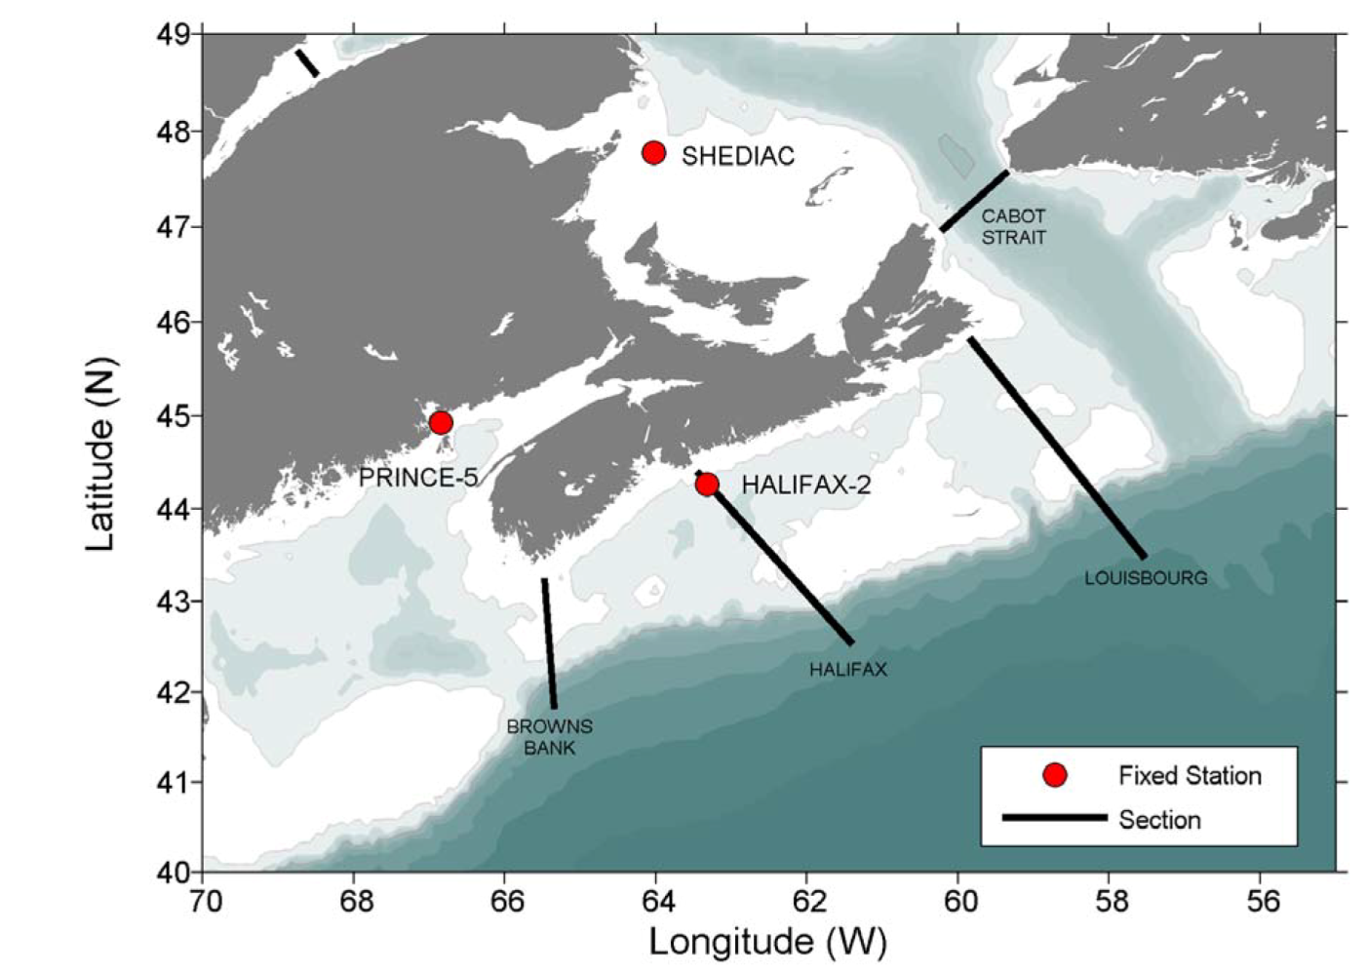
Atlantic Zone Monitoring Program (AZMP)
Primary AZMP sections and fixed stations sampled in the DFO Maritimes and Gulf regions

Slide 2
Fixed Stations: Halifax 2, Prince 5 and Shediac Valley
Sampled every 2 weeks to monthly (when possible)
In 2011, HL 2 sampled 21 times; Prince 5, 12 times; Shediac Valley, 8 times
CTD profiles with O2, Fl, PAR and pH (sometimes)
Niskin bottles – standard depths – nutrients, salinity, O2, chl and phytoplankton enumeration
Vertical nets – zooplankton biomass and enumeration
Shelf Sections: 4 Primary Transects: Browns Bank, Halifax, Louisbourg and Cabot Strait
Sampled April/May and Oct/Nov; Halifax sometimes in May/June
CTD profiles with O2, Fl, PAR (some locations) and pH (some locations)
Niskin bottles – standard depths – nutrients, salinity, O2, chl
-- includes POC
Vertical nets – zooplankton biomass and enumeration
Trawl Surveys:
Georges Bank (late winter), Western Scotian Shelf (spring), Scotian Shelf/eastern Gulf of Maine (summer), southern Gulf of St. Lawrence (fall)
CTD profiles with O2, Fl, PAR and pH (sometimes)
Niskin bottles – standard depths – nutrients, salinity, O2, chl
Vertical nets – zooplankton biomass and enumeration

Slide 3
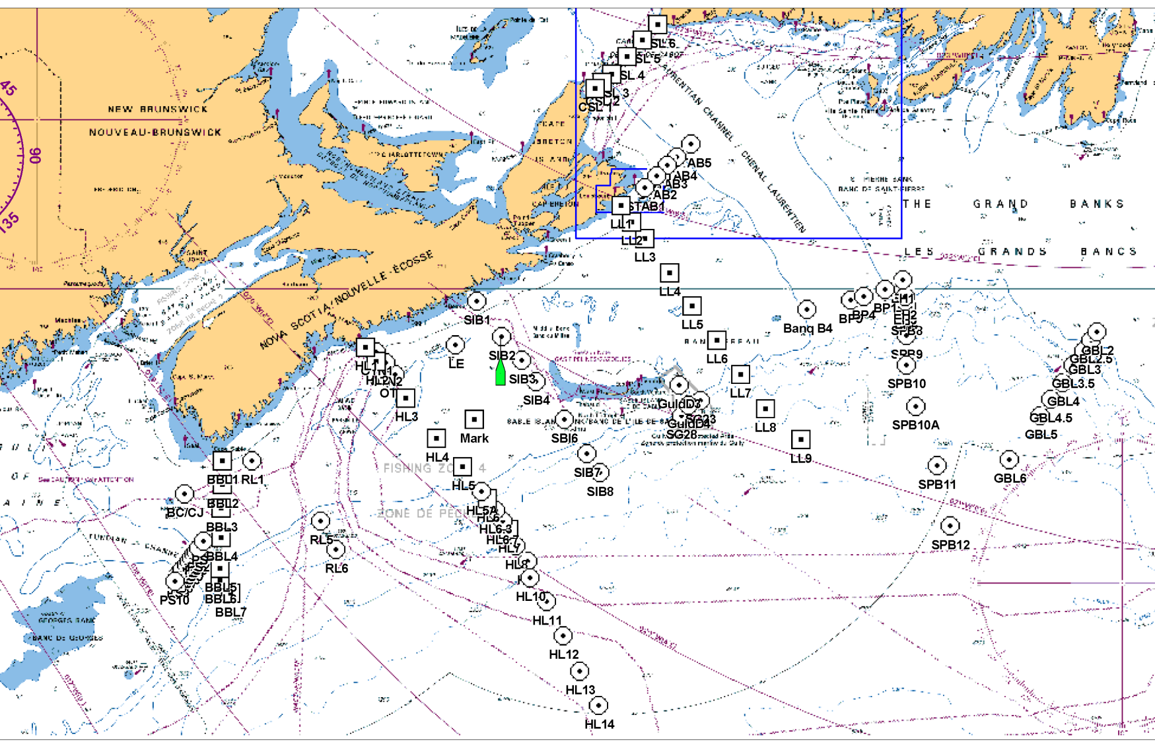
2012 Fall AZMP Sampling Sites

Slide 4
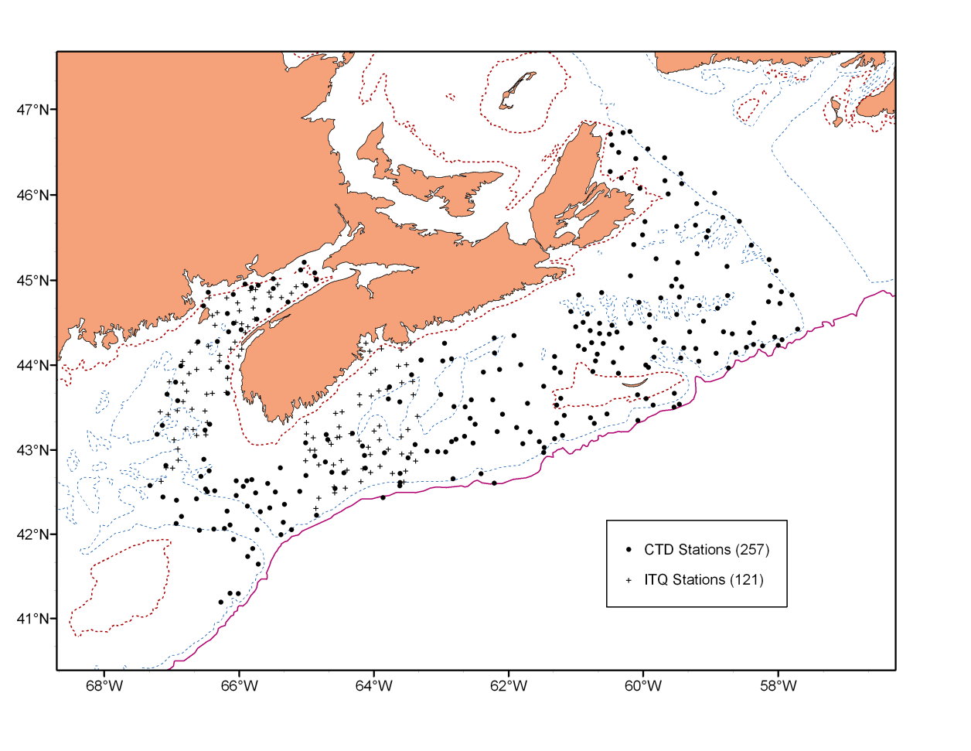
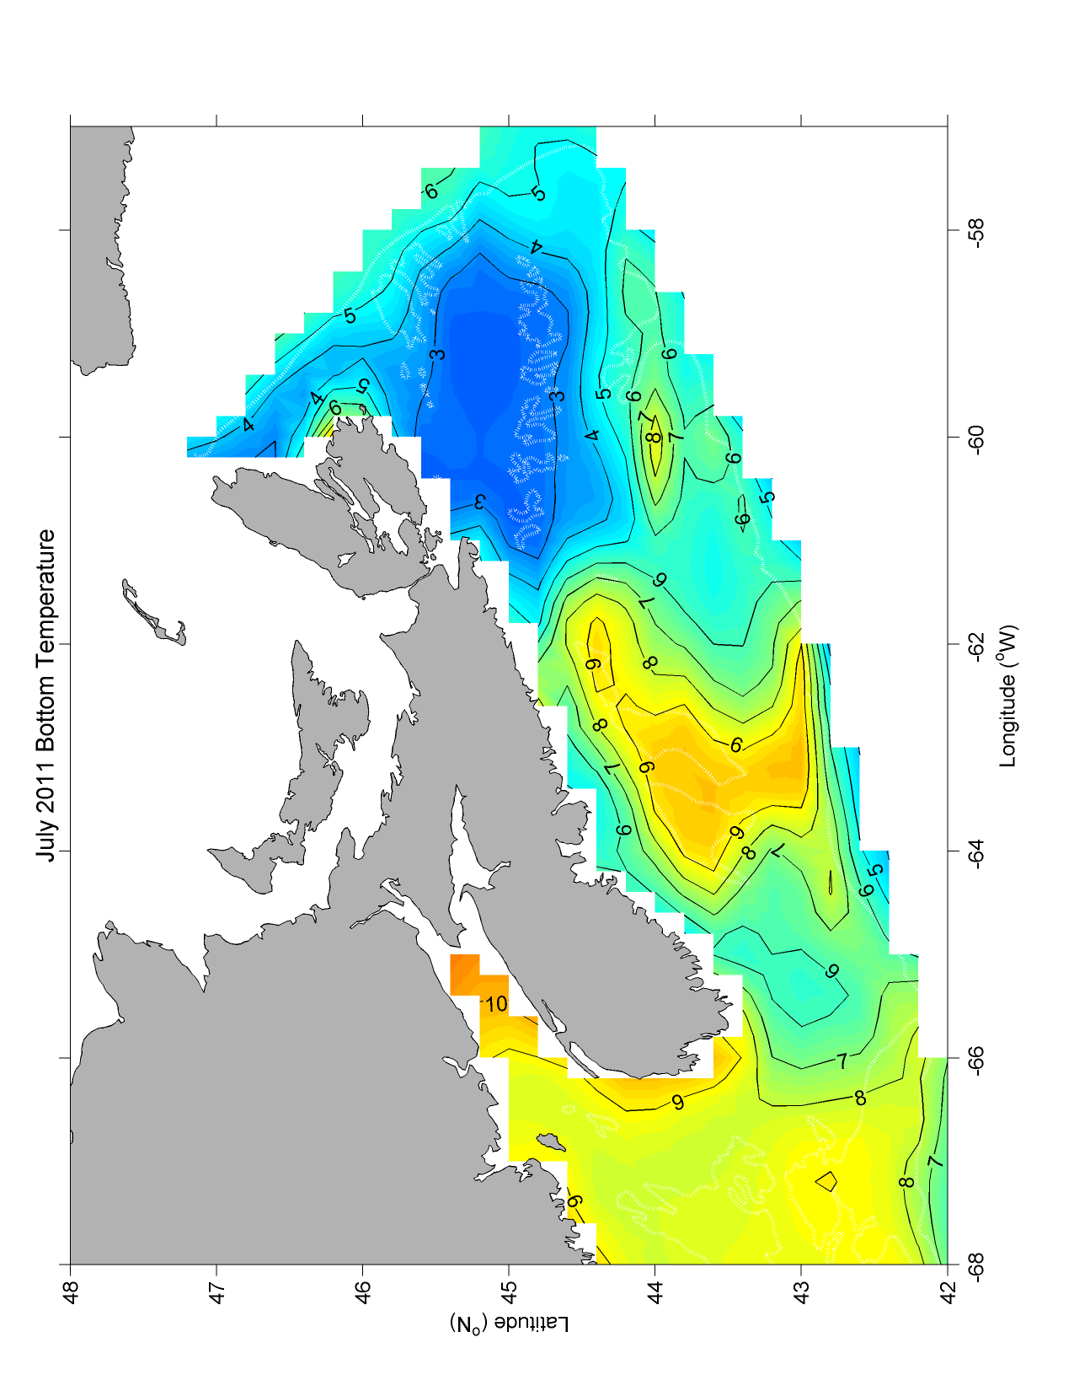
2012 July Groundfish Survey

Slide 5
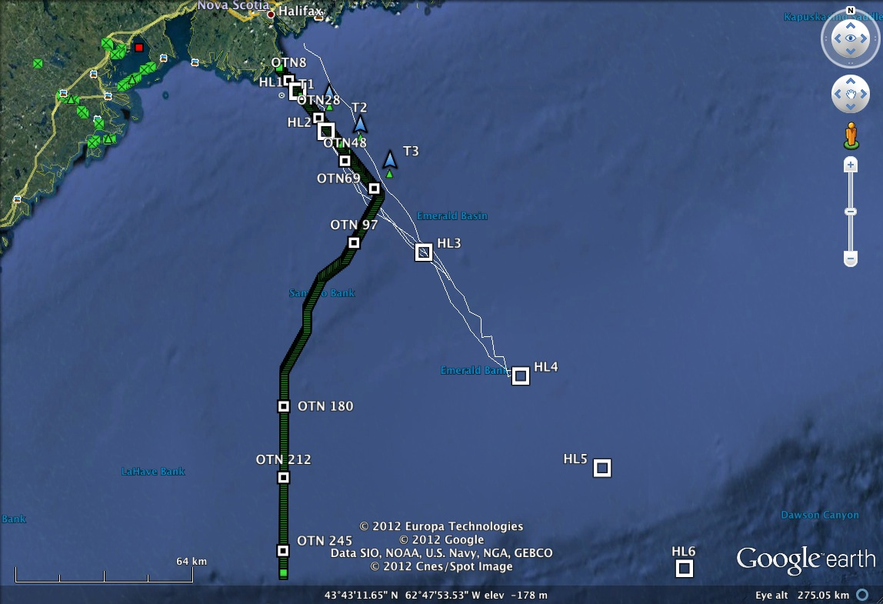
Locations of the AZMP Halifax Line stations (white boxes), the OTN acoustic receivers (green boxes), benthic pods (white boxes), bottom ADCPs/CTDs (blue triangles) and a typical glider path (white line)

Slide 6
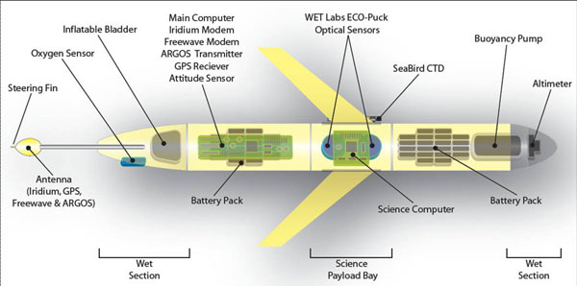
OTN Gliders
The science payload consists of a Seabird CT pairs, an Aanderaa O2 optode, two Wetlabs ECO-packs measuring CDOM, chl a fluorescence, backscatter at 470, 532 660 and 880 nm and a Satlantic radiometers at 412, 443, 490 and 555 nm.

Slide 7
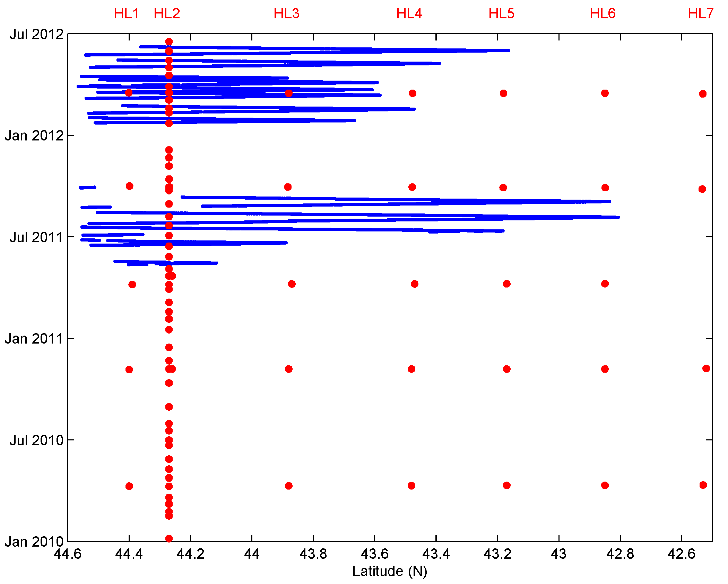

Slide 8
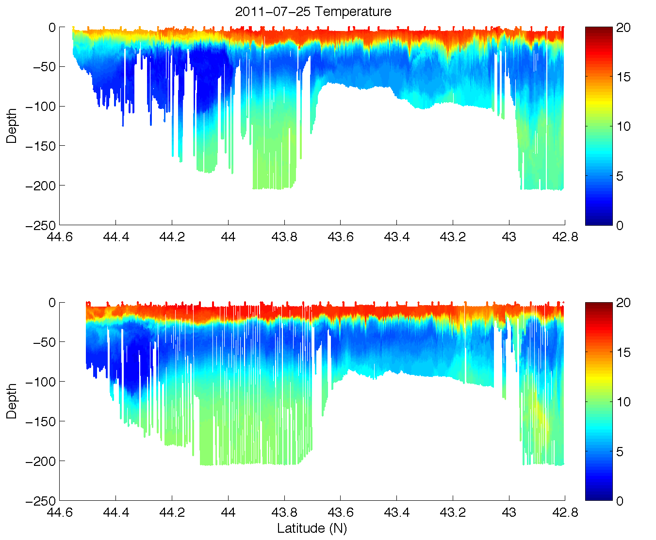
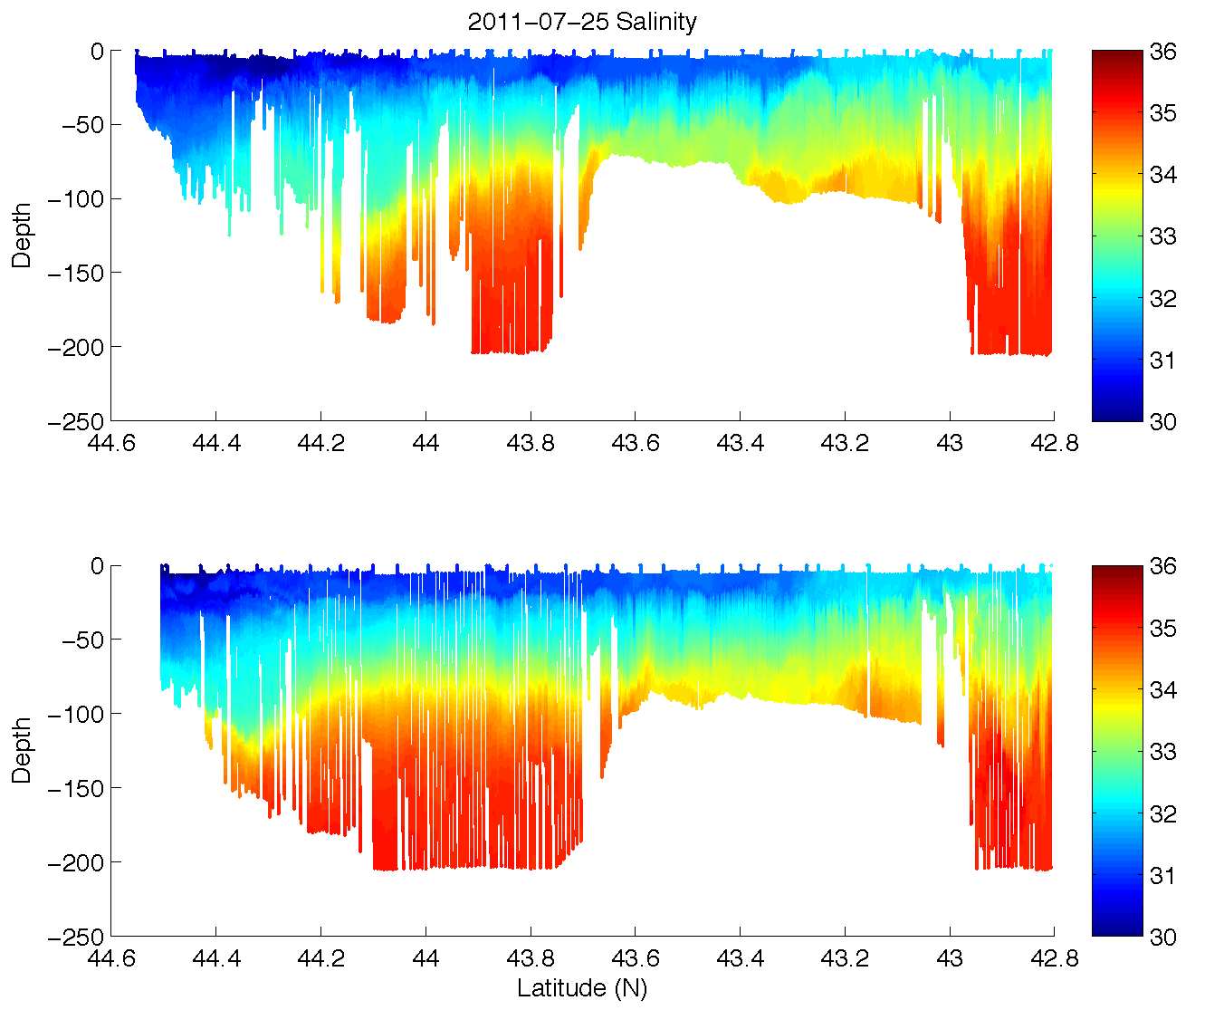
2011-07-26 OTN Glider Deployment

Slide 9
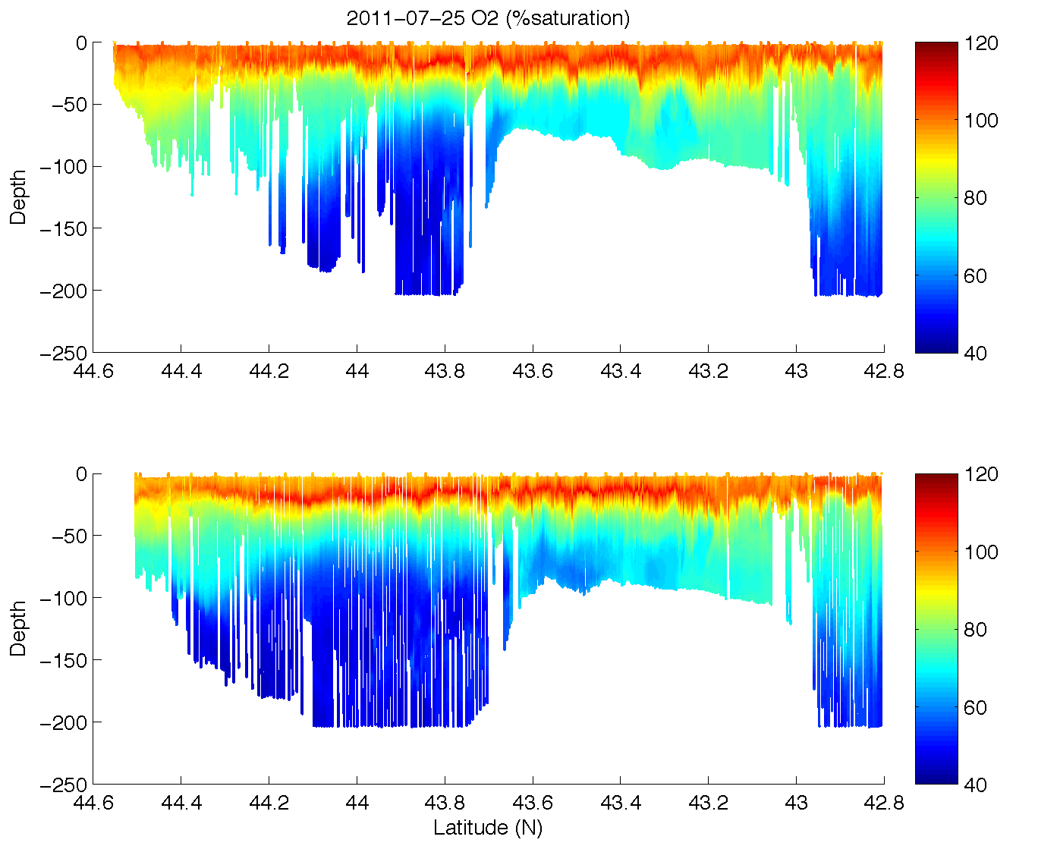
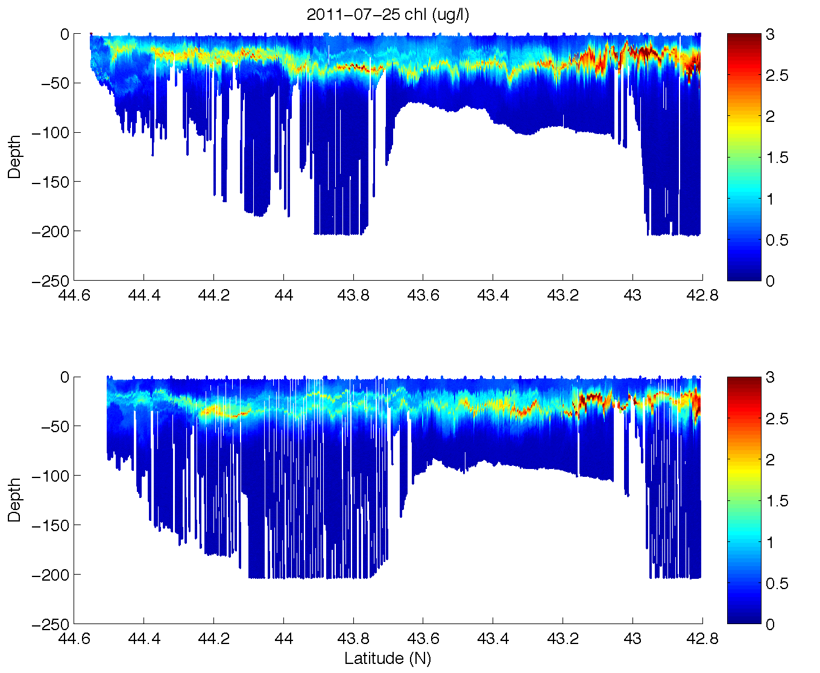
2011-07-26 OTN Glider Deployment

Slide 10
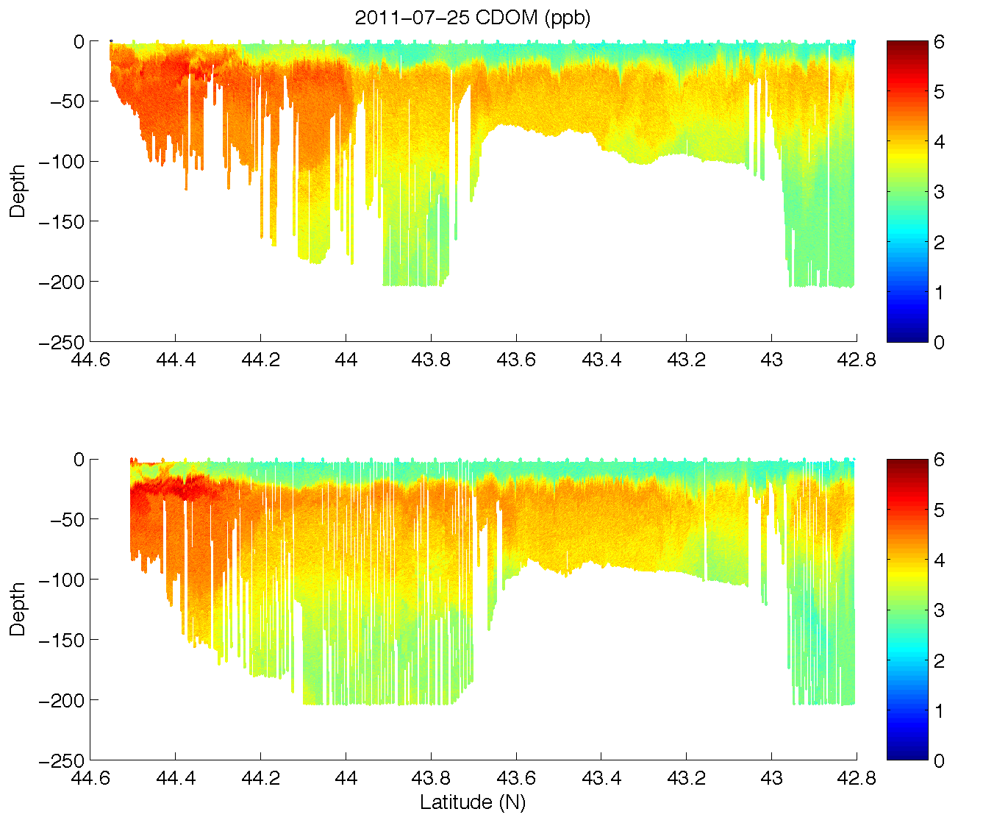
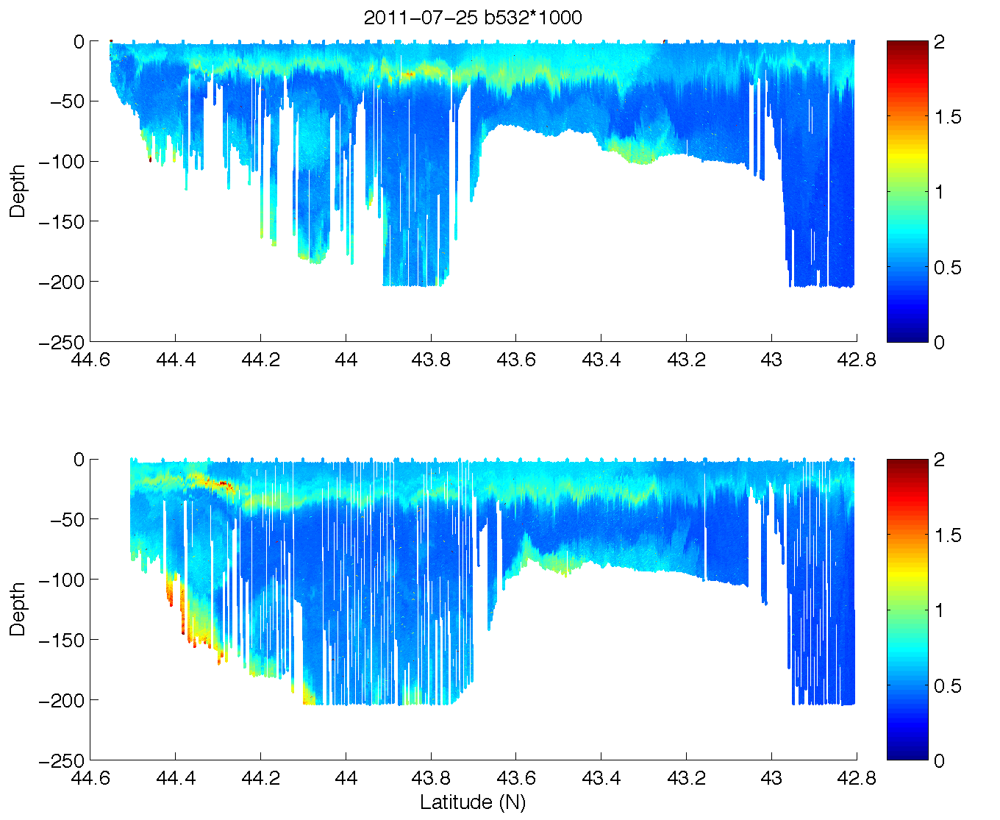
2011-07-26 OTN Glider Deployment

Slide 11
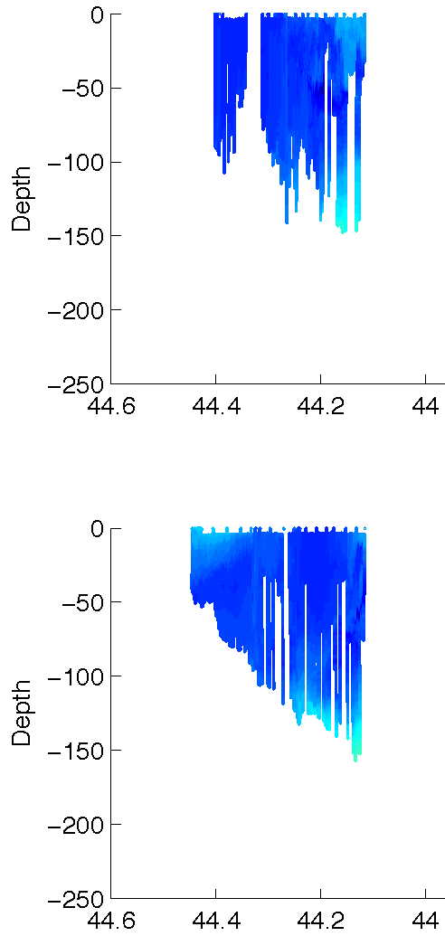
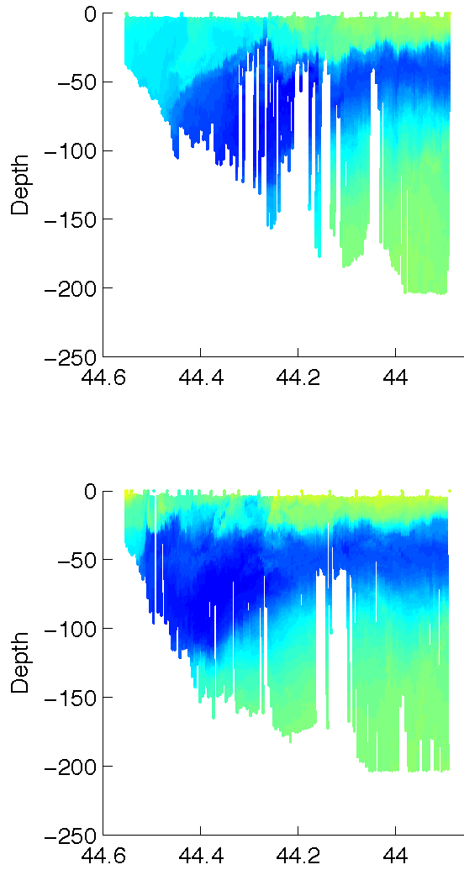
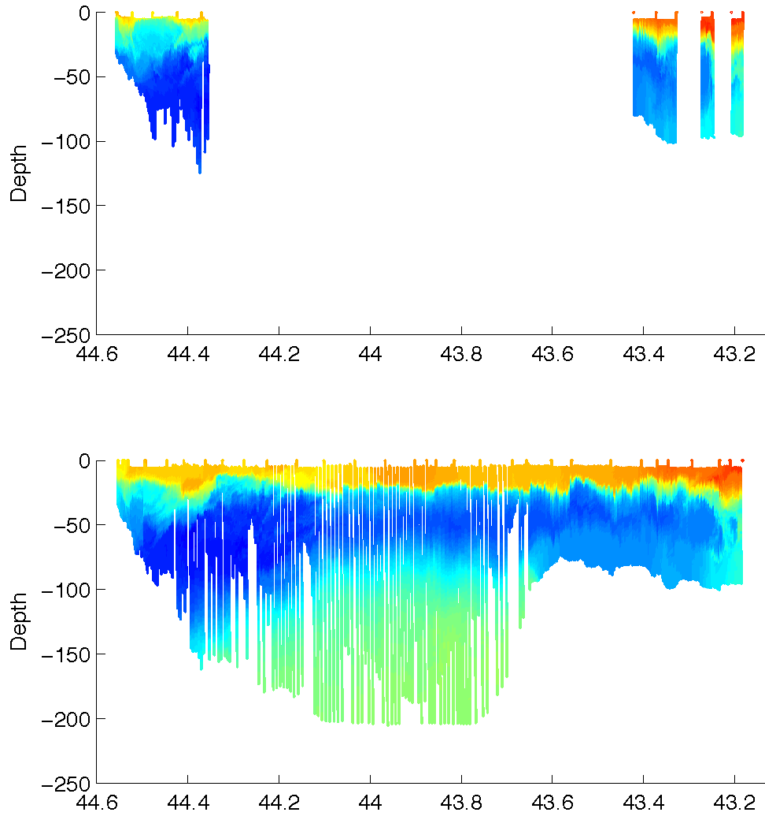
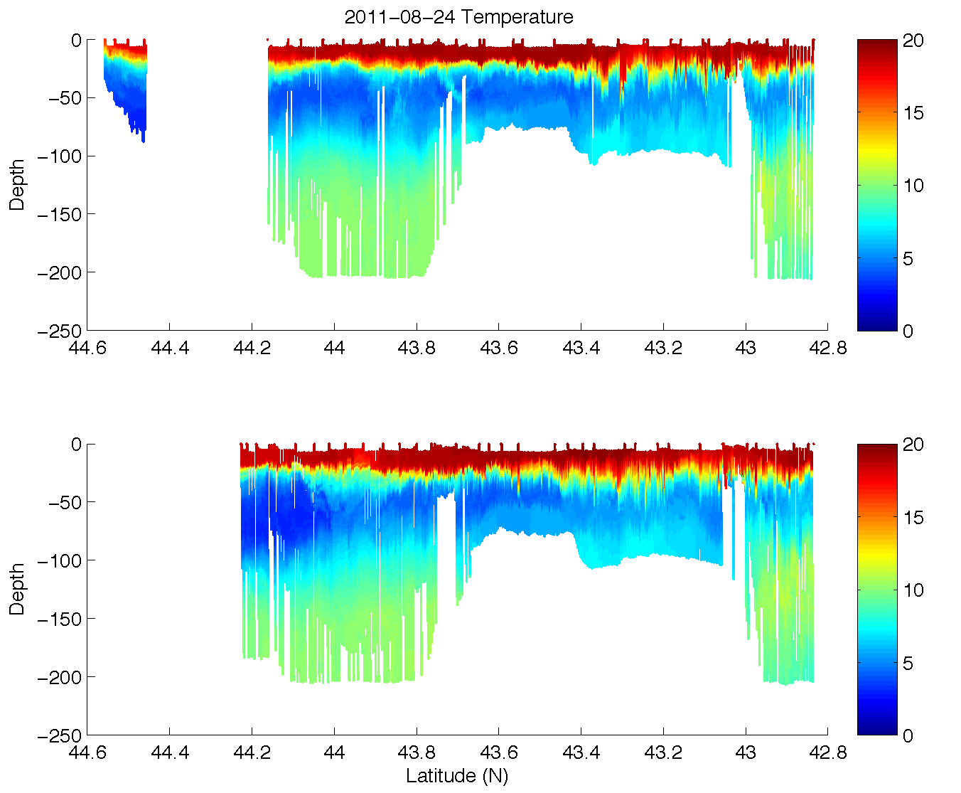
Temperature
5/13-16
6/17-21
7/05-13
5/16-19
6/21-27
7/13-20
7/26-8/06
8/24-9/03
8/06-15
9/03-12

Slide 12
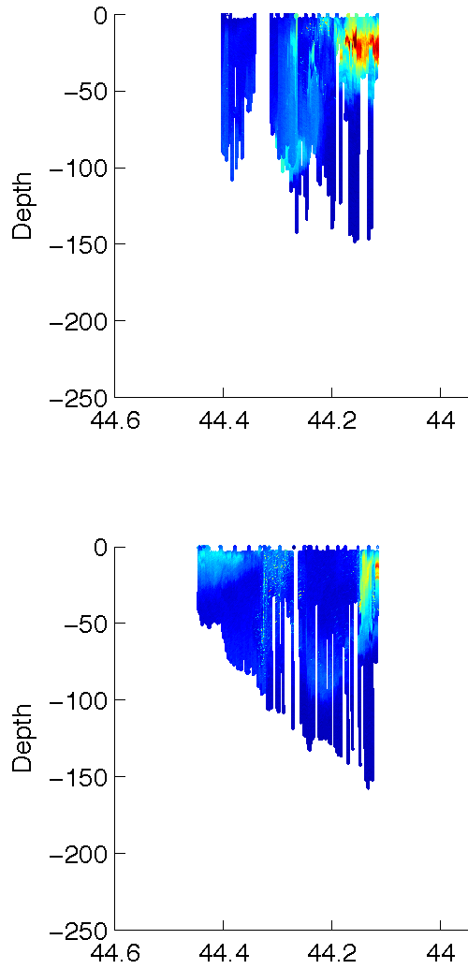
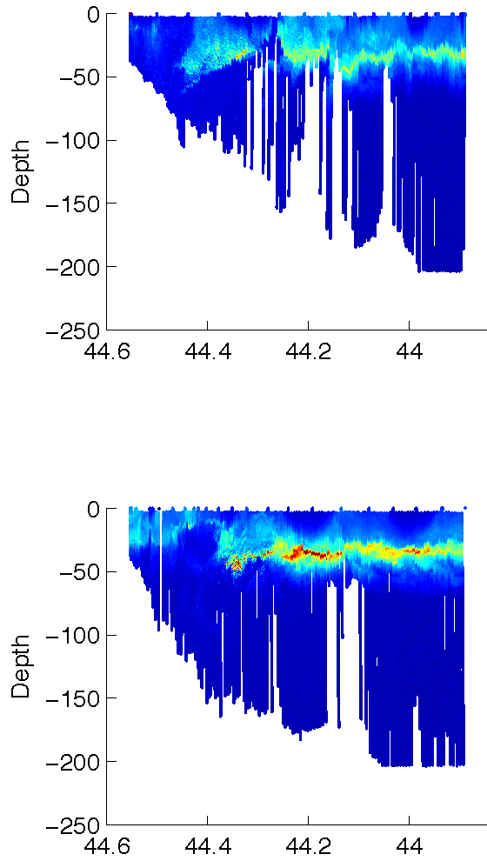
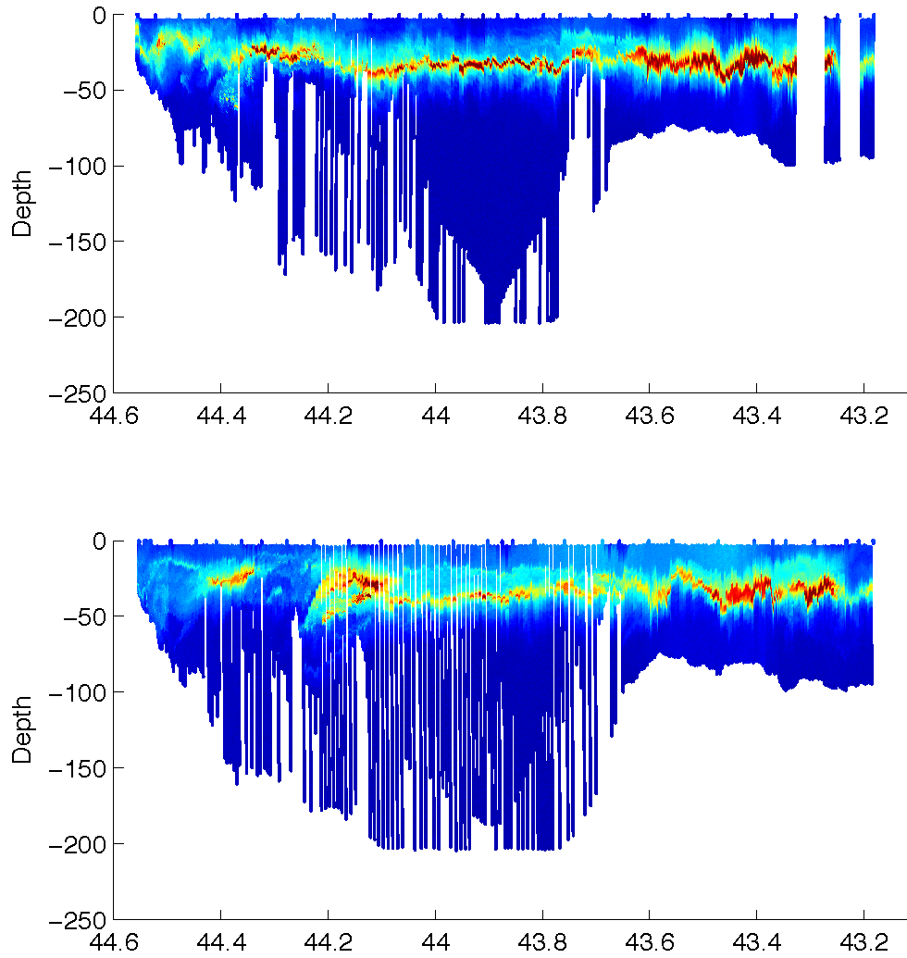
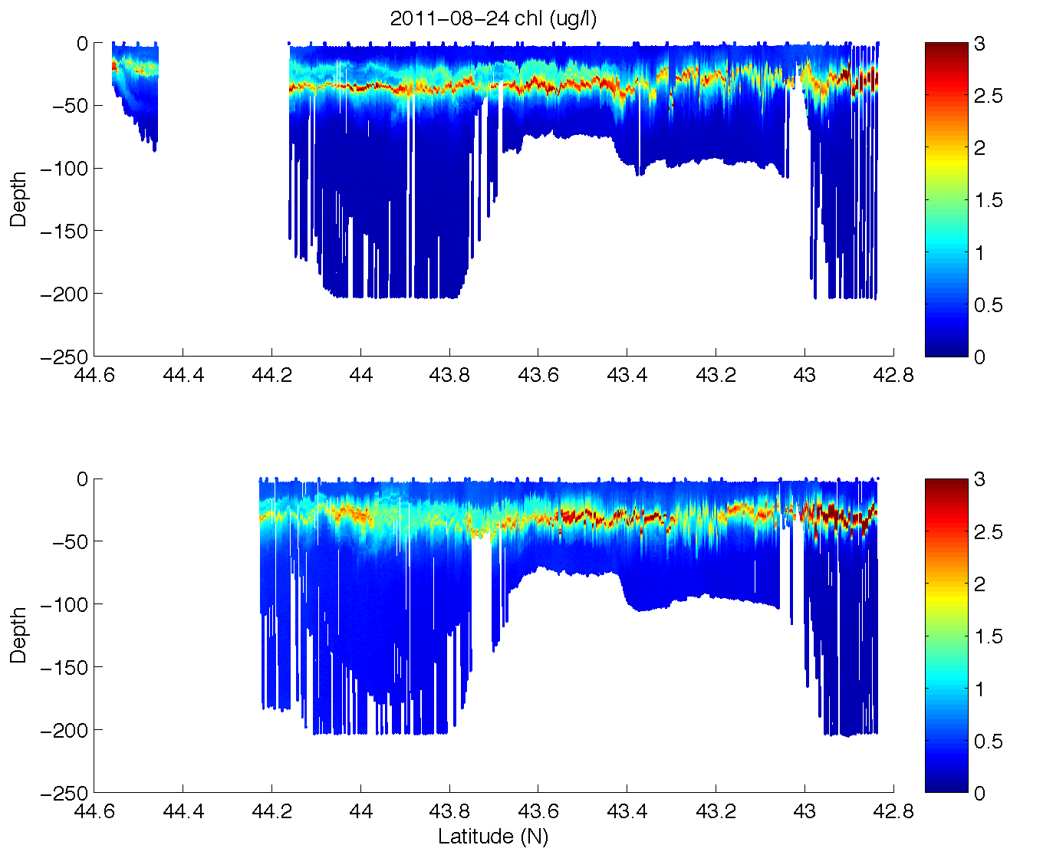
Chl (ug/l)
5/13-16
6/17-21
7/05-13
5/16-19
6/21-27
7/13-20
7/26-8/06
8/24-9/03
8/06-15
9/03-12

Slide 13
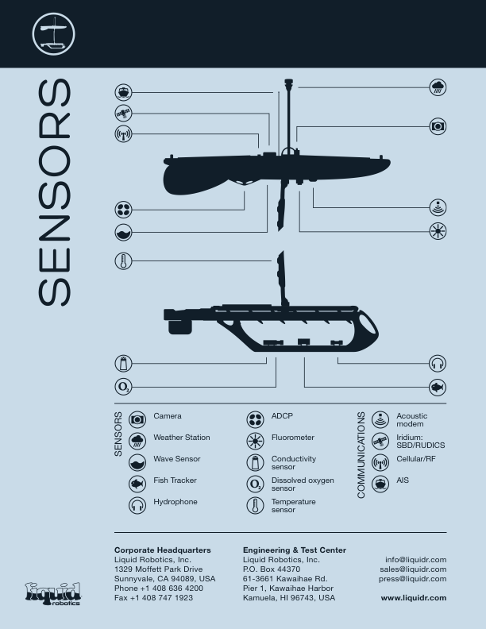
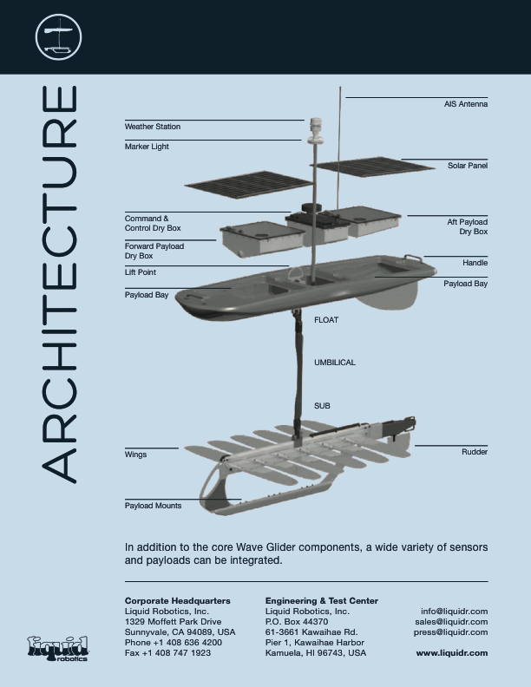
OTN Wave Glider

Slide 14
