Slide 1
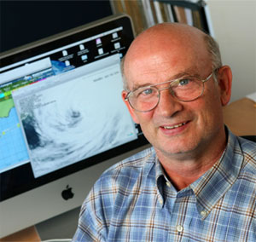
Overview of Initial Project 1.1 A Relocatable Coupled Atmosphere-Ocean Prediction System
Rapid appraisal of socio-economic risks
Rapidly Deployable Observations
Atmos-Ocean Modelling
Project Leader: Hal Ritchie
Environment Canada
Dalhousie University

Slide 2
Project Team
Researchers | Multi-Sector | Multi-discipline
Hal Ritchie $ | Dalhousie and EC | global and regional weather modelling
Ken Lee $ | Dalhousie and DFO | oceanography, offshore oil & gas
Mae Seto | Dalhousie and DRDC | defence observation systems
Anthony Charles | SMU | marine socioeconomics & management
Marlon Lewis | Dalhousie | ocean biology, observations & industry
Keith Thompson $ | Dalhousie | ocean modelling & data assimilation
Doug Wallace | Dalhousie | ocean tracers & technology
Serge Desjardins | EC | marine & coastal meteorology
Fred Whoriskey | Dalhousie | ocean ecosystem observations
Gilbert Brunet $ | McGill & EC | meteorological dynamics & analysis
Luc Fillion $ | McGill & EC | atmospheric data assimilation
Greg Smith | EC | global & regional atmosphere-ocean models
Ken Denman | UVic and Venus | biogeochemical & foodweb modelling
Rich Pawlowicz $ Richard Dewey | UBC UVic | ocean observations & analysis physical oceanography, observations

Slide 3
A Relocatable Coupled Atmosphere-Ocean Prediction System
Outcomes
A tested relocatable coupled atmosphere-wave-ocean data assimilation and forecast system capable of deployment within hours of an emergency will include new modules for forecasting movement and evolution of hazardous substances (and tracers).
New mechanisms for rapid appraisal of socio-economic values and impacts during an emergency.
Transfer of system to Environment Canada for operational use.
Primary Stakeholders
Environment Canada
Department of Fishries & Oceans
Canadian Coast Guard
Defence Research & Development Canada
Lloyd‘s Register Educational Trust
Insurance industry
Oil & gas industry

Slide 4
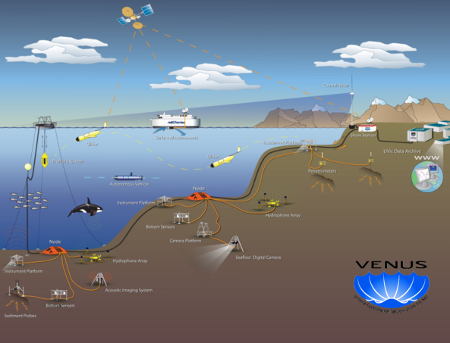
A Relocatable Coupled Atmosphere-Ocean Prediction System
Approach:
Extend EC & DFO “CONCEPTS“ initiative:
→ construct relocatable atmosphere-ocean-wave model with data assimilation capability
Develop mechanisms for rapid appraisal of socioeconomic vulnerability and risks during emergencies including local-level, community-based approaches
Test and evaluate model with data from Halifax Harbour / Scotian Shelf and Strait of Georgia (VENUS) and incorporate data from new systems for rapid environmental assessment (with Obs. Core) in addition to small-scale tracer-release experiment off Halifax (with Obs. Core)
Develop data/information products for receptor groups and partners

Slide 5
Main Milestones by Year 3
development of relocatable capability of GEM-NEMO system.
development of ocean data assimilation scheme for relocatable NEMO ocean model.
initial testing and evaluation of relocatable NEMO model at VENUS site in collaboration with IP1.2.
development of relocatable GEM atmospheric model and data assimilation scheme.
demonstration of tracer evolution modules.
development of relocatable tide and storm surge model to provide boundary conditions for relocatable NEMO.
development of mechanisms for the ‘rapid appraisal’ of socioeconomic values, vulnerabilities and risks associated with an emergency, on a spatially-explicit basis and including local-level community-based approaches.
Papers in literature and student progress.

Slide 6
Main Milestones by Year 5
Compare progress (or not) between first and second partner workshops.
Successful trials of relocatable system in specially designed field experiments in collaboration with the Observation Core, e.g. on the Scotian Shelf.
Successful application of system Strait of Georgia, based on scientific evaluations and feedback from partners.
Successful technology transfer of the relocatable system to Environment Canada.
Successful demonstration of mechanisms for the ‘rapid appraisal’ of socioeconomic values, vulnerabilities and risks associated with an emergency, on a spatially-explicit basis and including local-level community-based approaches.
Papers in literature and quality of theses.

Slide 8
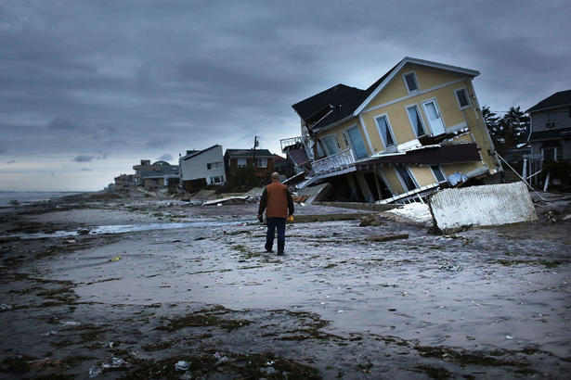
A Relocatable Coupled Atmosphere-Ocean Prediction System
Problem:
Hazards can be encountered anywhere along Canada‘s vast coastline and offshore areas at anytime (including regions undergoing new development and new economic uses)
Canada requires rapidly-deployable prediction systems (to guide response to marine emergencies)
Source: Spencer Platt/Getty Images

