Slide 1
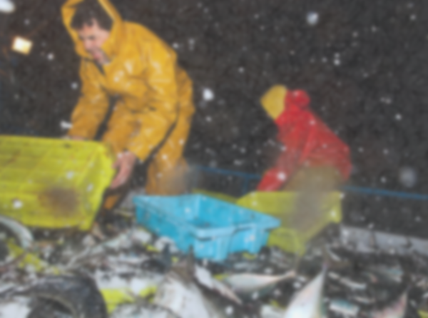
RISK ANALYSIS OF THE EFFECTS OF EXTREME WEATHER CONDITIONS ON COMMERCIAL FISHING VESSEL INCIDENTS
Sara Rezaee
Dalhousie University
Sept. 2015

Slide 2
Why Interdisciplinary Research?
Data
Methodology
Research Problem
Outcome
Meteorology
Industrial Engineering
Policy Making
Statistics

Slide 3
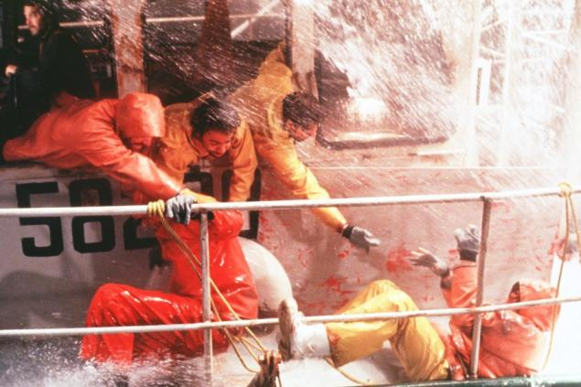
Research problem
The existing relationships between extreme environment and commercial fishing safety in Canadian Atlantic Waters
Changes in fishing safety over time due to clime change effects in the area of interest.
Recommendation on how fishing safety can be improved with respect to finding from 1 and 2.
Source: Perfect Storm Movie

Slide 4
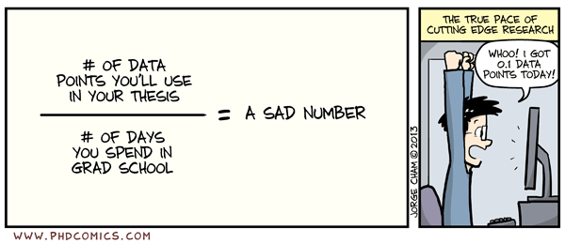
Data
Extreme Weather Factors
Fishing Safety
Wind speed
Sea Surface Temperature
Air Temperature
Precipitation
Laplacian of Pressure/ Vorticity
Time
Location
Fishery Type
Related Fishing Traffic
Vessel Size

Slide 5

Methodology
Do the environmental factors have any effect on the level of fishing activities (i.e. traffic amount)?
  Random Parameters Negative Binomial Regression
Do the environmental factors have any effect on the occurrence of commercial fishing incidents?
  Zero-Inflated Negative Binomial Regression
Do the environmental factors have any effect on the fishing incident rates (incident frequencies relative to the traffic amount)?
  Random Parameters Negative Binomial Regression
  Fractional Logistic Regression
Do the environmental factors have any effect on the severity level of commercial fishing incidents?
  Logistic Regression
  Support Vector Machines
Does climate change have any effect on commercial fishing safety?
  Classification and Regression Trees

Slide 6
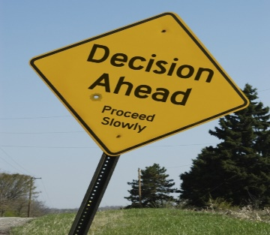
Outcome
How can findings of this research be put into practice?
Determine safety Factors in Canada
Ascertain relationships between safety factors and findings of the research
Review Canadian policies related to safety factors from step 1.
Make recommendations to improve safety based on the relationships from step 2 and 3.
Environmental Factors
Environmental Factors
Safety Factor
Current Policy
Recommendations to Update Policies

Slide 7

Publications
Rezaee, S., Pelot, R.P., and Finnis, J. (2015). The effect of extratropical cyclone weather conditions on fishing vessel incidents’ severity level in Atlantic Canada. (Submitted for publication)
Rezaee, S., Pelot, R.P., and Ghasemi, A. (2015). The Effect of Extreme Weather Conditions on Commercial Fishing Activities and Vessel Incidents in Atlantic Canada. (Submitted for publication)
Rezaee, S., Seiler, C., Pelot, R.P., and Ghasemi, A. (2015). Will Commercial Fishing Be a Safe Occupation in Future? A Framework to Quantify Future Fishing Risks under Climate Change Scenarios. (Submitted for publication)
Rezaee, S., Brooks, M., and Pelot., R. (2015).Review of Fishing Safety Policies in Canada with Respect to Extreme Environmental Conditions and Climate Change Effects. (Submitted for publication)
Contact: Sara.Rezaee@Dal.ca

