Slide 1
Initial Project 1.2a:
Building a fixed coastal observing and forecast system for Halifax Harbour
Team Members:
Researchers | Institutions | Research Areas
Jinyu Sheng | Dal | Ocean circulation modelling
Will Perrie | BIO/Dal | Ocean wave modelling
John Cullen | Dal | Ocean observation (biological)
Dave Hebert | BIO/Dal | Ocean observation (physical)
Bill Li | BIO/Dal | Ocean observation (bio-chemical)
Keith Thompson | Dal | Ocean modelling and data assimilation
Hal Ritchie | EC/Dal | Atmospheric circulation modelling
Serge Desjardins | EC/Dal | Atmospheric circulation modelling

Slide 2
Objectives for Halifax Harbour Component:
Develop a real-time forecast system for physical properties (sea level, currents, waves, temperature and salinity) within Halifax Harbour and the adjacent shelf.
Develop schemes to assimilate physical observations (e.g., currents from mooring in Bedford Basin, surface currents from the high frequency radar on the inner shelf) into the model of Halifax Harbour and adjacent shelf.
Demonstrate the capability for real-time forecasting of physical conditions in Halifax arbour with quantified measures of forecast skill based on observations from moored instruments and high frequency radar measurements.
Generate maps of the risk of ship collision taking into account forecast ocean conditions.
Transition the real-time system to operations through a private sector partner.

Slide 3
Timeline and Key Deliverables
Year 1:
Reports on workshops with partners to coord;inate planning, user needs, and communication of expected research results
Deploy buoy in Halifax Harbour (Sheng and Perrie with Observations Core).
Year 2:
Deploy and test parallelized version of new wave model system based on WW3 and unstructured SWAN (Perrie, Sheng).

Slide 4
Year 3:
Together with Prediction Core, evaluate analyses and predictions from the initial analysis and modelling system, and make results available to partners on a trial basis (Sheng, Perrie, Thompson).
Year 4:
Assessment of the benefit of assimilation in terms of forecast skill, and comparison of results with those from existing GEM-NEMO forecasts systems at coarser scale (Sheng, Perrie).
Year 5:
Publication of GEM-NEMO results and intercomparison with initial system(Sheng, Perrie, Thompson).

Slide 5
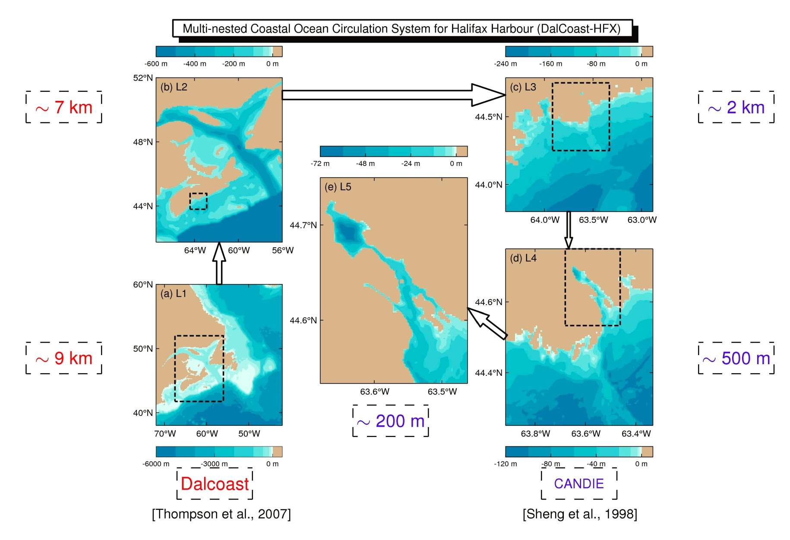

Slide 6
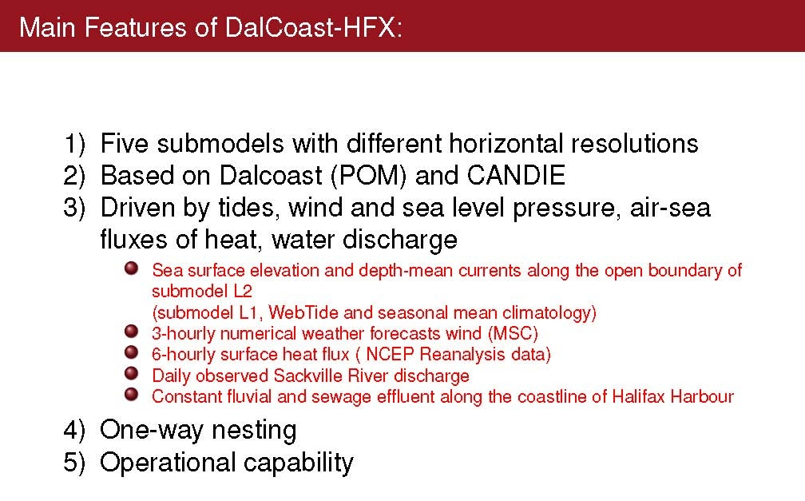

Slide 7
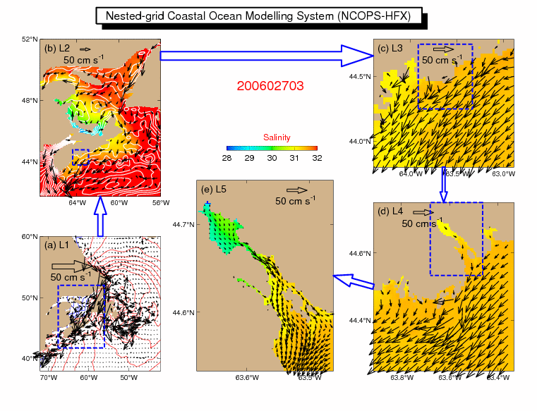

Slide 8
