Slide 1
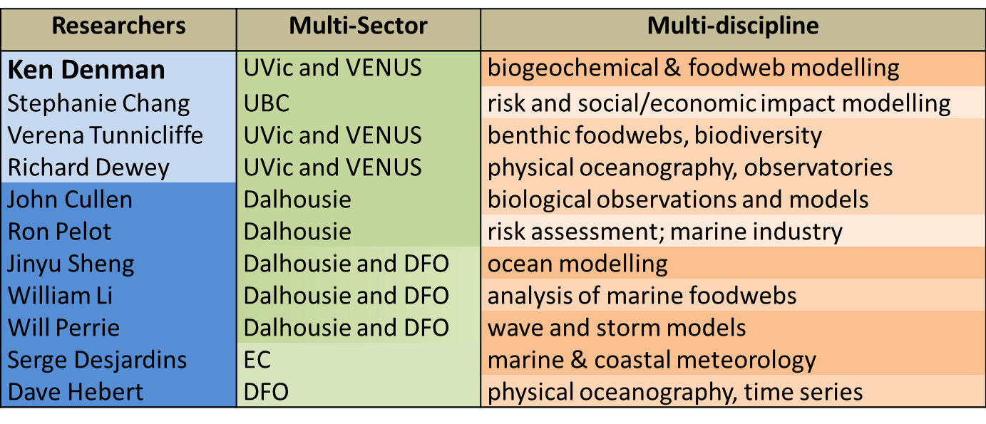
Theme 1; Initial Project 1.2: Building a network of fixed coastal observing and forecast systems
List of Network Investigators and Collaborators (in the original proposal):

Slide 2
Research Plan:
This project will build integrated observing and prediction systems for strategically important locations (e.g., harbours, straits) in order to transform observations into useful products (e.g., forecasts of sea level, waves, currents, biogeochemical properties) for multiple users (e.g., port authorities, municipalities, oil and gas sector).
The focus of this project is short-term forecasting at potentially very high resolution (tens of meters).
The domains of these models will generally be significantly smaller than the domains typically needed for the relocatable model (order 200 km for the ocean component, and larger for the atmospheric component).

Slide 3
Key Research Questions to be Addressed:
Assessing whether state-of-the-art coupled observing systems/forecasting models improve the ability of government and private sectors to respond to existing and emerging marine hazards on timescales of hours to months (e.g., extreme marine weather, storm surges and coastal flooding, extreme waves and currents, movement of marine pollutants, and the occurrence of oxygen depleted waters) in geographically fixed locations of high importance and known marine environmental risks (e.g., major ports or straits).
This project will build integrated observing and prediction systems for strategically important locations (Halifax Harbour and the southern Strait of Georgia) in order to transform observations into useful products (e.g., forecasts of sea level, waves, currents, biogeochemical properties) for multiple users (e.g., port authorities, municipalities, oil and gas sector). The focus is short term forecasting at potentially very high resolution (tens of meters).

Slide 4
Expected Outcomes:
Observations transformed into useful products and adapted to the needs of multiple users e.g. near-real-time maps of collision risk and forecasts for spill response.
Indicators of socioeconomic risk derived from predicted quantities e.g. damage to infrastructure, losses to marine-dependent economic sectors.
Transfer of systems to private sector for commercial purposes.

Slide 5
Main Components of Project 1.2:
Subproject 1.2a: Building a fixed coastal observing and forecast system for Halifax Harbour
Subproject 1.2b: Building a fixed coastal forecast system for the southern Strait of Georgia, incorporating the existing VENUS coastal network
Subproject 1.2c: Analysis of risk and delivery of information to key stakeholders and the public for the two regions

Slide 6
Objectives for Halifax Harbour Component:
Develop a real-time forecast system for physical properties (sea level, currents, waves, temperature and salinity) within Halifax Harbour and the adjacent shelf.
Develop schemes to assimilate physical observations (e.g., currents from mooring in Bedford Basin, surface currents from the high frequency radar on the inner shelf) into the model of Halifax Harbour and adjacent shelf.
Demonstrate the capability for real-time forecasting of physical conditions in Halifax arbour with quantified measures of forecast skill based on observations from moored instruments and high frequency radar measurements.
Generate maps of the risk of ship collision taking into account forecast ocean conditions.
Transition the real-time system to operations through a private sector partner.

Slide 7
Objectives for Strait of Georgia:
Test and implement the relocatable model component from IP1.1 in the Strait of Georgia, using physical observations from the VENUS Coastal Network.
Expand the atmosphere-ocean system to include a biogeochemical component.
Develop a marine environmental prediction and response capability for the southern Strait of Georgia, building on the existing and planned VENUS observing network.
Incorporate indicators of socioeconomic risk for users (e.g., damage to physical infrastructure along coastlines, losses to marine-dependent economic sectors).

Slide 8
Timeline and Key Deliverables (Years 1-3)
Year 1:
Reports on workshops (East and West coasts) with partners to coordinate planning, user needs, and communication of expected research results (Sheng, Perrie, Denman, Chang).
Deploy buoy in Halifax Harbour (Sheng and Perrie with Observations Core).
Catalogue of information sources on Halifax Harbour risks (Pelot).

Slide 9
Year 2:
Deploy and test parallelized version of new wave model system based on WW3 and unstructured SWAN (Perrie, Sheng).
Integrate VENUS observations from cabled sites, ferries, gliders, high frequency radar, into a database for assimilation into NEMO fixed model (Denman, Pawlowicz, in collaboration with the Observation Core).
Baseline GIS database of coastal uses in the Strait of Georgia (Chang).
GIS layers of processed shipping traffic in Halifax Harbour (Pelot).

Slide 10
Year 3:
Together with Prediction Core, evaluate analyses and predictions from the initial analysis and modelling system, and make results available to partners on a trial basis (Sheng, Perrie, Thompson).
Complete installation and testing of NEMO fixed forecasting model in the Strait of Georgia (Dewey, Denman, Thompson).
Publications on coastal uses in the Strait of Georgia and on vulnerability of selected coastal use(s) (Chang).
Report on non-commercial traffic in Halifax Harbour, and web-mapping service to share results with selected users (Pelot).

Slide 11
Year 4:
Assessment of the benefit of assimilation in terms of forecast skill, and comparison of results with those from existing GEM-NEMO forecasts systems at coarser scale (Sheng, Perrie).
Publication of development, implementation and testing of data-assimilating version of NEMO in the Strait of Georgia (Dewey, Denman, Thompson).
Publication on interdependent risks in a coastal socio-ecological system (Chang).
Report on the methods and results of the compound risk layer modelling (Pelot).

Slide 12
Year 5:
Publication of GEM-NEMO results and intercomparison with initial system, and generation of maps of the risk of ship collision taking into account forecast ocean conditions (Sheng, Perrie, Thompson).
Demonstrate assimilation of selected biogeochemical variables into Strait of Georgia NEMO forecast system (Denman, Dewey, Thompson).
Coastal disaster scenarios: Incorporate indicators of socioeconomic risk for users, e.g., damage to physical infrastructure along coastlines, losses to marine-dependent economic sectors (, Chang, Denman, Tunnicliffe).
Final report risk modelling process and maps of risk characterization for Halifax Harbour (Pelot).

