Slide 1

Initial Project 1.1: A Relocatable Coupled Atmosphere-Ocean Prediction System
Ocean Data Assimilation

Slide 2
What will this activity help develop?
A data assimilative ocean forecast system, configurable within hours of a marine emergency, that will provide short-term forecasts (hours to weeks) of the physical properties of the ocean to help guide emergency response.
New capabilities such as ability to (i) assimilate physical properties of the ocean to improve the initial conditions, and (ii) provide measures of uncertainty.

Slide 3
Constraints
Focus: Ocean forecasting, thus need to improve initial conditions. Includes high res (<1 km) models of deep ocean and shelf (+tides).
Code: Use Concepts-friendly model code (NEMO) to facilitate collaboration and knowledge transfer.
Initial and Boundary Conditions, Downscaling: Use large-scale, operational models already in place, e.g., HYCOM. Natacha Bernier (for Gilbert Brunet) developing ensemble-based, global, water level forecasting system with application to coastal downscaling.
Robust and Rapid Assimilation: Deal with range of data types (e.g., coastal sea level, satellite SST, drifter trajectories, Codar, tidal information). Need to spin up system rapidly and generate modular code where possible. Ensemble-based methods to get at uncertainty.

Slide 4
Progress to date
Will say a few words about three topics:
Ocean modelling
Downscaling
Assimilation

Slide 5
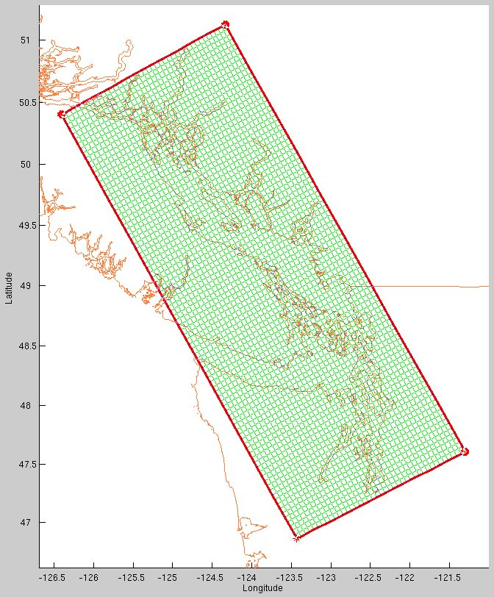
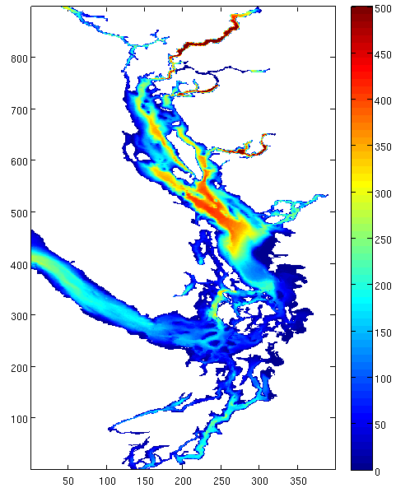
Relocatable capability applied to the Strait of Georgia
J.-P. Paquin, Y. Lu, K. Thompson and V. Korabel
Curvilinear grid definition using Seagrid
Cascadia bathymetry on SoG grid
One out of 10 grid point is shown
Grid size: 898x398
Resolution ~450m

Slide 6
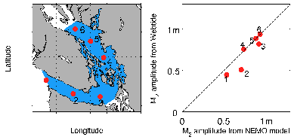
Validation of Tidal Heights from the Initial Configuration

Slide 7
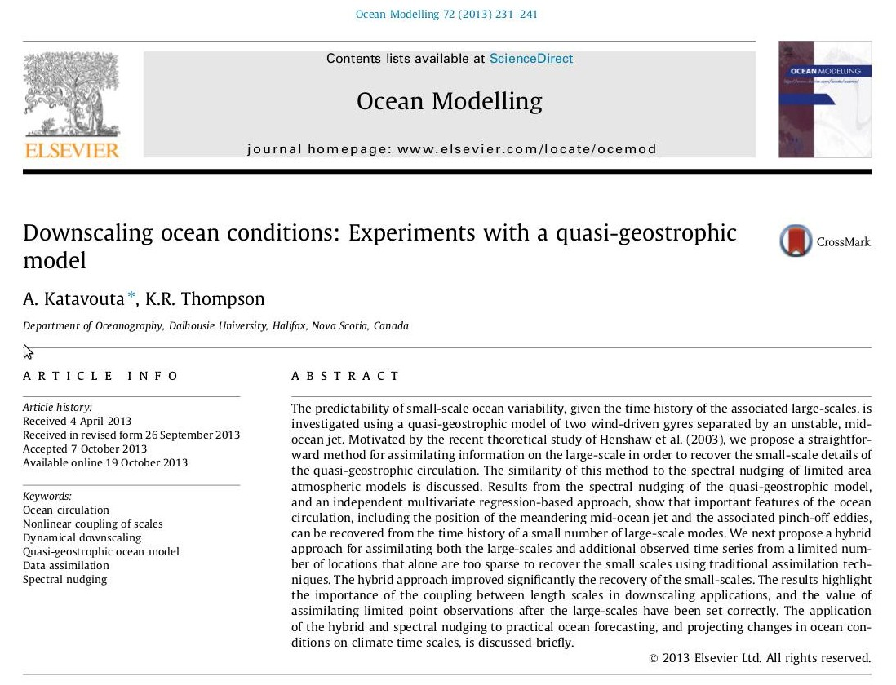
Downscaling Ocean Conditions

Slide 8
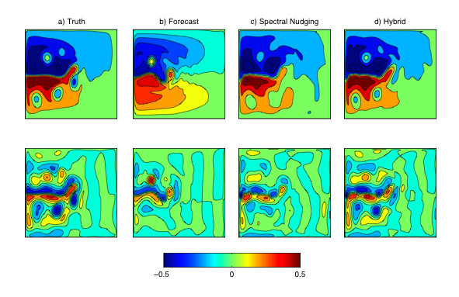
Example of Ocean Downscaling
Next steps: Scotian Shelf, Hycom …

Slide 9
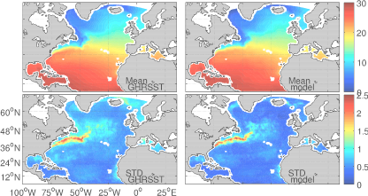
Ocean Data Assimilation: NA Experience

Slide 10
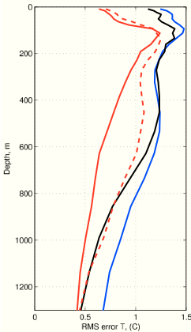
Importance of tailoring the ensemble
RMS of Difference Between
Argo T(z) and Various Predictions
of the North Atlantic
Black: Seasonal climatology
Blue: Non assimilative forecast
Red dash: Assimilation of SST and altimetry, no vertical tailoring
Red: Assimilation of SST and altimetry, with vertical tailoring

Slide 11
Two major applications planned:
Strait of Georgia (years 1 to 3): In situ ocean observations from VENUS (e.g., surface current fields from CODAR, temperature and salinity from moorings, gliders, and instrumented ferries).
Scotian Shelf (years 4 to 5): In situ ocean data collected by OTN, supplemented by hydrographic measurements made by autonomous surface vehicle operated by Observation Core. Small scale tracer release experiment, carried out in parallel with OTN measurements, will be performed on the inner Scotian Shelf.

