Slide 1
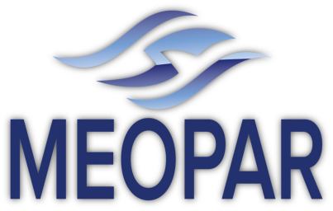


The Marine Environmental Observation Prediction and Response Network

Slide 2
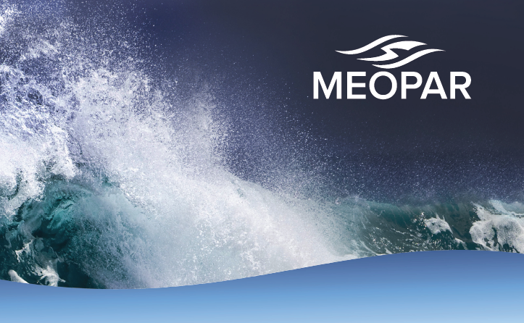
What is MEOPAR?
National network that brings together Canadian researchers, stakeholders and users in a multi-sectoral partnership to better understand, predict and respond to marine hazards
$25M of federal funding (2012-2017), renewable twice; additional funding from partners

Slide 3
MEOPAR is …
Multi-disciplinary
Multi-sectoral
Multi-purpose

Slide 4
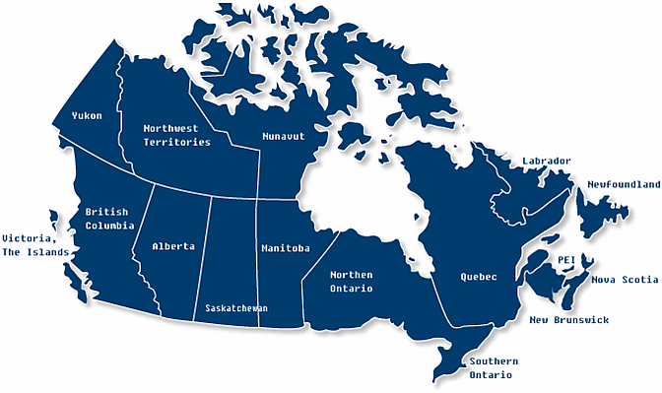










Networking & Partnerships
2 Canada Excellence Research Chairs
7 Canada Research Chairs
39 Investigators (initial)
University involvement to be grown via
Open Calls and the Recruitment Program
Sharing of resources via Observation and Prediction Cores

Slide 5
Receptors

Slide 6
MEOPAR’s Thematic Structure
Prediction Core
Theme 1
Hours - Seasons
Theme 2
Seasons - Decades
Observation Core

Slide 7
The Initial Projects
Address needs of partners and stakeholders
Build on existing capability, prior projects
Based on existing Canadian expertise
Theme 1
Hours - Seasons
Theme 2
Seasons - Decades
1.2 Building a Network of Fixed Coastal Observing / Forecast Systems
2.1 Climate Change and Extreme Events in the Marine Environment
1.1 A Relocatable Coupled Atmosphere-Ocean Prediction System
2.2 Biogeochemical Projections Under a Changing Climate

Slide 8
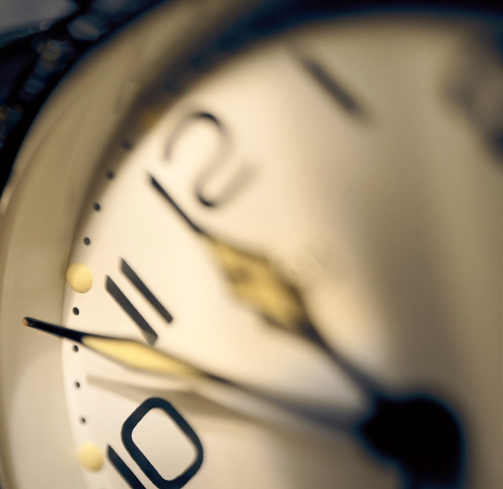
Theme 1
Improve ability of government and private sector to respond to existing and emerging marine hazards on time scales of hours to seasons

Slide 9
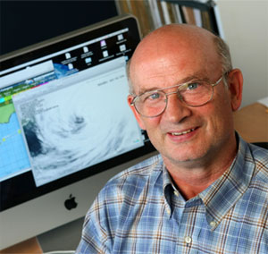
Initial Project 1.1: A Relocatable Coupled Atmosphere-Ocean Prediction System
Project Leader: Hal Ritchie
Environment Canada
Dalhousie University

Slide 10
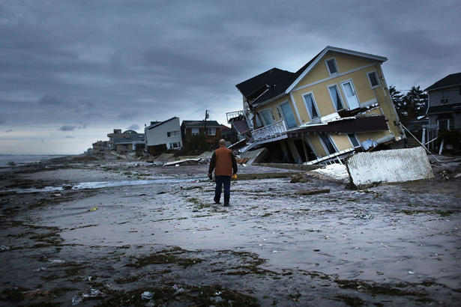
Relocatable Coupled Atmosphere-Ocean Prediction System
Hazards can be encountered anywhere and anytime along Canada‘s coastline and offshore areas
Canada requires rapidly-deployable prediction systems to guide response to marine emergencies
Source: Spencer Platt/Getty Images

Slide 11
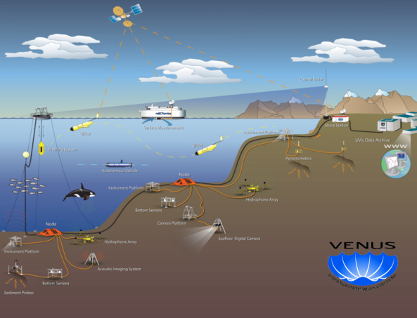
Relocatable Coupled Atmosphere-Ocean Prediction System
Construct relocatable atmosphere-ocean-wave model with data assimilation
Develop mechanisms for rapid appraisal of socioeconomic vulnerability and risks
Test in Strait of Georgia and on Scotian Shelf
Develop information products for receptor groups and partners

Slide 12
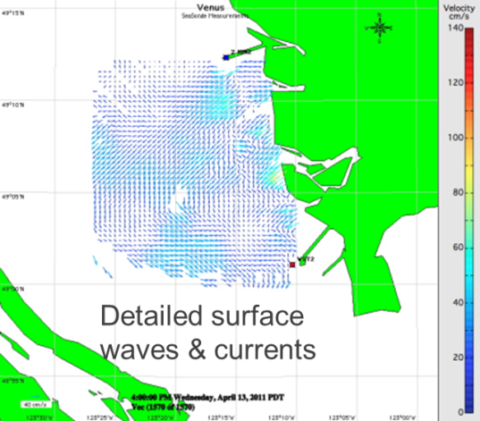
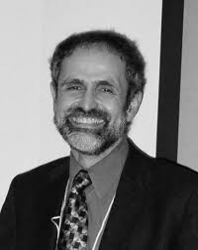
Initial Project 1.2: Building a Network of Fixed Coastal Observing & Forecast Systems
Original Project Leader: Ken Denman
UVIC
Need to find new lead

Slide 13
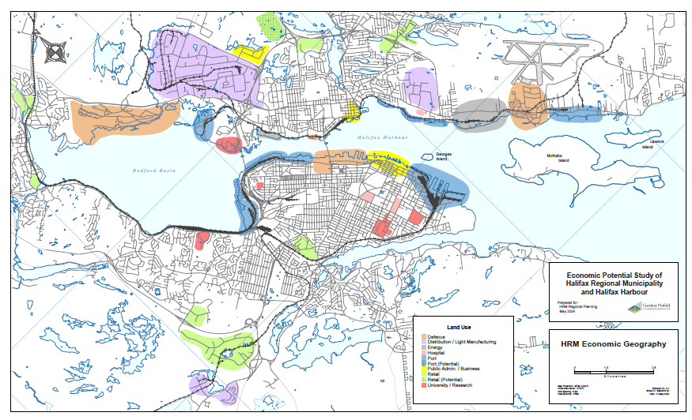
Building a Network of Fixed Coastal Observing & Forecast Systems
Economic activity and assets concentrated in specific locations (e.g. harbours, straits) vulnerable to multiple hazards
Preparedness for low amplitude/high- frequency and high amplitude /low- frequency hazards requires observation/prediction systems designed and operated with stakeholders
Halifax Harbour Economic Assets

Slide 14
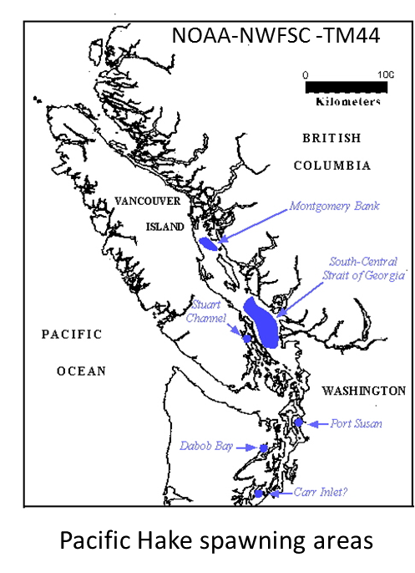
Building a Network of Fixed Coastal Observing & Forecast Systems
Establish real-time forecast system for physical properties and associated risks within Halifax Harbour and adjacent shelf
Implement system for southern Strait of Georgia, Vancouver
Develop indicators of socio-economic impacts based on measured / predicted quantities for communication of risk to stakeholders
Use existing models and observing networks (e.g. VENUS), incrementing as necessary
Source: NOAA

Slide 15
The Prediction Core
Respond to needs of projects for common services such as
Technical support for NEMO code
Model technique development (modular, generic):
downscaling;
biogeochemical data assimilation;
risk visualization;
socio-economic indicators
Repository for model code and documentation

Slide 16
The Observation Core
Observation support for all projects
Develop new technologies
Assemble data sets and make them available

Slide 17
Recruitment Program
Increase number of scientists in Canada working at the policy-science interface
Budget allocation is $1.2 million
Approach:
Provide research funds for work on MEOPAR projects to new or recently-hired (<5 years of appointment) tenure-track professors at Canadian universities
Target linking natural sciences with socioeconomic impacts and development of policy and regulatory frameworks

Slide 18
Partnership Program
Accelerate engagement of MEOPAR with industry and other non-academic partners, and transfer of network research to the private sector.
Budget allocation is $1.5M
Oil / Gas
Software
Industry
Insurance
MEOPAR Researchers
Consulting
SMEs
Munici-palities
Ocean
Tech

Slide 19
The Open Calls
Engaging
New partners, investigators, receptor needs
Vehicle for the Partnership Program
Enhancing
Expanding fixed observation & prediction systems (eg. Arctic, Nfld. offshore)
Facilitating interaction with other programs, partners, networks…. including international cooperation
Sustaining
Allowing adaptation to emerging Canadian priorities

