Slide 1
Initial Project 1.1
Ocean Models and Assimilation

Slide 2
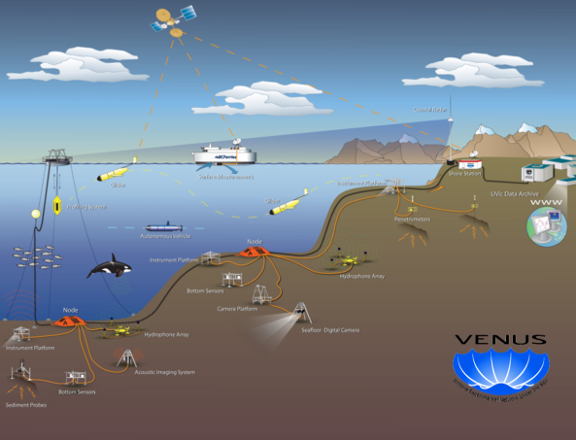
What will we do?
Build and test an ocean forecast system that can be set-up within hours of marine emergency, anywhere in Canadian waters
Provide short-term forecasts (hours to days) of physical properties of ocean to guide response to a marine emergency
Develop ability to assimilate data (e.g., obs from altimeters, gliders) and downscale predictions from larger scale models
Develop modules for offline prediction of movement and dispersion of plumes of hazardous materials

Slide 3
Modelling, Assimilation and Downscaling
Ocean Model Code: Shelf version of the NEMO (Nucleus for European Modelling of the Ocean) ocean forecast system. Start from system already implemented by CONCEPTS for Gulf of St. Lawrence
Initial and Boundary Conditions: From large-scale, operational models already in place. The initial conditions will be based on downscaling, enhanced by assimilation of observations.
Assimilation: Multivariate, ensemble-based optimal interpolation. Will be a difficult technical challenge for rapid deployments because exact region of study will not be known beforehand and so information on error covariance structures will be limited. Precalculation?
Downscaling: An important source of information will be forecasts from large-scale, coarser resolution models. Will use a form of spectral nudging recently developed and tested by Anna Katavouta.

Slide 4
Two Major Fields Tests of the Model
Strait of Georgia (years 1 to 3): In situ ocean observations from VENUS (e.g., surface current fields from CODAR, temperature and salinity from moorings, gliders, and instrumented ferries). Ocean model will be forced with high resolution winds from high res forecast model developed for the 2010 Olympics.
Scotian Shelf (years 4 to 5): In situ ocean data collected by OTN, supplemented by hydrographic measurements made by autonomous surface vehicle operated by Observation Core. Small scale tracer release experiment, carried out in parallel with OTN measurements, will be performed on the inner Scotian Shelf.

Slide 5
Main Deliverables and Timeline
Years 1-3
Develop ocean model and assimilation schemes, configured for Strait of Georgia and Scotian Shelf
Develop offline tracer prediction modules
Year 3
Testing and evaluation at VENUS site in collaboration with IP1.2
Year 4
Test relocatable system on Scotia Shelf (with OTN and Observation Core, including small scale tracer release experiment)
Complete testing and real-time implementation in Strait of Georgia

