Slide 1

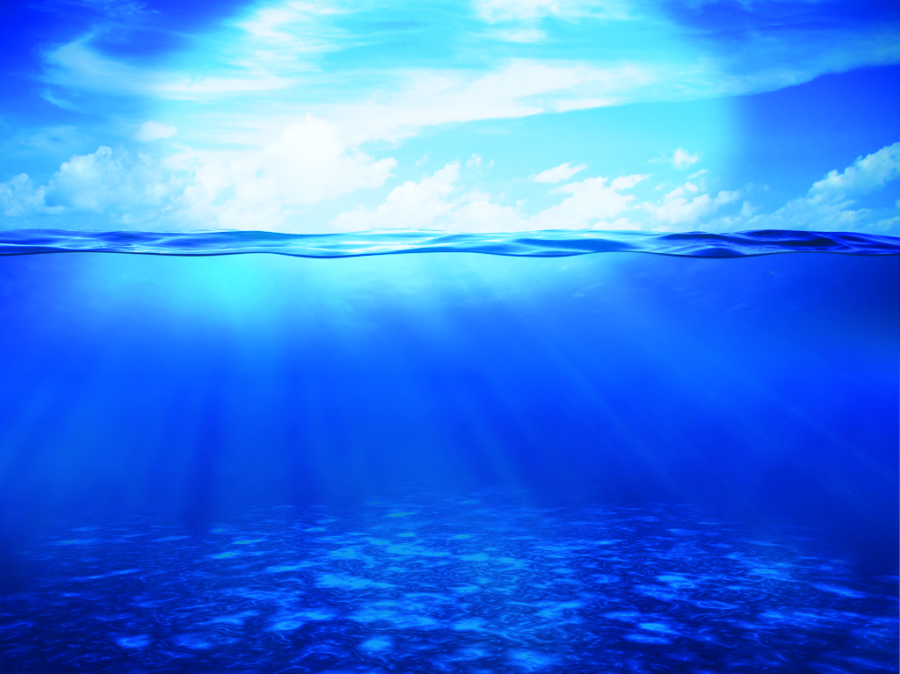
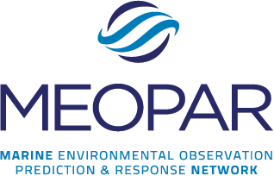

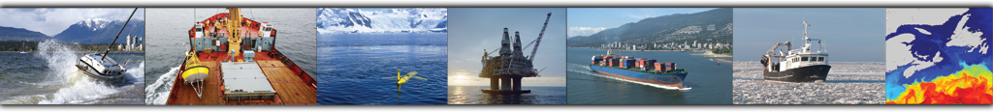
PRESENTATION TITLE
By: Your Name Here

Slide 2

MEOPAR’S Vision: Our Network
MULTIDISCIPLINARY
NATURAL SCIENCES
SOCIAL SCIENCES
MULTIPURPOSE
OBSERVATION
PREDICTION
MULTISECTORAL
PRIVATE SECTOR
ACADEMIA
POLICY SCIENCES
GOVERNMENT
NGOs
COMMUNITIES
RESPONSE
Working together to better understand and PREDICT the IMPACT of MARINE HAZARDS on human activities and ecosystems…
AND IMPROVE RESPONSE.

Slide 3
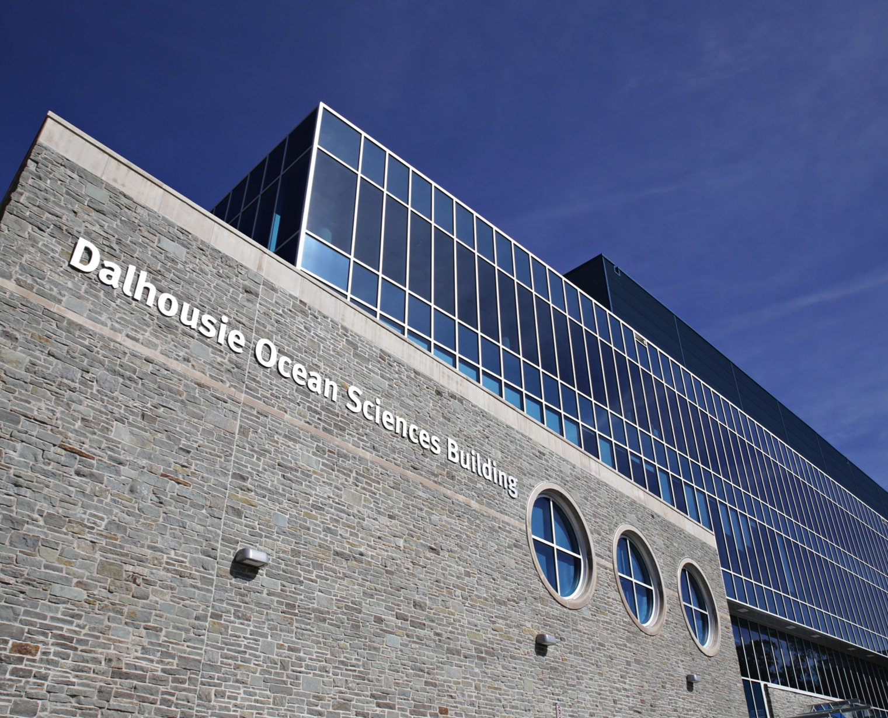

Who We Are
155+ university researchers
150+ highly-qualified people
from 20 universities
Who work with:
35 federal & provincial departments and agencies,
50 industrial and other partners
in Canada and beyond.
$25M Funding (2012-2017)
from the Networks of
Centres of Excellence
Notes:
We collaborate on over 20 research projects, but our network and projects are growing.
NATIONAL NETWORK, hosted by Dalhousie University in Halifax, NS

Slide 4
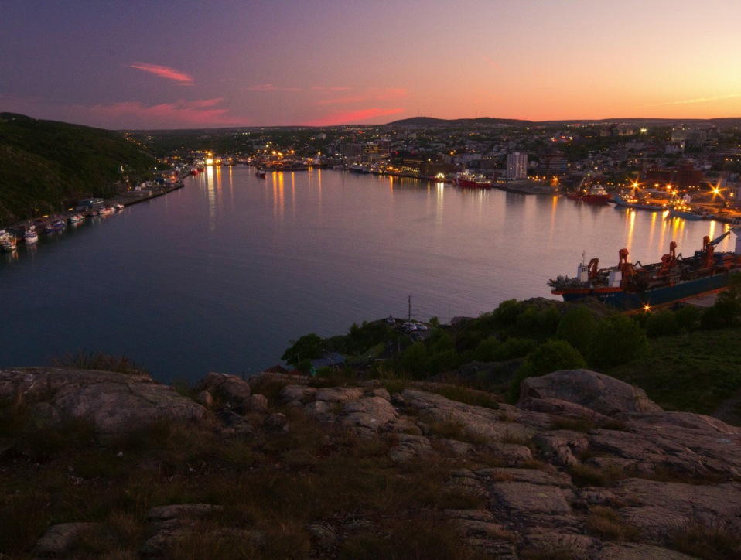

What We Do
Generating
knowledge
people want
and will use
Bringing
People together
in new and different ways
Training
the next generation
of ocean experts
Notes:
MEOPAR was formed because we all rely on the ocean.
Each MEOPAR project is a complex entity that involves a mix of people, ocean experts and students.
The projects that receive funding from MEOPAR meet very special criteria.
Every project has been highly vetted to have real world application, which is what distinguishes our mandate from traditional academic research.
The three aspects of a MEOProject are:
Generating knowledge and delivering research results that benefit people
Each project puts scientists, industry and ocean users together in new and different combinations
Training our students, the next generation of ocean experts
No I’d like to tell you more about specific projects MEOPAR is funding and their impact.

Slide 5
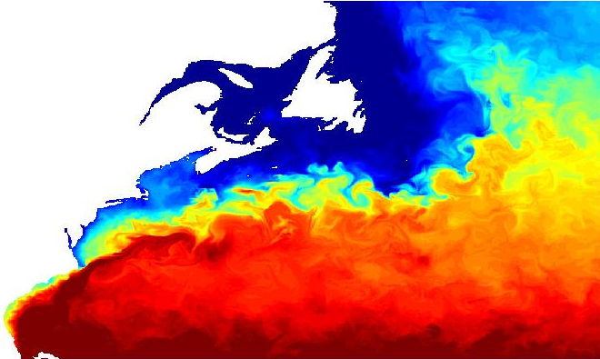
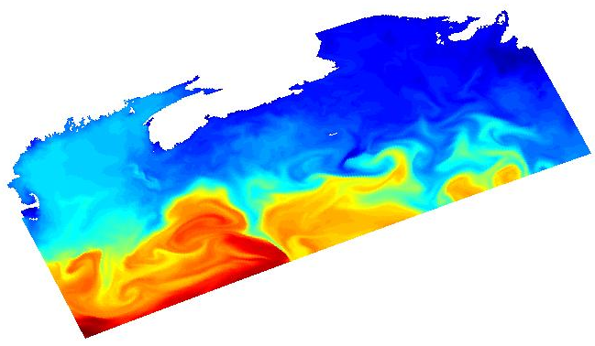
A Re-locatable Atmosphere-Ocean Prediction System
Cultural &
Organizational Divide
Government
Operational
Emergency Response
CONCEPTS
Academia
Fundamental Research
Training
Knowledge / Techniques
Expertise/Needs/Resources
HQP
Notes:
This is what sets MEOPAR apart – this is how we are changing the way ocean science is conducted in Canada. Project 1.1 connects EC and DFO to universities in a new way. This has been held by by both departments as an example of how to cooperate.
***On the left hand the government panel shows SST from an operational model run by a government agency (in this case it’s the US). MEOPAR is developing the capability to zoom in to areas of particular interest. The MEOPAR picture shows a zoom of SST for the Scotian Shelf based on the HYCOM output.

Slide 6
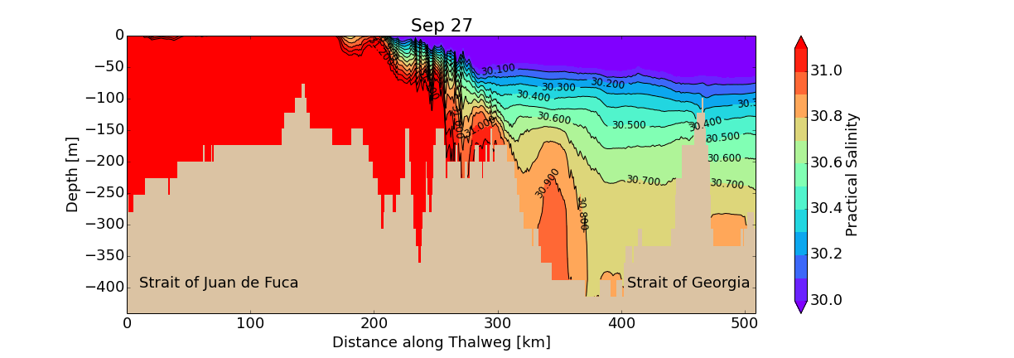
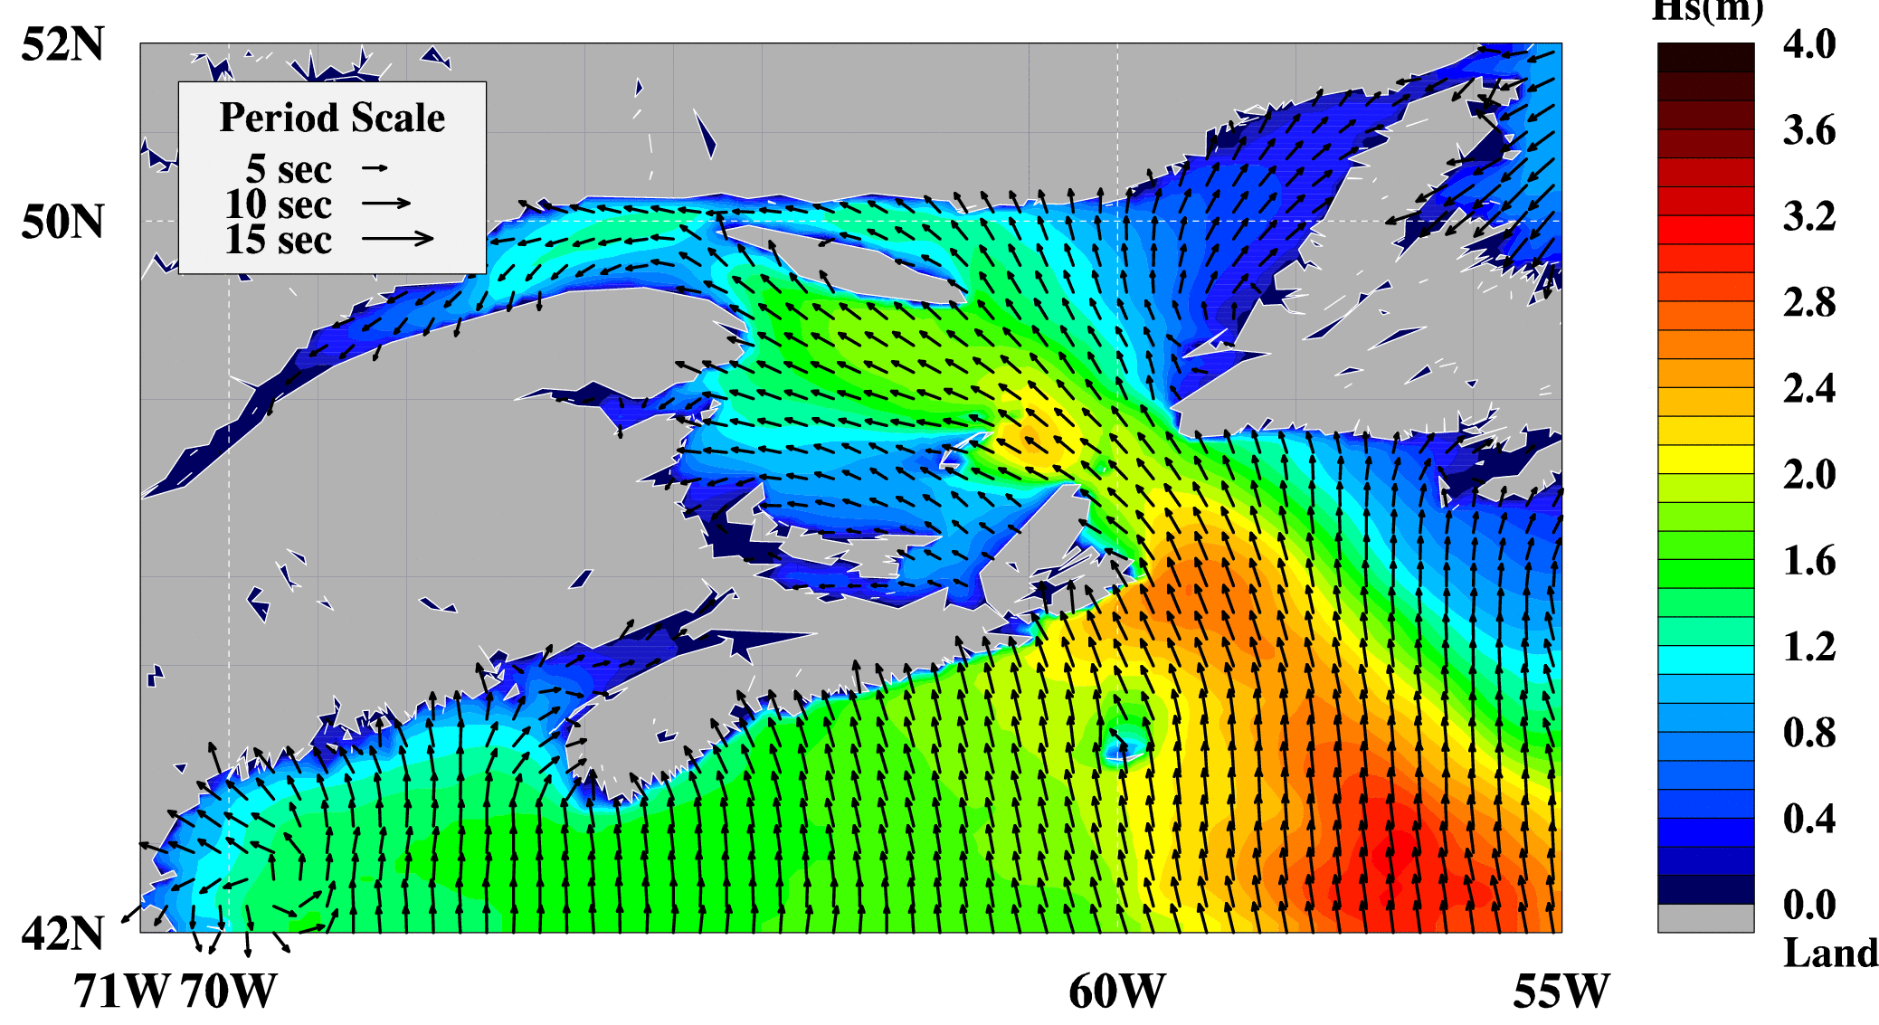
Building a Network of Fixed Coastal Observing & Forecasting Systems
West Coast
Data Rich (ONC)
Geographic Divide
East Coast
Model Rich
Models
Observational Capacity
Users of Research:
Municipalities
Ports
Notes:
Project 1.2 works in conjunction with 1.1 to bridge the geographic divide between east and west coast. The models developed on the east coast are tested on the west coast. Project 1.2 then connects to end users such as ports and municipalities. This outreach has led for example to a new operational forecast capability for the West Coast (Strait of Georgia) which, based on input from stakeholders like municipalities is focusing on storm surge prediction.

Slide 7
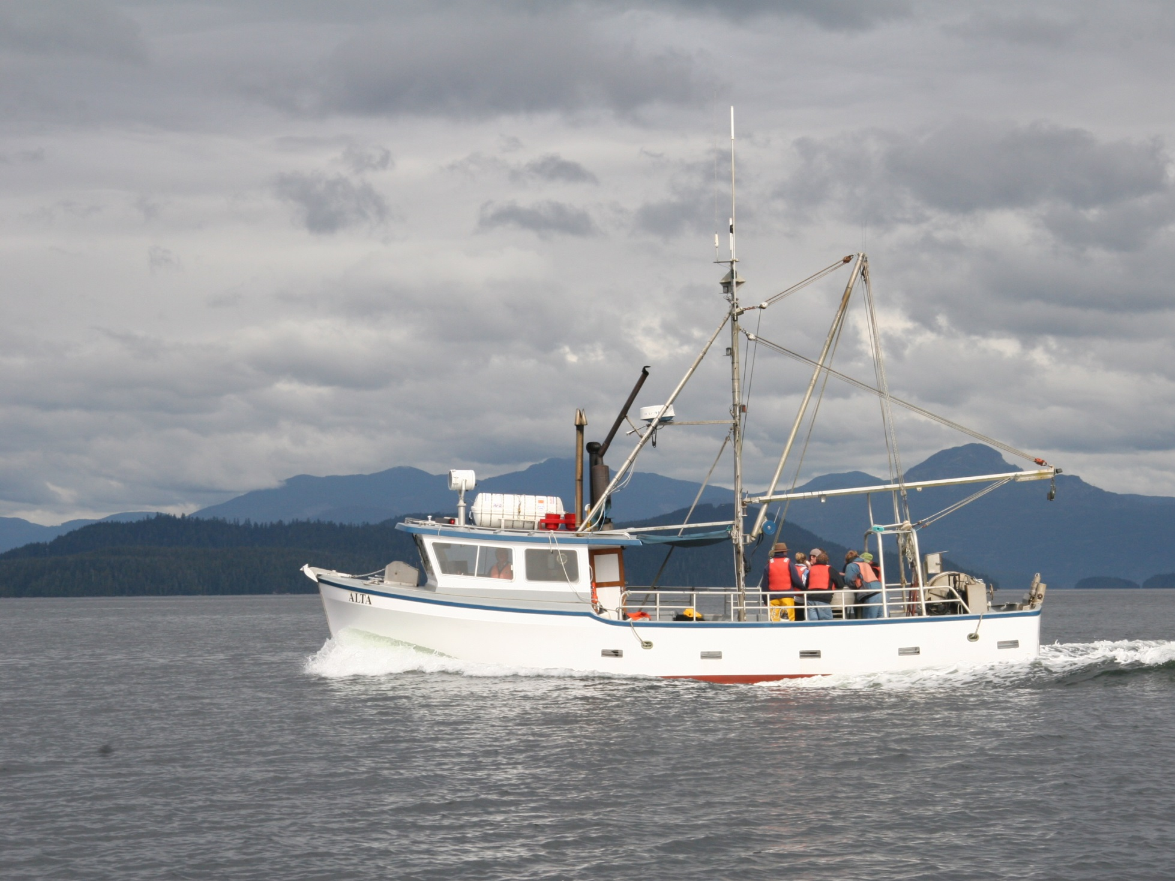
A Re-locatable Atmosphere-Ocean Prediction System
Who:
Dr. Harold Ritchie, Environment Canada/
Dalhousie University
Developing a re-locatable atmosphere-wave-ocean forecast system that can be set up within hours of a marine emergency. It can track plumes of tracers and hazardous materials in two and three dimensions.
Providing forecasts (hours to days) of the physical properties of the ocean and atmosphere to help guide response to an emergency. Eventually, this system will be transferred to Environment Canada for national, operational use.
What:
Impact:
Photo: Fisheries and Oceans Canada

Slide 8
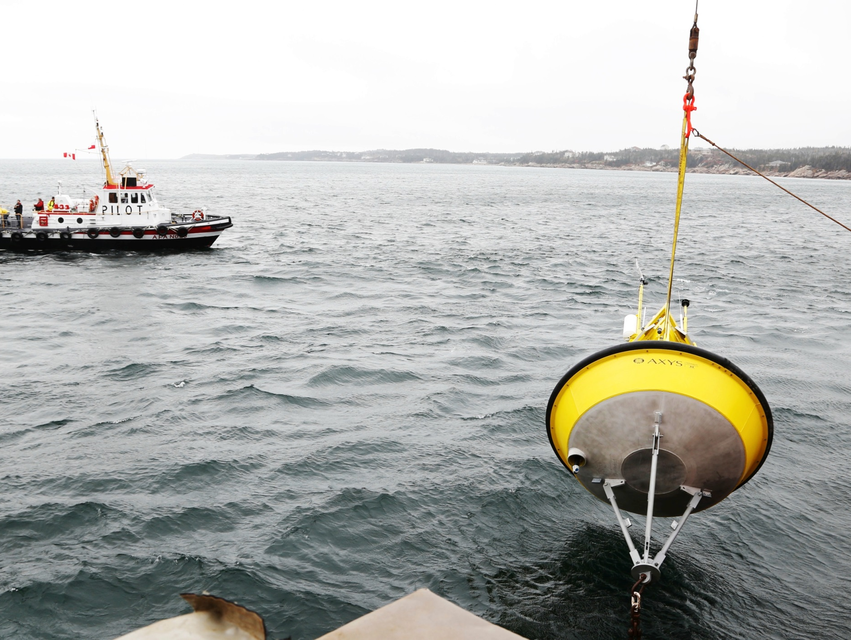
Building a Network of Fixed Coastal Observing & Forecast Systems
Who:
Dr. Jinyu Sheng, Dalhousie University and Dr. Susan Allen, University of British Columbia
Helping build an integrated observation and prediction system for Halifax Harbour, NS and the southern Strait of Georgia, BC.
Creating useful real-time forecasts of sea level, waves, currents, and bio-geochemical properties for multiple stakeholders like port authorities, municipalities, and the oil and gas sector.
What:
Impact:
Notes:
Building a Network of Fixed Coastal Observing and Forecast Systems
Who: Dr. Jinyu Sheng, Dalhousie University and Dr. Susan Allen, University of British Columbia
What: Helping build an integrated observation and prediction system for Halifax Harbour, NS and the southern Strait of Georgia, BC.
Impact: Creating useful real-time forecasts of sea level, waves, currents, and bio-geochemical properties for multiple stakeholders like port authorities, municipalities, and the oil and gas sector.

Slide 9
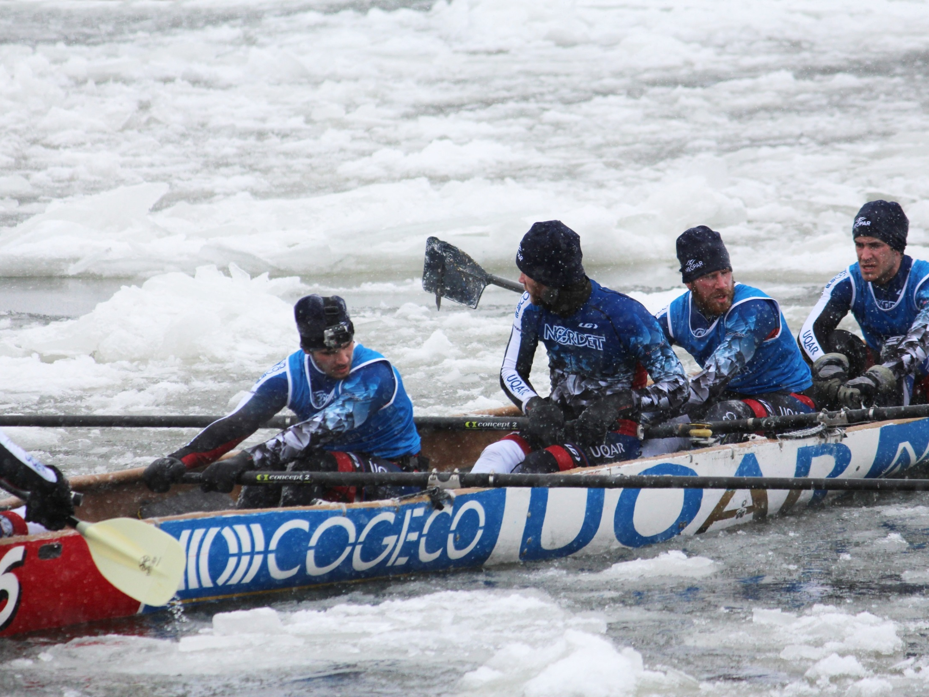
Improving Surface
Drift Forecasts
Who:
Dr. Dany Dumont, Université du Québec à Rimouski
Improving surface drift forecasts in seasonally ice-infested seas by recording data that estimates wave forecasts and surface drifting. Buoys were deployed by UQAR ice canoe team.
Being able to respond to emergencies along Canadian coasts requires accurate hindcasts and forecasts of winds and surface currents to estimate where a person or an oil patch will drift. Time is key in ice-infested water where survival time is short and conditions are extremely difficult.
What:
Impact:

Slide 10
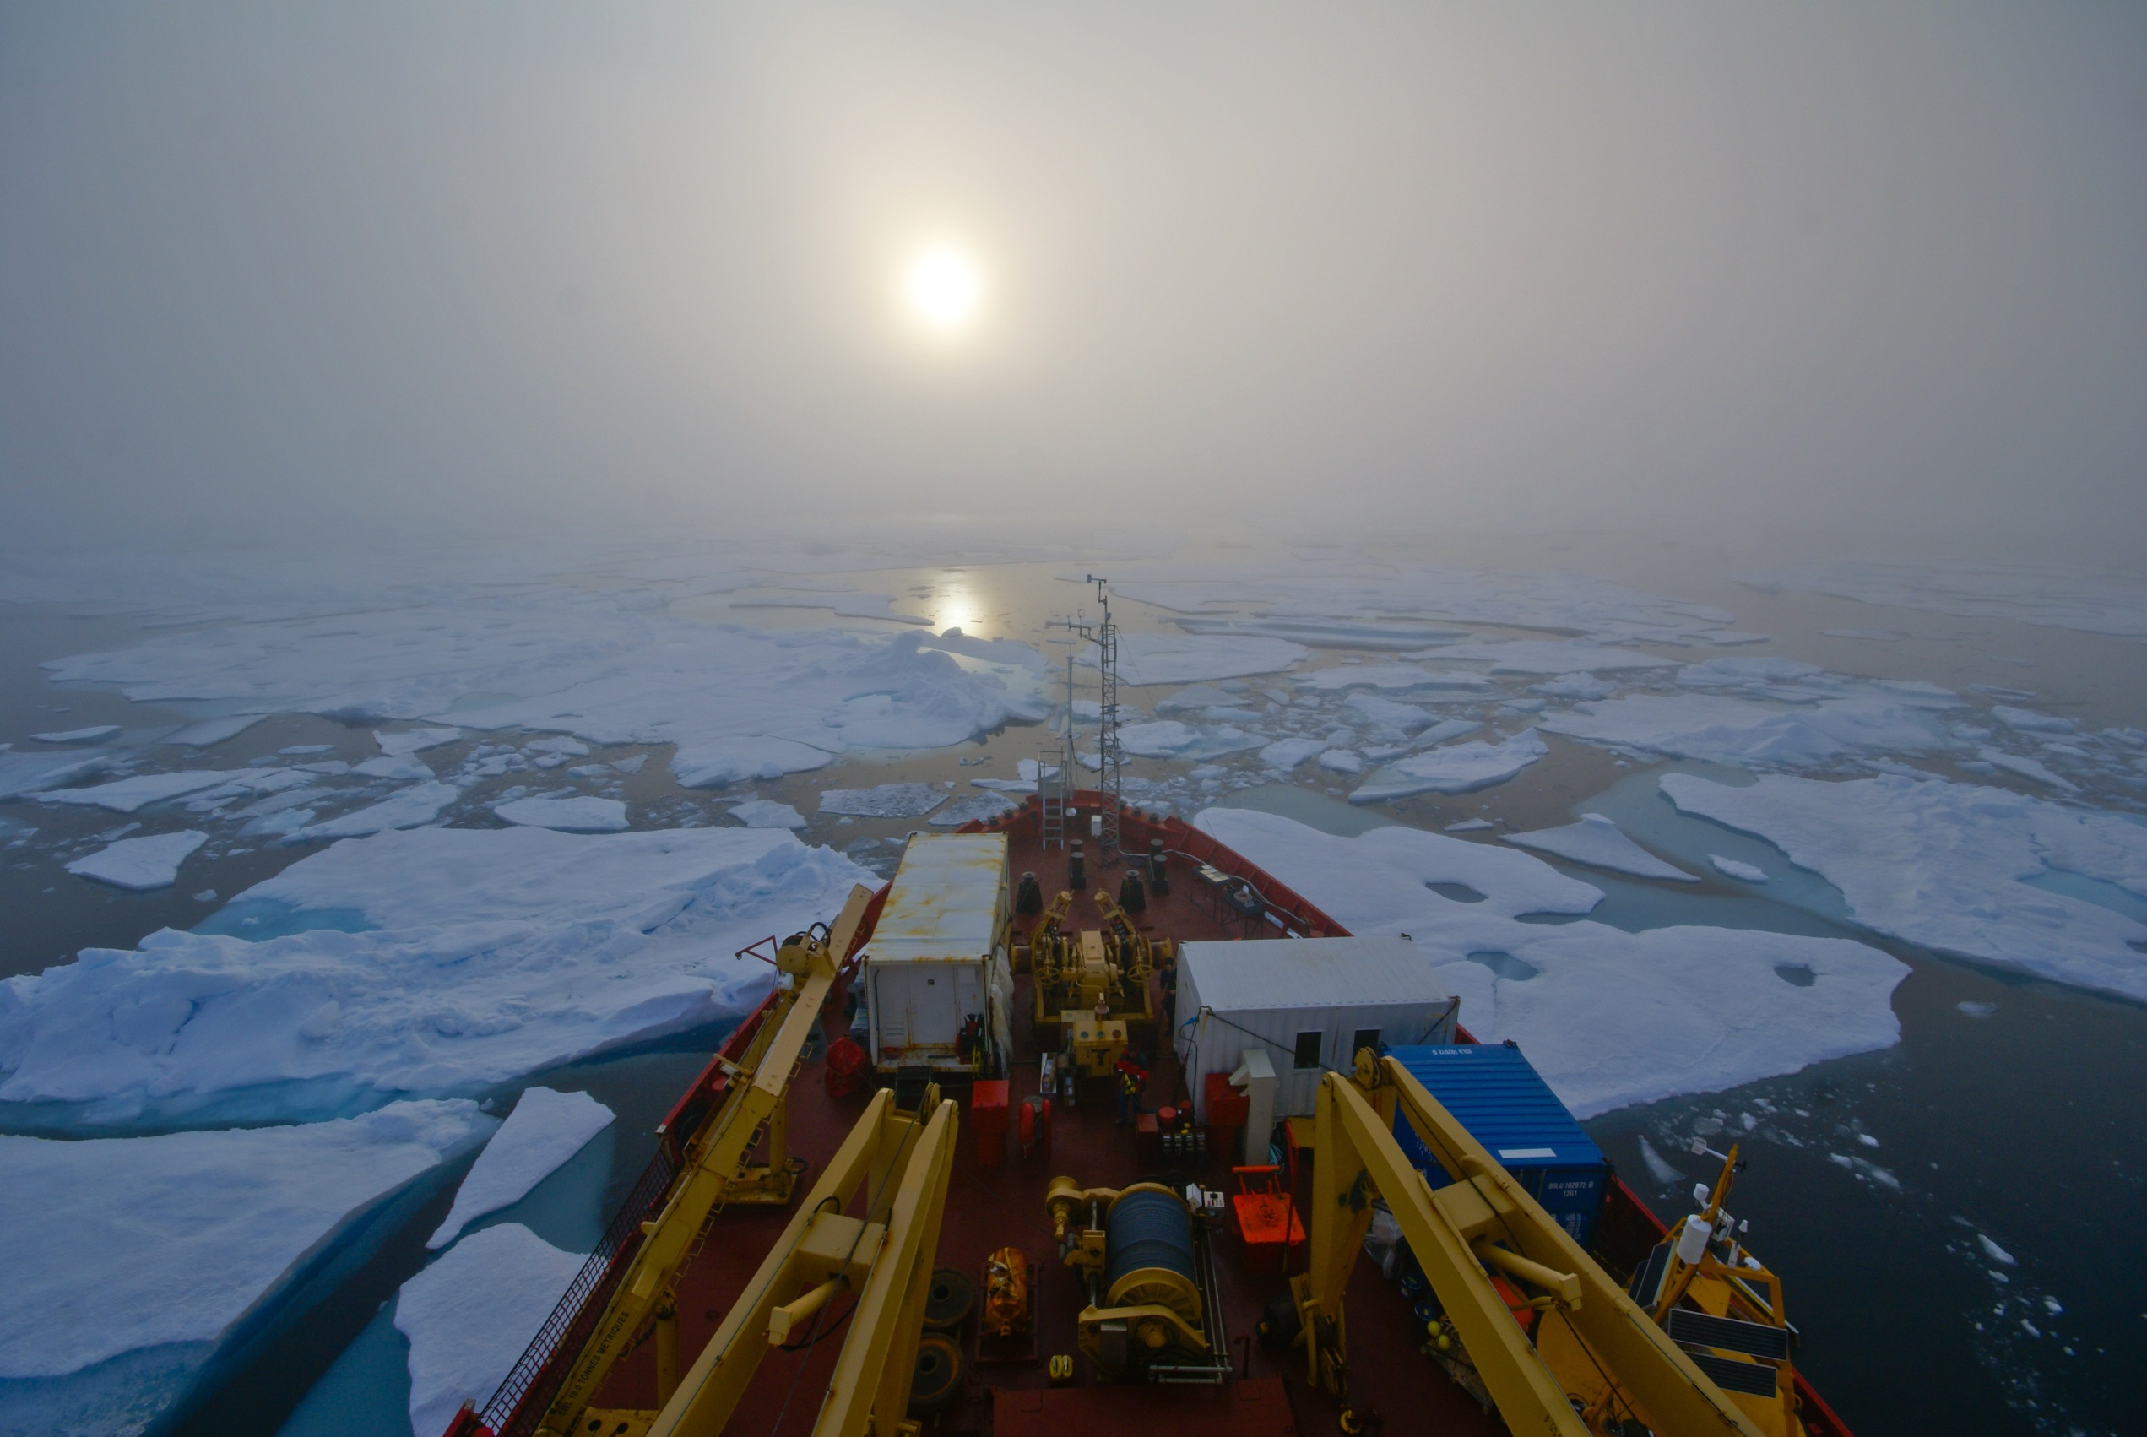
User-Driven Monitoring of Adverse Marine and Weather States in the Eastern Beaufort Sea
Who:
Dr. David Atkinson,
University of Victoria
How large-scale weather patterns adversely impact marine transport and
industrial activity and near-by stakeholders in the Eastern Beaufort Sea.
Ensure marine operators, coastal communities and emergency response operators have access to weather forecast information that helps them when planning their operations.
What:
Impact:
Photo: Martin Fortier, ArcticNet
Notes:
http://www.polarphotogallery.com/Main/Gallery/25684965_6ddkmT#!i=2185153772&k=RNp7SHd

Slide 11
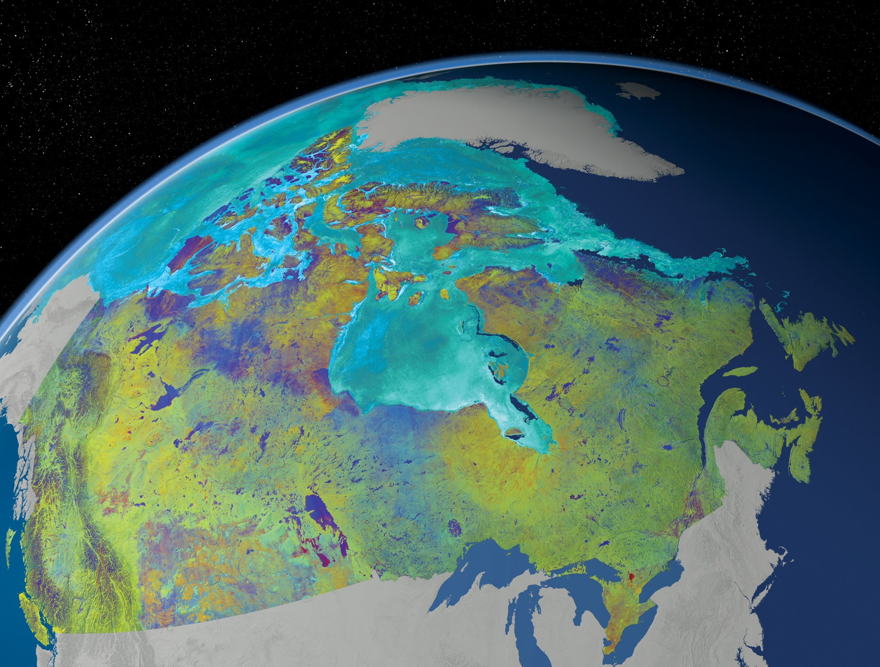
Improving Sea Ice Forecasts
Who:
Dr. Andrea Scott,
University of Waterloo
Develop a method to use radar (SAR) satellite images to improve the monitoring of ice conditions in the water. Information about the type of ice, concentration and detection of open water are essential for ship navigation.
Accurate information about sea ice conditions is critical for weather forecasting and safe navigation in ice-covered regions.
What:
Impact:

Slide 12
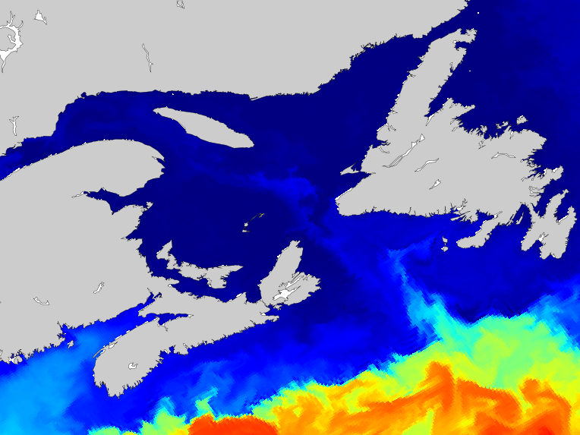
Biogeochemical Projections
Under a Changing Climate
Who:
Dr. Katja Fennel, Dalhousie University
Globally, our oceans are warming, becoming more acidic and losing oxygen. These changes impact local ecosystems and the intensity of weather-related events on our coasts.
This research will help planning efforts for a number of end users including the fishing industry, the oil and gas industry, and coastal communities.
What:
Impact:

Slide 13
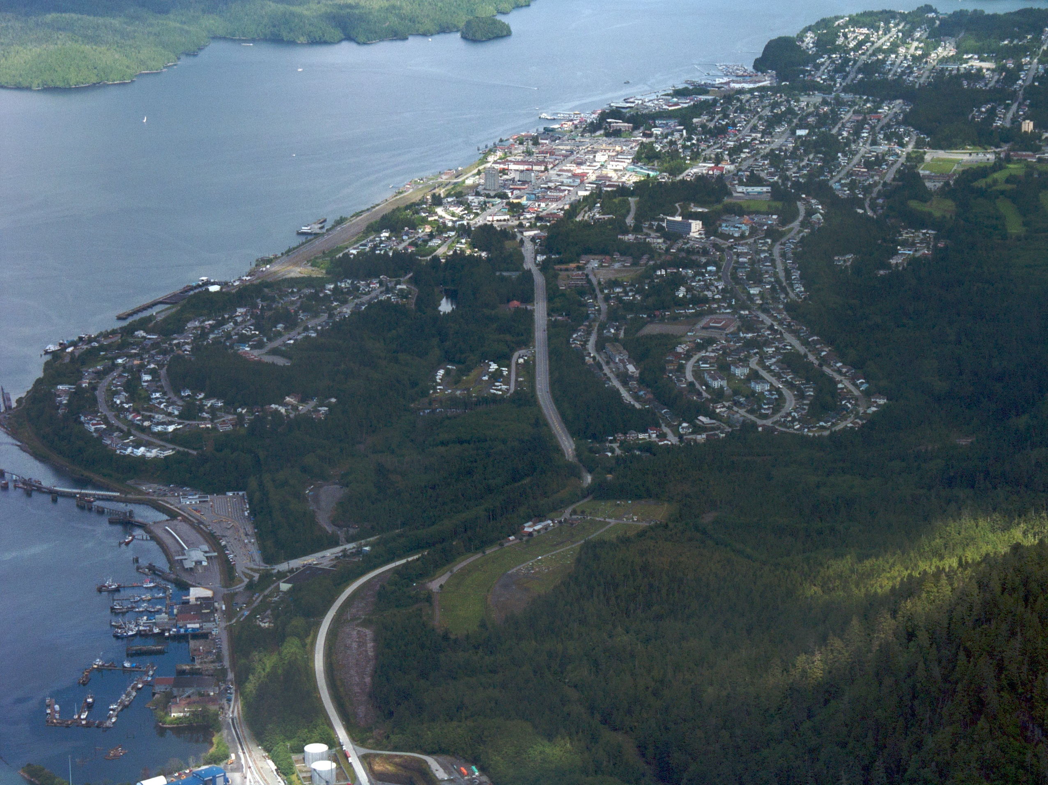
Climate Change and Extreme Events in the Marine Environment
Who:
Dr. Gregory Flato,
Environment Canada/University of Victoria
Flato and his team are developing ways to assess and visualize changes in the marine environment and the associated risks. How to create accurate and detailed risk maps of ocean conditions will be explored.
These ocean maps could be used to guide ship traffic, and drift models could be used in the event of a spill. The fishing industry and coastal communities could also use these maps to manage their exposure to extreme weather events.
What:
Impact:
Photo: CC Sam Beebe
Notes:
Prince Rupert, BC

Slide 14
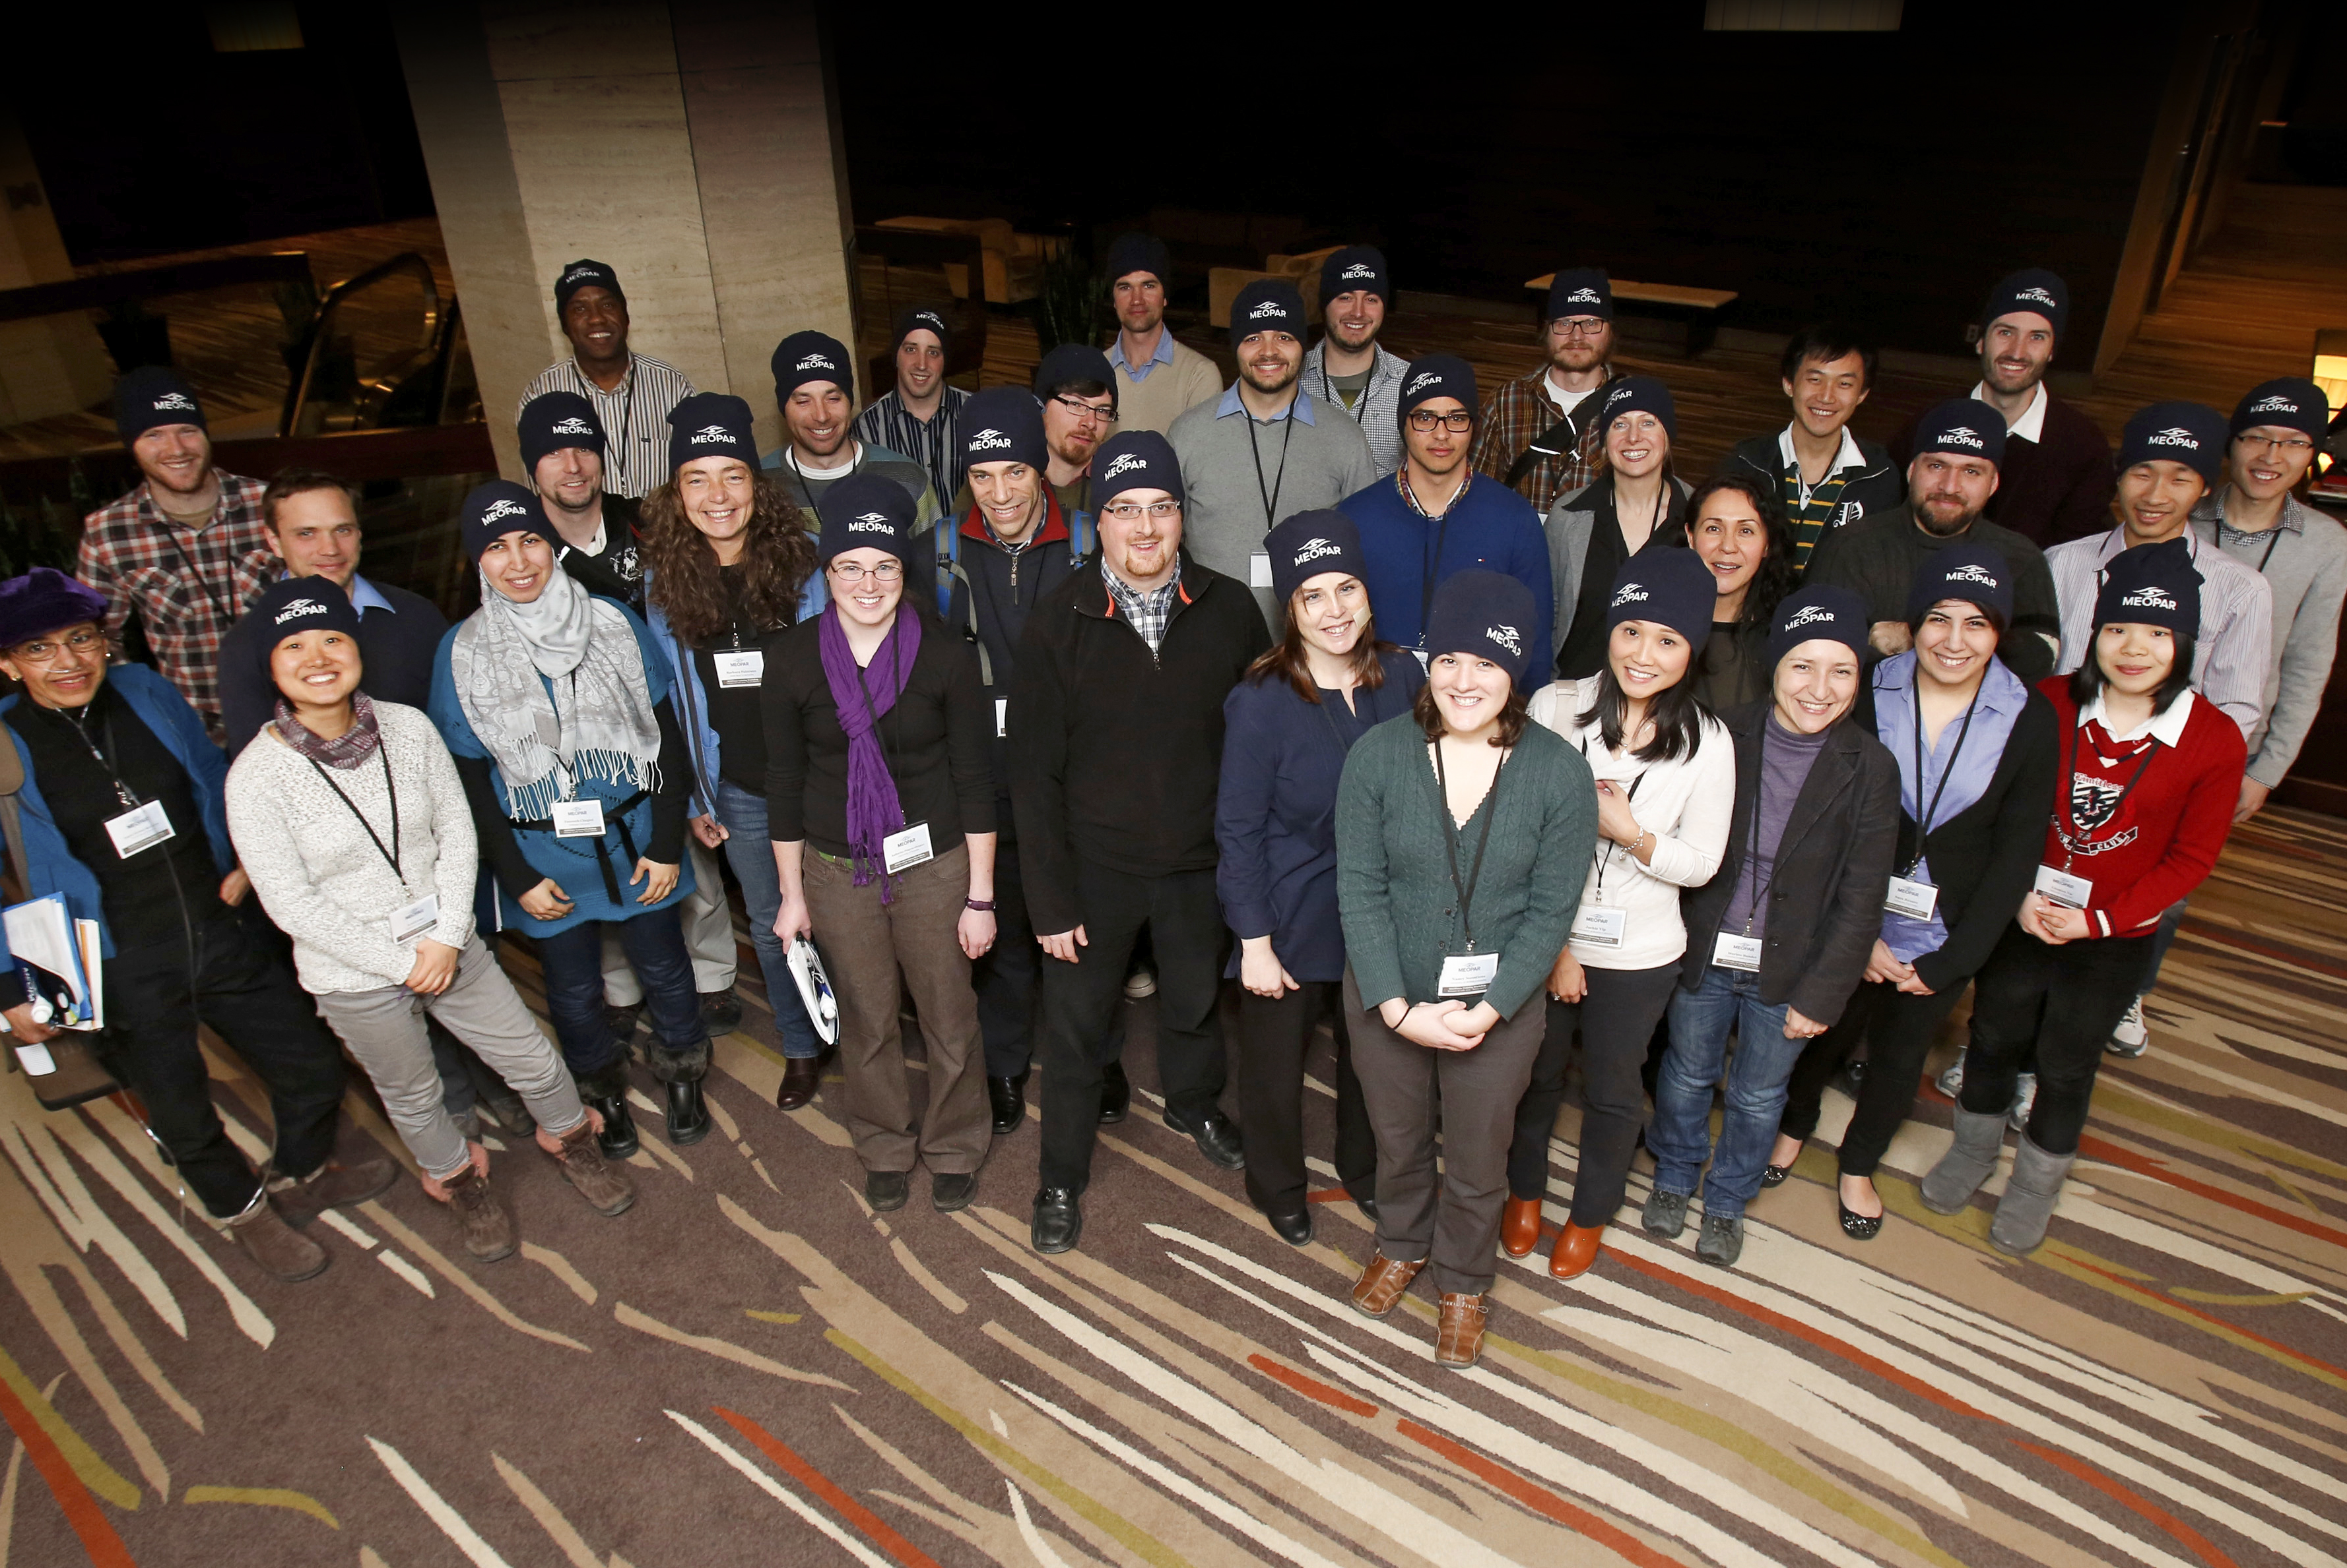
MEOPeers
Our projects train students. Masters students, PhD candidates and Post-doctoral fellows engaged in MEOPAR projects are known as “MEOPeers”.
Notes:
All our research projects are training students – our MEOPeers.
We have a network of XX 60?MEOPeers across the country.
Find your student(s) in this picture and highlight them.

Slide 15
Training Strategy
NATURAL SCIENCES
ENGINEERING
SOCIAL SCIENCES, POLICY & ECONOMICS
OPERATIONS
BUILD BRIDGES BETWEEN SECTORS
Notes:
Attract, develop and retain outstanding researchers in marine research areas and technologies critical to Canada
Implement training strategies that expose HQP to the full range of economic, social, and policy implications of our MEOPAR research

Slide 16

MEOPAR’s Programs
Generating Knowledge
Proposal Calls
Research Program
Training
Researcher Development
Recruitment
Program
Bringing People Together
Partnership Workshop Program
Partnership Program
Notes:
How we do this is through our operational programs. This is how we achieve our 5 year objectives and reach our ultimate 15 year goals.

Slide 17
Project Funding - Open Calls
FIRST OPEN CALL
Issued in 2012, $650,000 budget
Over 30 LOIs, 8 full proposals
3 projects added in June 2013 (to original 4 projects)
SECOND OPEN CALL
Issued in 2013, $4 million budget
Over 40 LOIs, 14 full proposals
Projects to be awarded summer 2014
FUTURE CALLS?
Opportunity for future funding
Opportunity for new collaborations and partners
Likely smaller and targeted

Slide 18
Partnership Program
OCEAN TECH
INSURANCE
SOFTWARE
INDUSTRY
MEOPAR RESEARCHERS
OIL/GAS
MUNICIPALITIES
CONSULTING
SMEs
Notes:
To accelerate engagement of MEOPAR with industry and other non-academic partners, and transfer of network research to the private sector.
Budget allocation is $1.5M

Slide 19
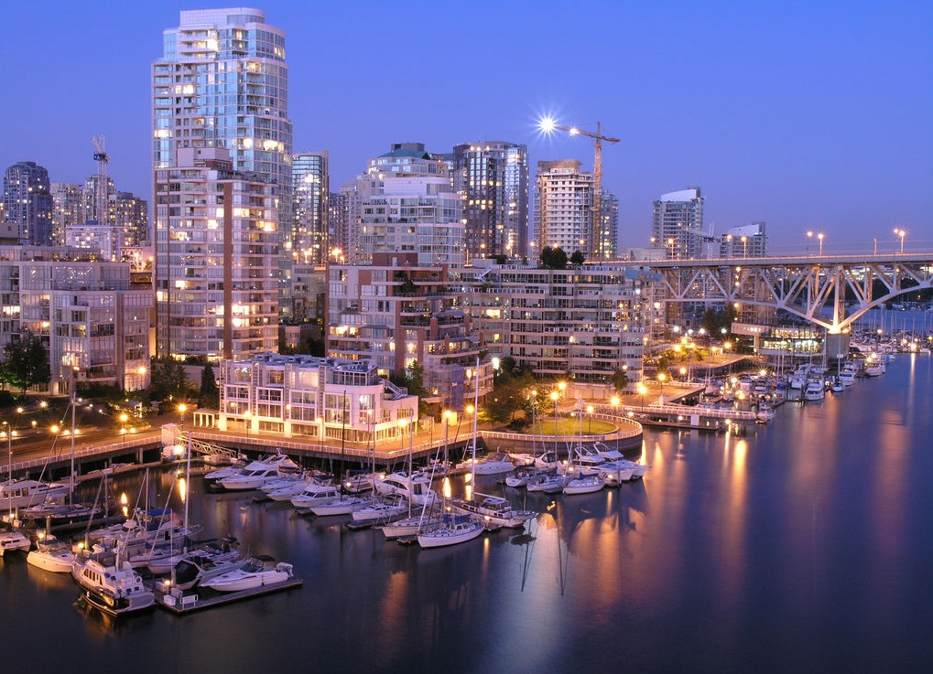
Partnership Program
Engage external partners from industry, other levels of government, NGOs.
Host workshops, seminars and meetings; build networks
Co-fund research with external groups
No application deadline

Slide 20
MEOPeer Researcher Development
Supports academic, research and/or career development needs of MEOPeers.
Max $2,500/HQP to participate in one event/fiscal year.
Pays expenses for MEOPeer to attend a researcher development event.
MEOPeers involved with a MEOPAR-funded project are eligible.
Event/training must be related to MEOPAR and not included in MEOPAR project budget.
Estimate 10 awards for April 2014-March 2015.
Will be reviewed in March 2015, and if funds permit, will be promoted prior to 2015/16.

Slide 21
Five Year Objectives
Establish pan-Canadian network of integrated observing & prediction systems
Develop new tools & technologies
Link future changes to local scales
Assess impact of long-term oceanic change
Introduce new training
Share natural & social sciences expertise
Organize an “Expert Forum”

Slide 22
MEOPAR’s Outcomes
INFORMED SOCIETY
Bringing together researchers, industry, and NGOs
Hazard management
Better techniques & policies
More people using research results
Information about the ocean readily available
COORDINATED CANADIAN APPROACH
TRAINED PEOPLE
Ocean skills
Student mentoring
Notes:
As we achieve these objectives, we deliver these outcomes: informed society, a coordinated Canadian approach and trained people.

Slide 23
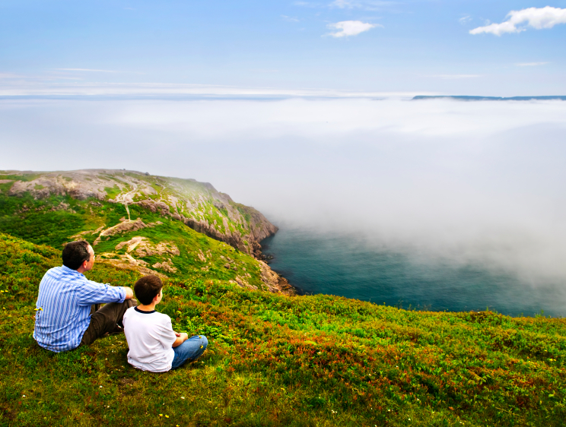


www.meopar.ca
(902) 494-4384

Slide 24

Questions?
www.meopar.ca
902-494-4384
Your name here
How to reach you

Slide 25
Title

Slide 26
Title

