Slide 1



The Marine Environmental Observation Prediction and Response Network

Slide 2

What is MEOPAR?
National network that brings together Canadian researchers, stakeholders and users in a multi-sectoral partnership to better Observe, Predict and Respond to marine hazards
$25M of federal funding (2012-2017), renewable twice; additional funding from partners

Slide 3
MEOPAR’s Thematic Structure
Prediction Core
Theme 1
Hours - Seasons
Theme 2
Seasons - Decades
Observation Core

Slide 4
The Initial Projects
Address needs of partners and stakeholders
Build on existing capability, prior projects
Based on existing Canadian expertise
Theme 1
Hours - Seasons
Theme 2
Seasons - Decades
1.1 A Relocatable Coupled Atmosphere-Ocean Prediction System
2.1 Climate Change and Extreme Events in the Marine Environment
1.2 Building a Network of Fixed Coastal Observing / Forecast Systems
2.2 Biogeochemical Projections Under a Changing Climate

Slide 5
Initial Project 1.1
A Relocatable Coupled
Atmosphere-Ocean Prediction System
Will focus on
Modelling and Assimilation

Slide 6
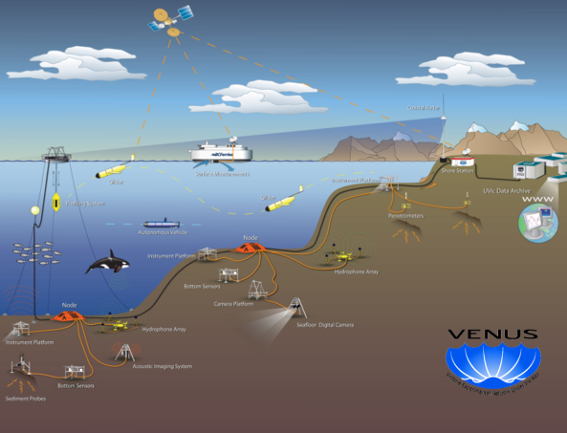
What will we do?
In collaboration with our government partners we will
Build and test ocean forecast system that can be set-up within hours of marine emergency, anywhere in Canadian waters
Provide short-term forecasts (hours to days) of physical properties of ocean to guide response to a marine emergency
Develop ability to assimilate data (e.g., obs from altimeters, gliders) and downscale predictions from larger scale models
Develop modules for offline prediction of movement and dispersion of plumes of hazardous materials

Slide 7
Project Team
Researchers | Multi-Sector | Multi-discipline
Hal Ritchie $ | Dalhousie and EC | global and regional weather modelling
Haibo Niu $ | Dalhousie | oil spill modelling, offshore oil & gas
Mae Seto | Dalhousie and DRDC | defence observation systems
Anthony Charles | SMU | marine socioeconomics & management
Marlon Lewis | Dalhousie | ocean biology, observations & industry
Keith Thompson $ | Dalhousie | ocean modelling & data assimilation
Doug Wallace | Dalhousie | ocean tracers & technology
Serge Desjardins | EC | marine & coastal meteorology
Fred Whoriskey | Dalhousie | ocean ecosystem observations
Gilbert Brunet $ | McGill & EC | meteorological dynamics & analysis
Luc Fillion $ | McGill & EC | atmospheric data assimilation
Greg Smith | EC | global & regional atmosphere-ocean models
Susan Allen | UVic and Venus | biogeochemical & foodweb modelling
Rich Pawlowicz $ Richard Dewey | UBC UVic | ocean observations & analysis physical oceanography, observations

Slide 8
Modelling, Assimilation and Downscaling
Ocean Model Code: Version of the NEMO (Nucleus for European Modelling of the Ocean) ocean forecast system developed by CONCEPTS. Will facilitate collaboration and knowledge / technology transfer. See Youyu Lu’s presentation.
Initial and Boundary Conditions: From large-scale, operational models already in place. The initial conditions will be based on downscaling, enhanced by assimilation of local observations. Natacha Bernier (for Gilbert Brunet) leading R&D on global water level forecasting system with application to coastal downscaling.
Assimilation and downscaling: See presentations by Keith Thompson and Luc Fillion.

Slide 9
Two Major Fields Tests of the Model
Strait of Georgia (years 1 to 3): In situ ocean observations from VENUS (e.g., surface current fields from CODAR, temperature and salinity from moorings, gliders, and instrumented ferries). We plan to drive the ocean model with high resolution forcings from EC forecast models (coordinated by Luc Fillion).
Scotian Shelf (years 4 to 5): In situ ocean data collected by OTN, supplemented by hydrographic measurements made by autonomous surface vehicle operated by Observation Core. Small scale tracer release experiment, carried out in parallel with OTN measurements, will be performed on the inner Scotian Shelf.

Slide 10
Recent Personnel Developments
PDF Fatemeh Chegini is being hired for R&D on relocatable ocean model capabilities for two years, co-supervised by Hal Ritchie and Youyu Lu. Then focus on relocatable coupled capabilities.
Erica Rogers is a new MSc student who will help develop a tracer transport model for NEMO configured for SoG, co-supervised by Haibo Niu and Keith Thompson. Currently familiarizing with Ariane tracking code for use with NEMO.
PDF Vasily Korabel is conducting R&D on ocean data assimilation with Keith Thompson.
Technician Fred Woslyng is configuring models and conducting related activities for storm surge and tidal models, awaiting arrival of a grad student.
PhD student Jean-Pierre Auclair is examining fast implicit solvers for CICE, for later impact on coupling, supervised by Hal Ritchie and J-F Lemieux.

Slide 11
Main Deliverables and Timeline
Years 1-3
Develop ocean model and assimilation schemes, configured for Strait of Georgia
Develop offline tracer prediction modules
Testing and evaluation at VENUS site in collaboration with IP1.2
Years 4-5
Test relocatable system on Scotia Shelf (with OTN and Observation Core, including small scale tracer release experiment)
Complete testing and real-time implementation in Strait of Georgia

Slide 12
The Prediction Core
Respond to needs of projects for common services such as
Technical support for NEMO code
Model technique development (modular, generic):
downscaling;
biogeochemical data assimilation;
risk visualization;
socio-economic indicators
Repository for model code and documentation

Slide 13
The Observation Core
Observation support for all projects
Develop new technologies
Assemble data sets and make them available

Slide 14
Concluding Comments
IP1.1 has no plans to run operational models.
Our objective is R&D for capabilities and knowledge / technology transfer to our government partners.
Hence this meeting to coordinate the MEOPAR and CONCEPTS GEM, NEMO and coupled modelling to be complementary, coordinated, aligned and mutually beneficial.
An imminent MEOPAR Open Call (~$4M) opportunity.

