Slide 1


Maritime Activity & Risk Analysis
Ronald Pelot, Ph.D., P.Eng.
Department of Industrial Engineering
Dalhousie University
Ronald.Pelot@Dal.ca
www.marin-research.dal.ca
Marine Environmental, Observation, Prediction and Response Network

Slide 2
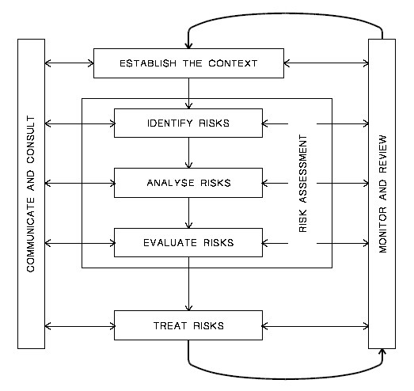
Risk Management Process
Source: AS/NZS 4360 2004: Risk Management
Marine Environmental, Observation, Prediction and Response Network

Slide 3
Maritime Activity and Risk Investigation Network
Spheres of Interest
Maritime Security: defending the coasts
Maritime Safety: responding to accidents
Environmental Protection: responding to spills
Coastal Zone Risk Management
Marine Environmental, Observation, Prediction and Response Network

Slide 4
Maritime Risk Model
RISK FACTORS
OUTCOME MEASURES
Type and Level of Activity
Likelihood of Occurrence of Marine Incident
Environmental Conditions
OVERALL RISK
Operator/Passenger Training
Severity of Incident
Regulations / Navigation and Safety Equipment
Marine Environmental, Observation, Prediction and Response Network

Slide 5
Maritime Activity Types
Commercial shipping
Commercial fishing
Commercial recreational
Aquaculture
Ferries
Cruise ships
Private recreational
Tugs
Government vessels
Marine Environmental, Observation, Prediction and Response Network

Slide 6
Four Examples:
Merchant shipping accident risk
Weather impact on commercial fishers
Maritime spill attribution
Canadian Arctic traffic projections
Marine Environmental, Observation, Prediction and Response Network

Slide 7
Example 1: Merchant Shipping Accident Risk
Chris Uremovich, M.A.Sc.
East coast merchant shipping
Marine Environmental, Observation, Prediction and Response Network

Slide 8
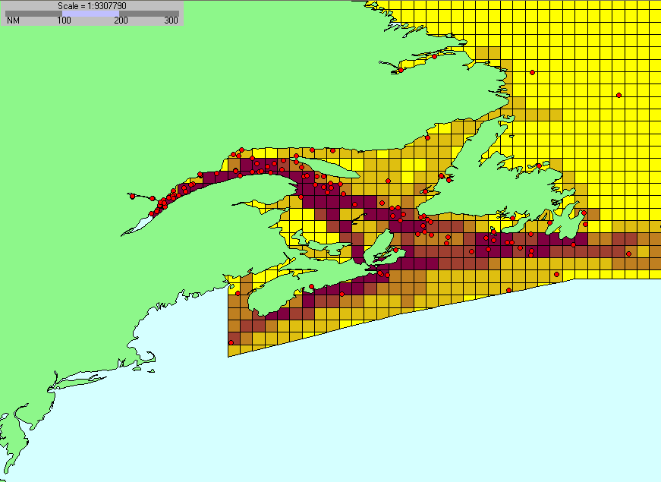
Merchant Shipping Incidents vs. Traffic

Slide 9
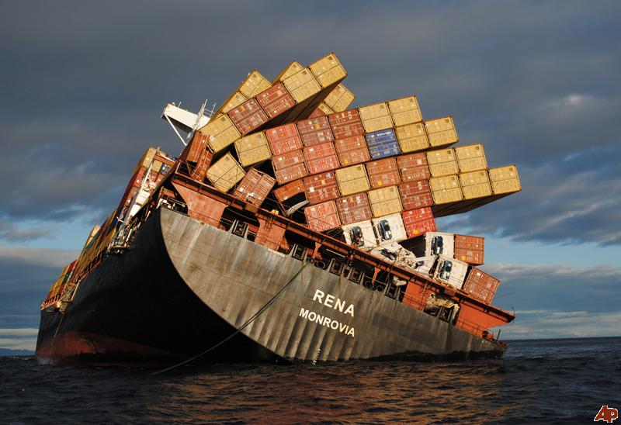
Problem: What vessel factors are related to merchant shipping incidents
Marine Environmental, Observation, Prediction and Response Network

Slide 10
Results
3 of these 5 factors are significant predictors: -Type of vessel (bulk, cargo or tanker) -Distance of trip (km) -Age of vessel (year) -Size of vessel (GT) -Vessel flag of registry
Accident rate using logistic regression:
Marine Environmental, Observation, Prediction and Response Network

Slide 11
Shipping Predictive Model

Slide 12
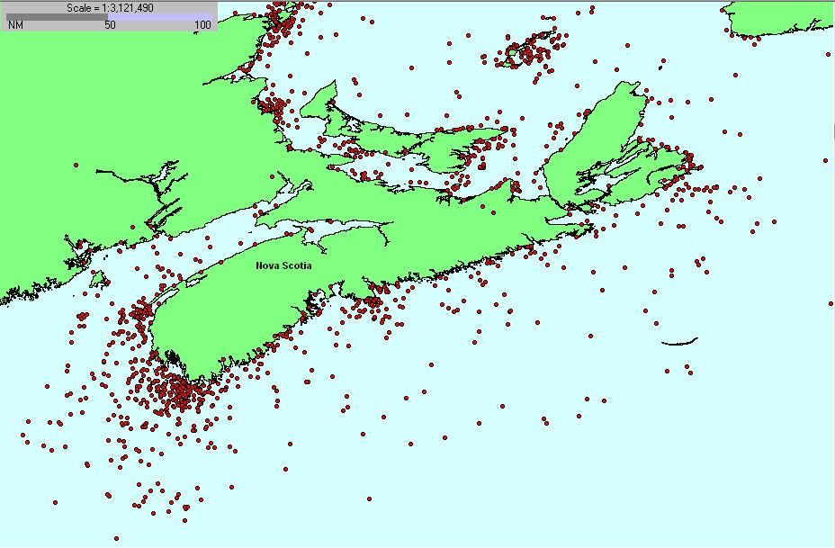
Example 2: Weather Impact on Commercial Fisheries
Helen Wu, Ph.D
Fishing incident distribution
Marine Environmental, Observation, Prediction and Response Network

Slide 13
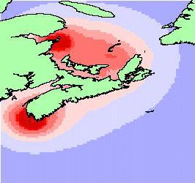
Fishing Incidents Density
Marine Environmental, Observation, Prediction and Response Network

Slide 14
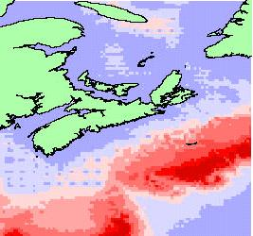
Fishing Incident Rate Distribution
Marine Environmental, Observation, Prediction and Response Network

Slide 15
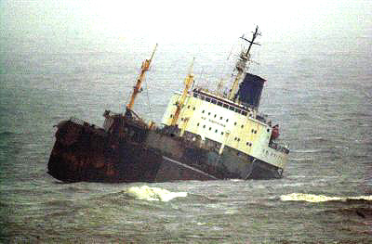
Problem: How are the fishing incident rates related to weather?
Results:
2 of these 6 factors are related to incident severity: -Wave Height (m)
-Ice Concentration (%) -Air Temperature (ºC)
-Amount of Precipitation (mm/day) -Sea Surface Temperature (ºC) -Fog Existence Indicator
Marine Environmental, Observation, Prediction and Response Network

Slide 16
Weather Drivers of Incident Rate
Marine Environmental, Observation, Prediction and Response Network

Slide 17
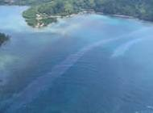
Problem: Maritime Spill Attribution
Andrew Szeto, M.A.Sc.
How can spatial analysis help identify the culprit for a mystery spill?
Marine Environmental, Observation, Prediction and Response Network

Slide 18
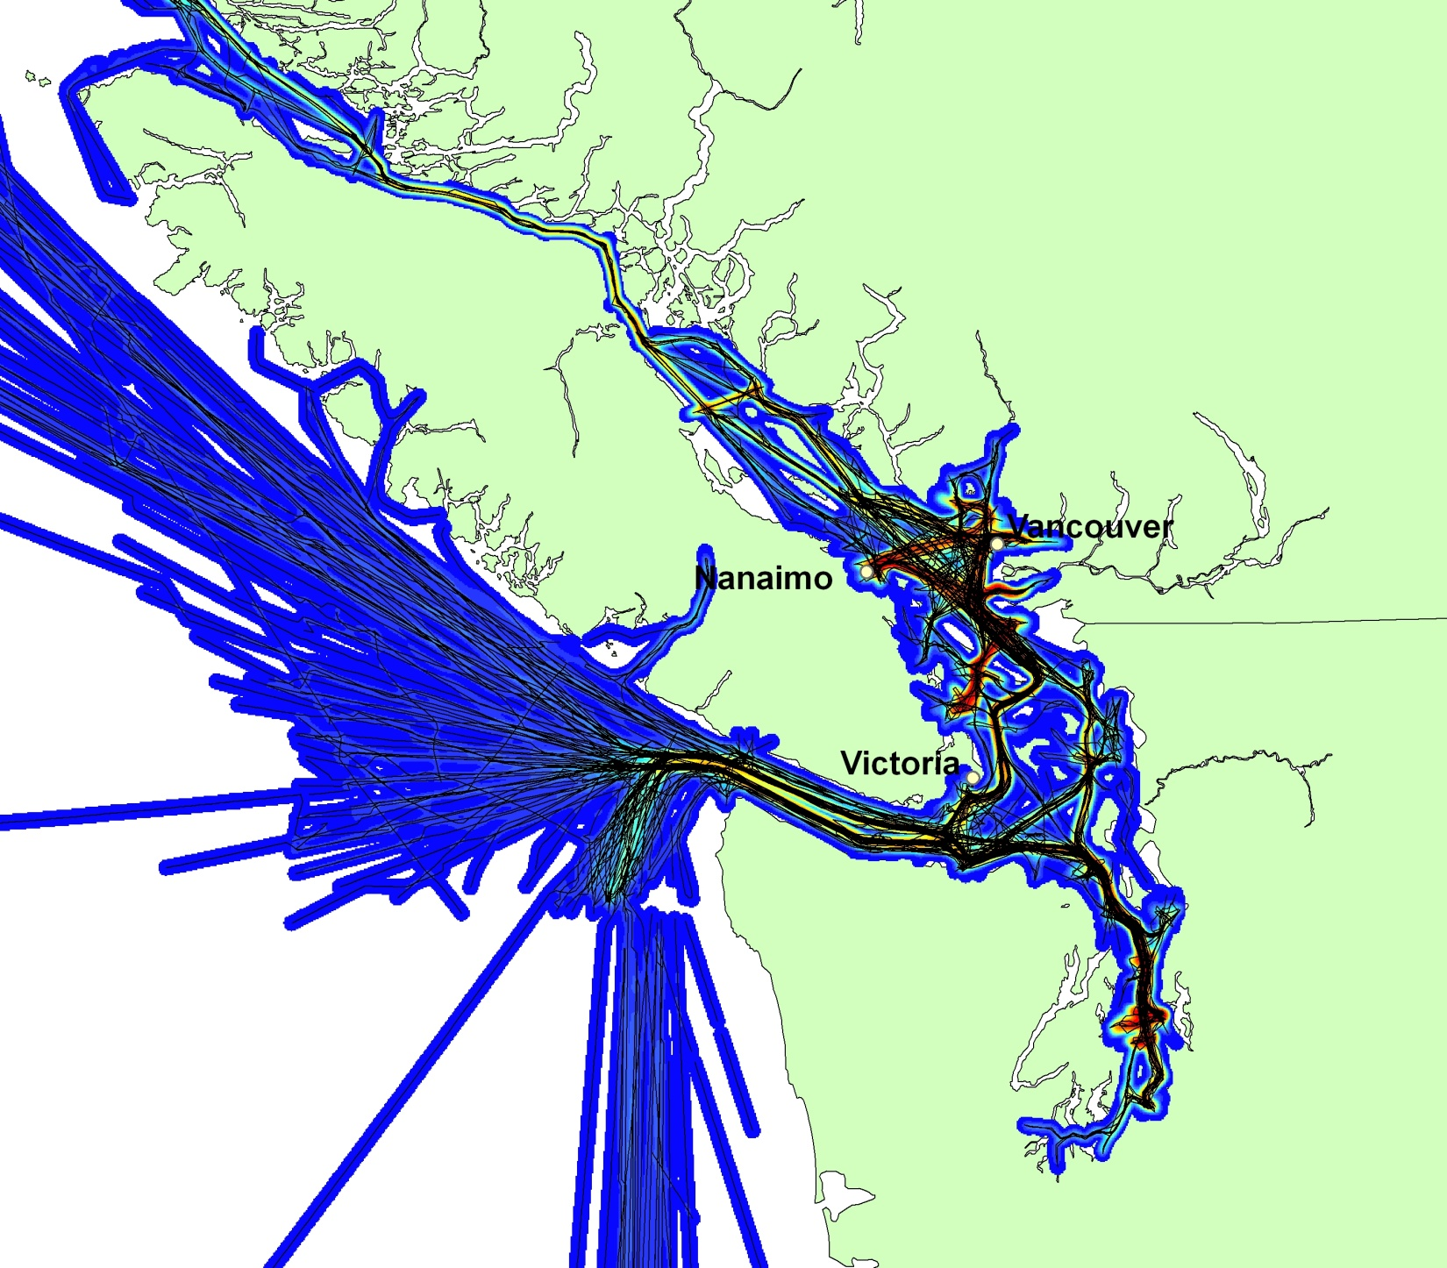
West Coast Shipping Routes
Marine Environmental, Observation, Prediction and Response Network

Slide 19
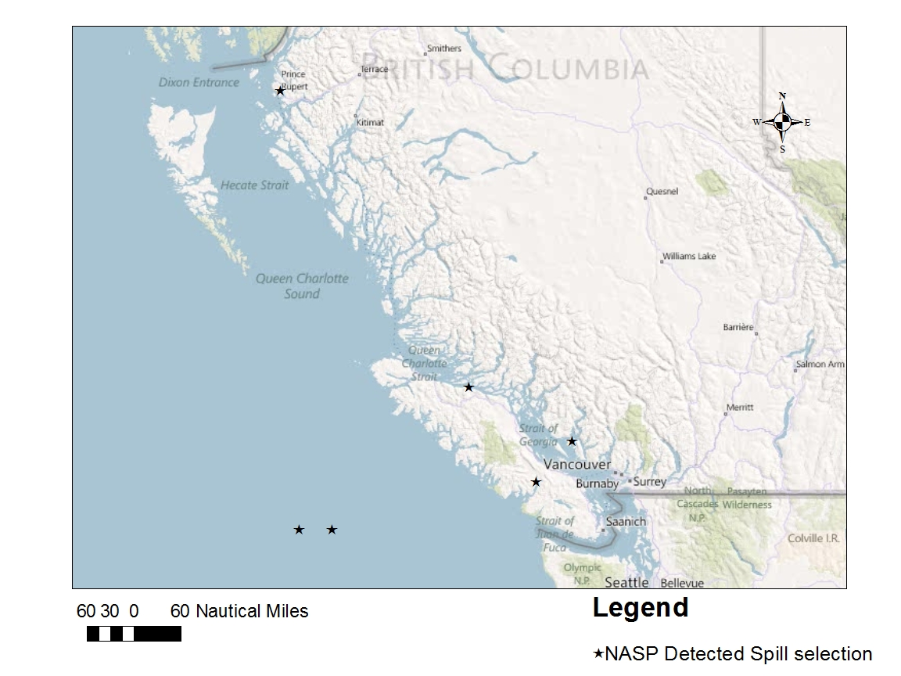
NASP Detected Spills 2011
Marine Environmental, Observation, Prediction and Response Network

Slide 20
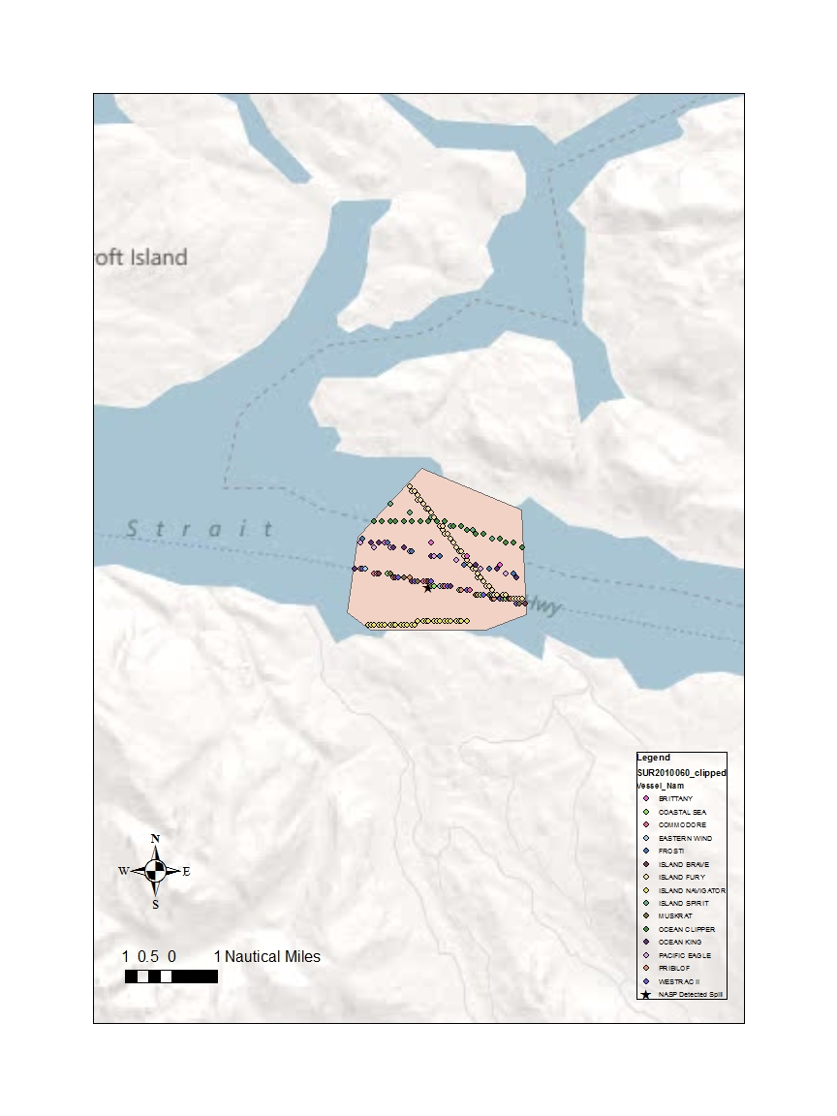
Intersection of Traffic & Spill
Marine Environmental, Observation, Prediction and Response Network

Slide 21
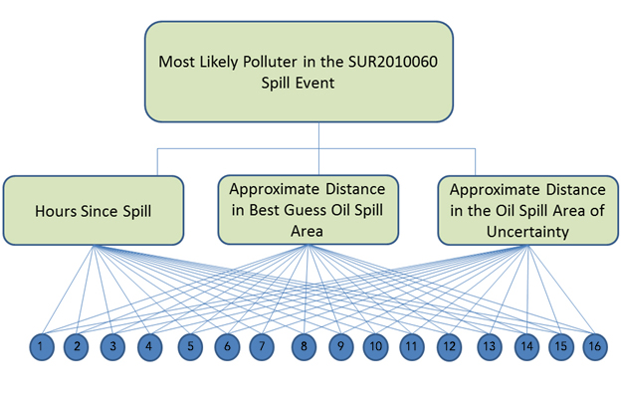
Multi-criteria Assessment to Rank Spill Source

Slide 22
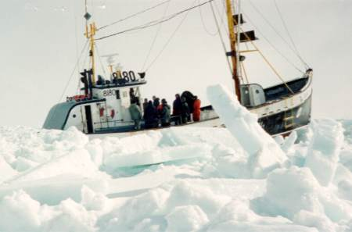
Example 4: Canadian Arctic Traffic Projections
Dr. Laurent Étienne Industrial Engineering
Project maritime traffic in 2020 in the Canadian Arctic by ship type, location and month
Marine Environmental, Observation, Prediction and Response Network

Slide 23
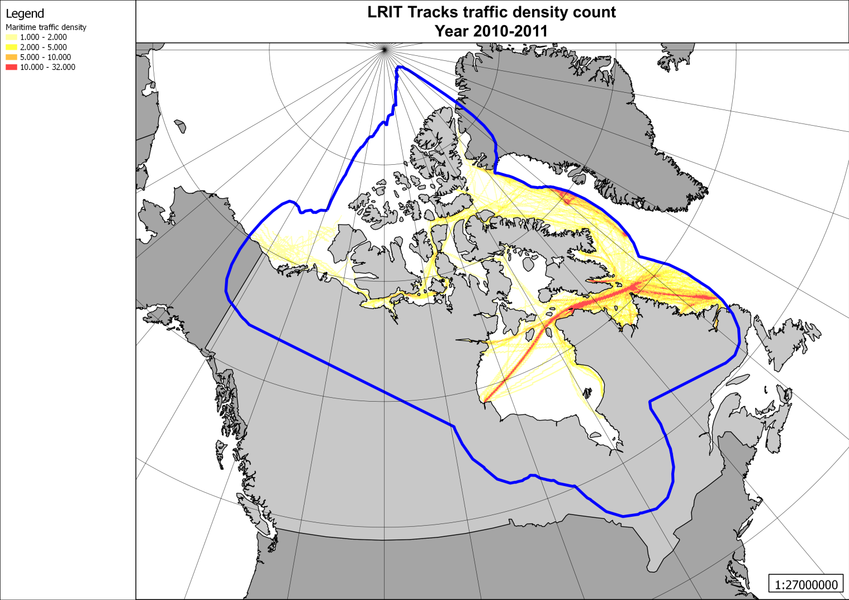
Current Traffic Density in the Arctic

Slide 24
Drivers for Changes in Arctic Traffic
Feasibility
-Ice melt (New routes, open longer)
Economic
-Natural resources (Mines, Oil & Gas, Fishing)
-Global transits (Time, Cost, Safety)
-Tourism
Other
-Sovereignty
-Safety and Security issues
Marine Environmental, Observation, Prediction and Response Network

Slide 25
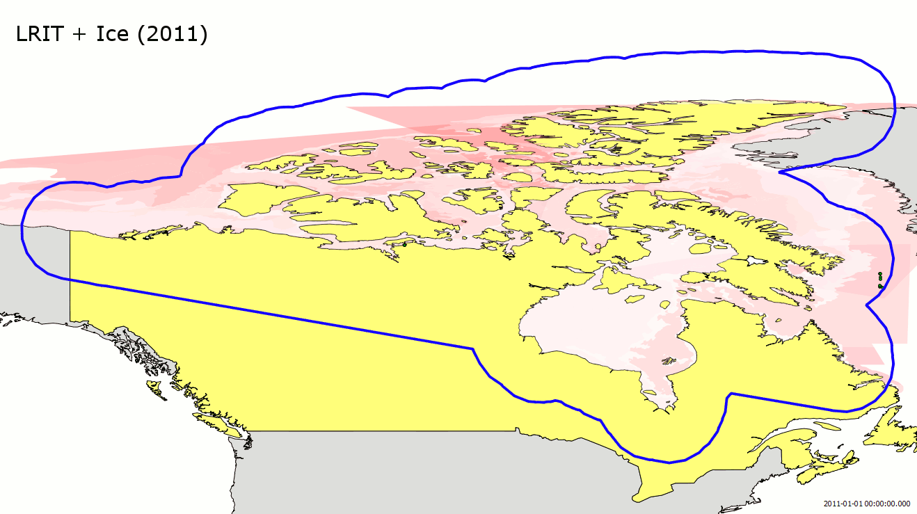
Sea Ice Conditions: Canadian Ice Services
Forms of Development | Stage of Development | Concentration

Slide 26
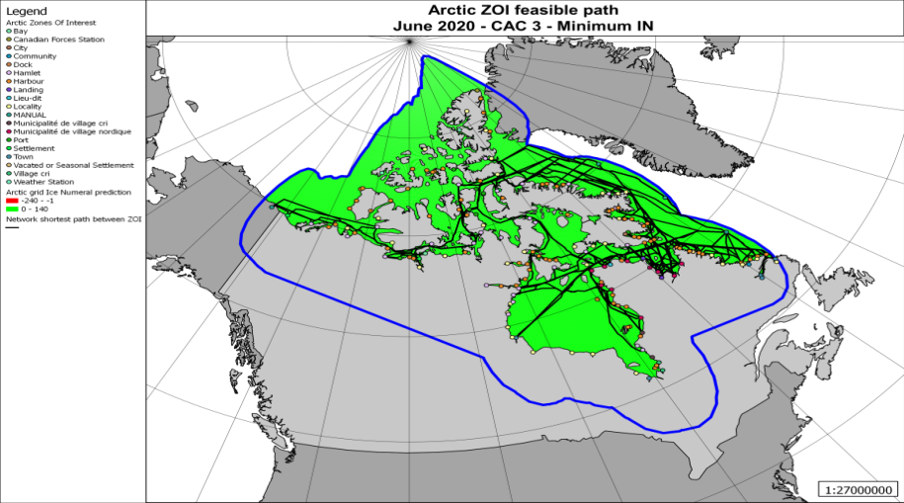

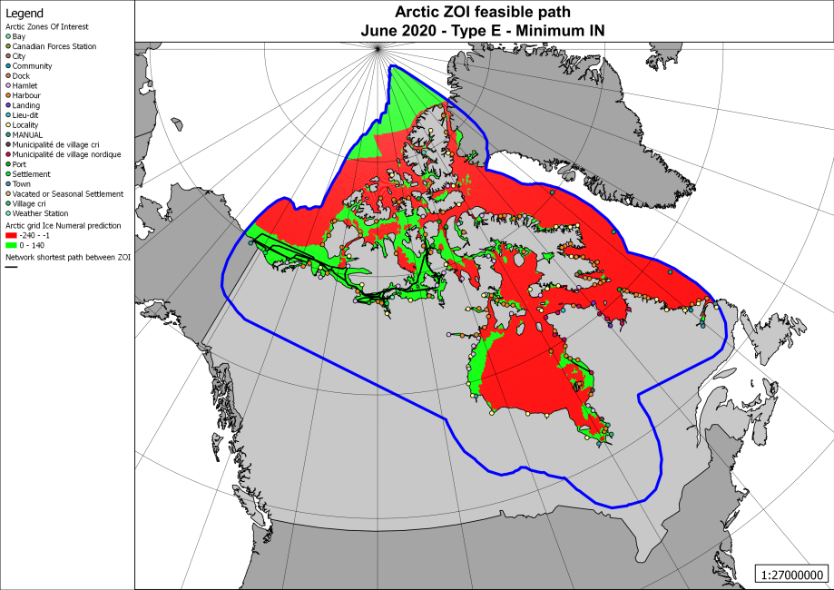
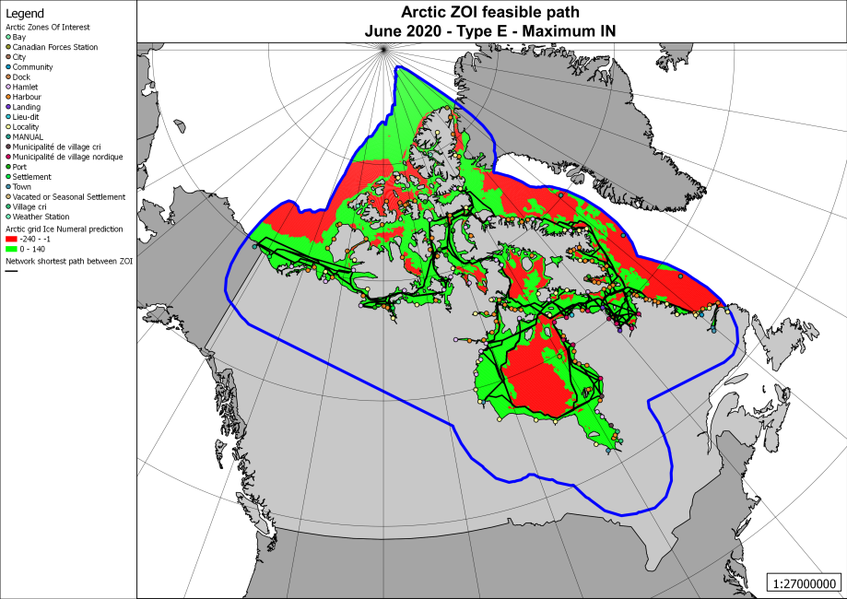
Shortest Path Results – June 2020
 | Minimum Ice Numeral | Maximum Ice Numeral
CAC 3
Type E

Slide 27
MEOPAR & Maritime Risks
Theme 1 Projects
- relocatable prediction model for large spills: drift and impact assessment
- improved risk maps for vulnerable areas using fixed system data and models for currents, waves, winds
Theme 2 Projects
- long-term changes in frequency, severity, and path of storms impacting fishing fleets and other maritime activities
Marine Environmental, Observation, Prediction and Response Network

