Slide 1
Maritime risk analysis
Ronald Pelot, Ph.D., P.Eng.
Department of Industrial Engineering
Dalhousie University
Ronald.Pelot@Dal.ca
www.marin-research.dal.ca

Slide 2
Risk to things on the water
Risk to things on the water
Traffic modelling (exposure)
Collision risk
Grounding (wind, waves, currents, bathymetry)
Spill drift: oil, HAZMAT
Recovery/SAR

Slide 3
Risk to things on the shore
Receptors
Infrastructure
People, animals
Ecosystems
Marine-related industries

Slide 4
Spheres of Interest
Maritime Activity and Risk Investigation Network
Maritime Security: defending the coasts
Maritime Safety: responding to accidents
Environmental Protection: responding to spills
Coastal Zone Risk Management

Slide 5
Maritime Risk Model
RISK FACTORS
OUTCOME MEASURES
Type and Level of Activity
Likelihood of Occurrence of Marine Incident
Environmental Conditions
OVERALL RISK
Operator/PassengerTraining
Severity of Incident
Regulations / Navigation and Safety Equipment

Slide 6
Activity Types
Commercial shipping
Commercial fishing
Commercial recreational
Aquaculture
Ferries
Cruise ships
Private recreational
Tugs
Government vessels

Slide 7
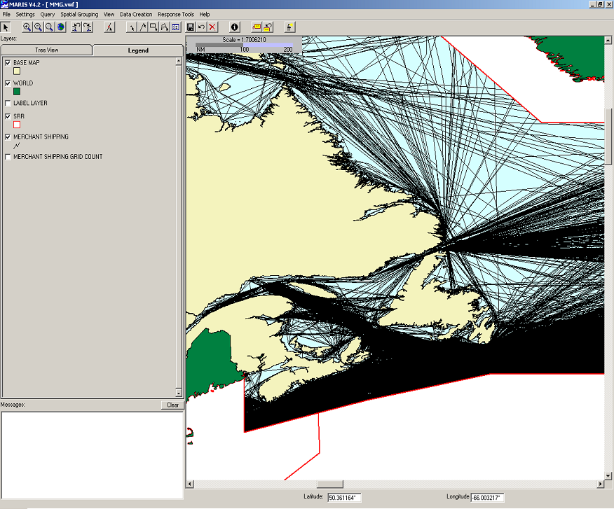
East Coast Merchant Shipping

Slide 8
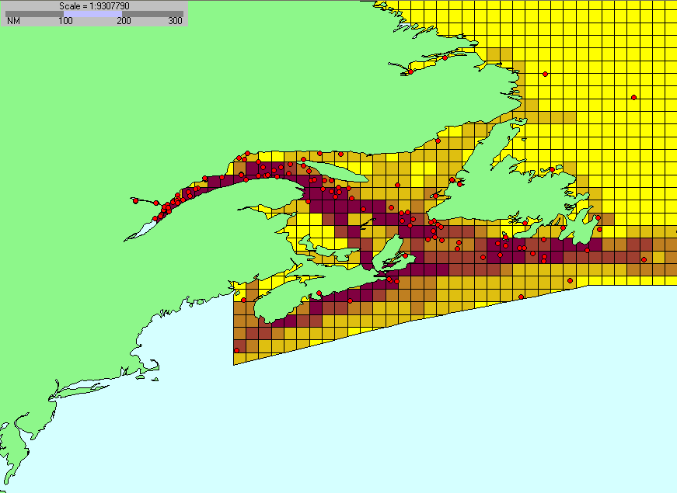
Merchant Shipping Incidents vs traffic

Slide 9
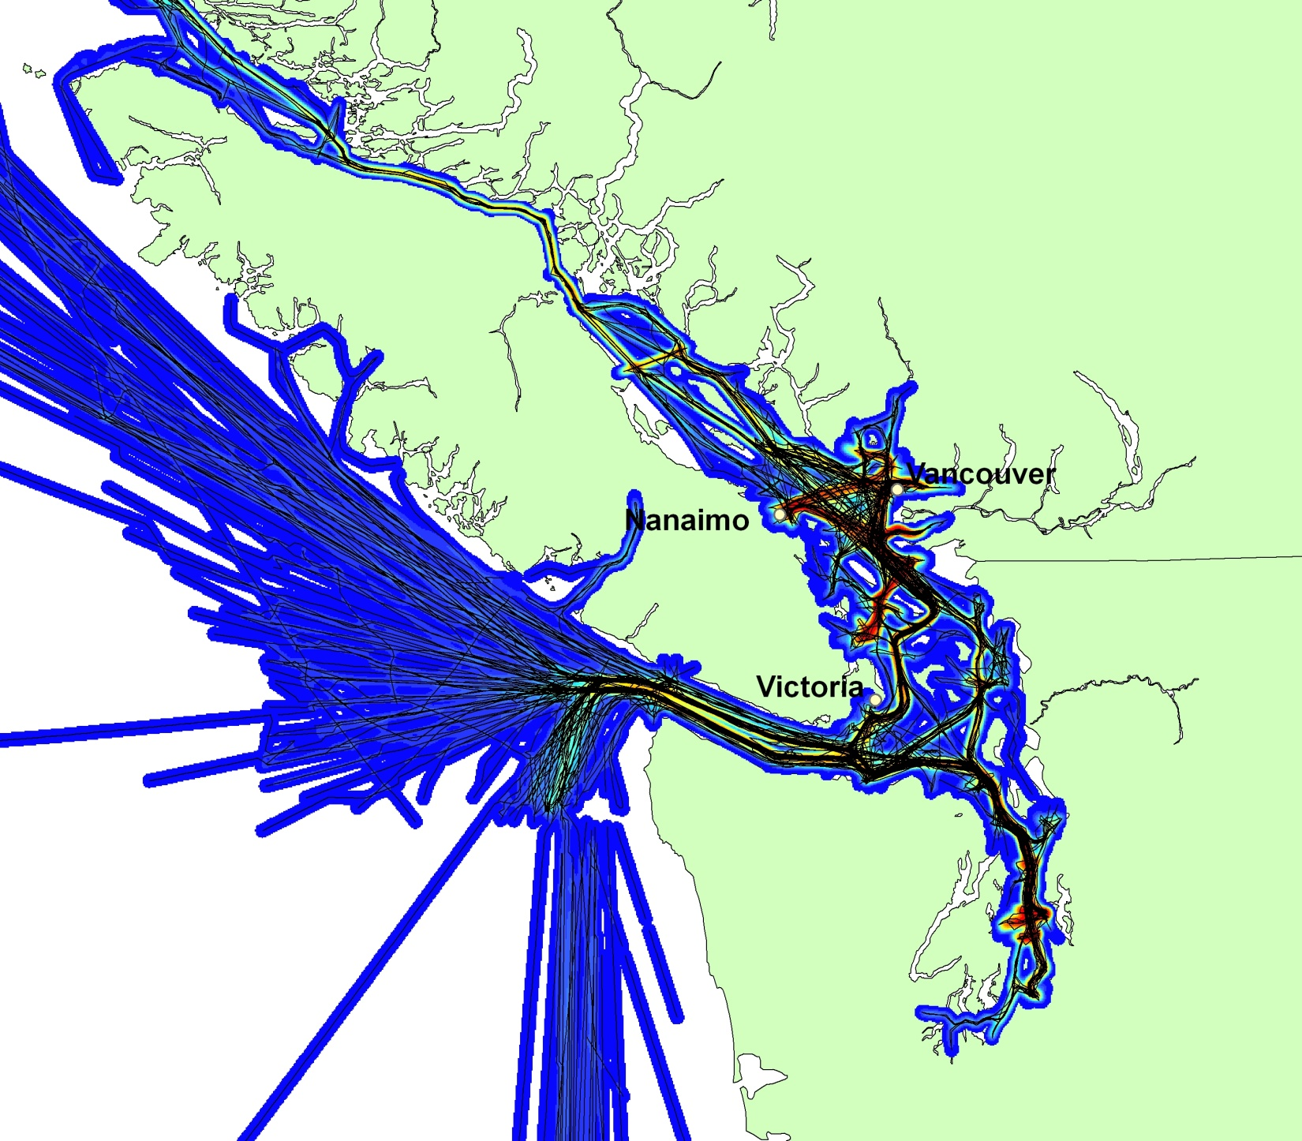
West Coast shipping: typical route identification

Slide 10
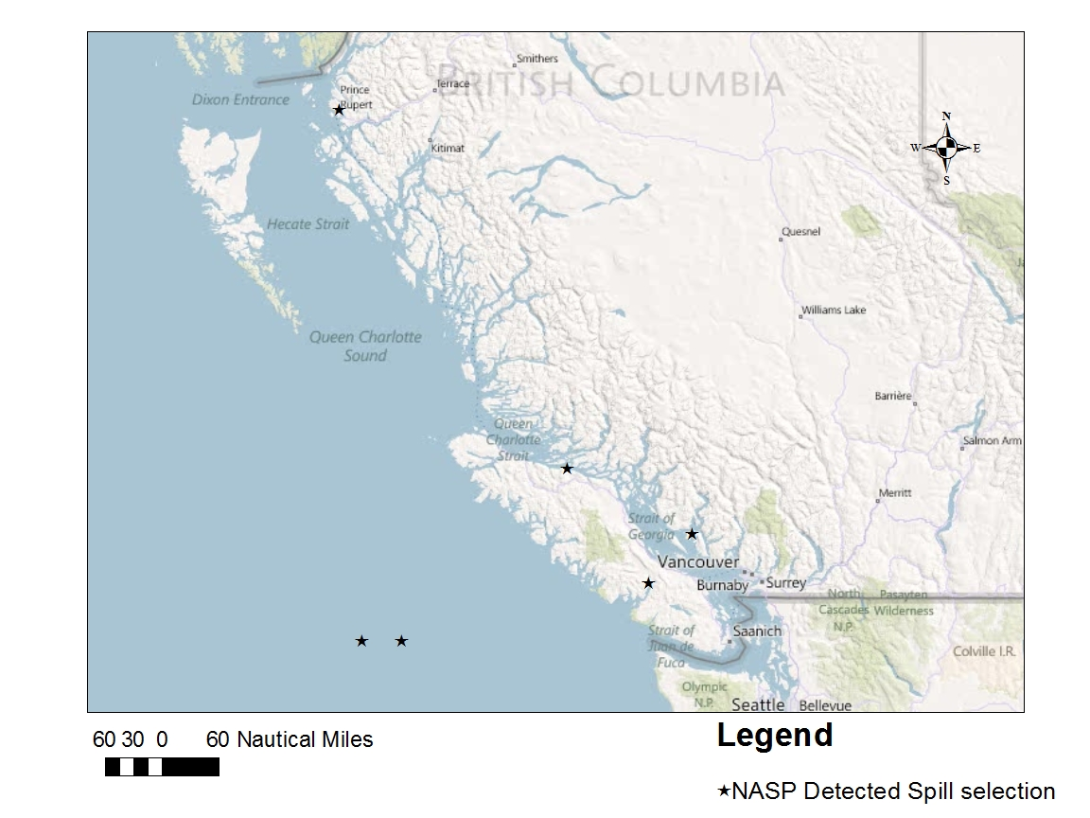
NASP detected spills 2011

Slide 11
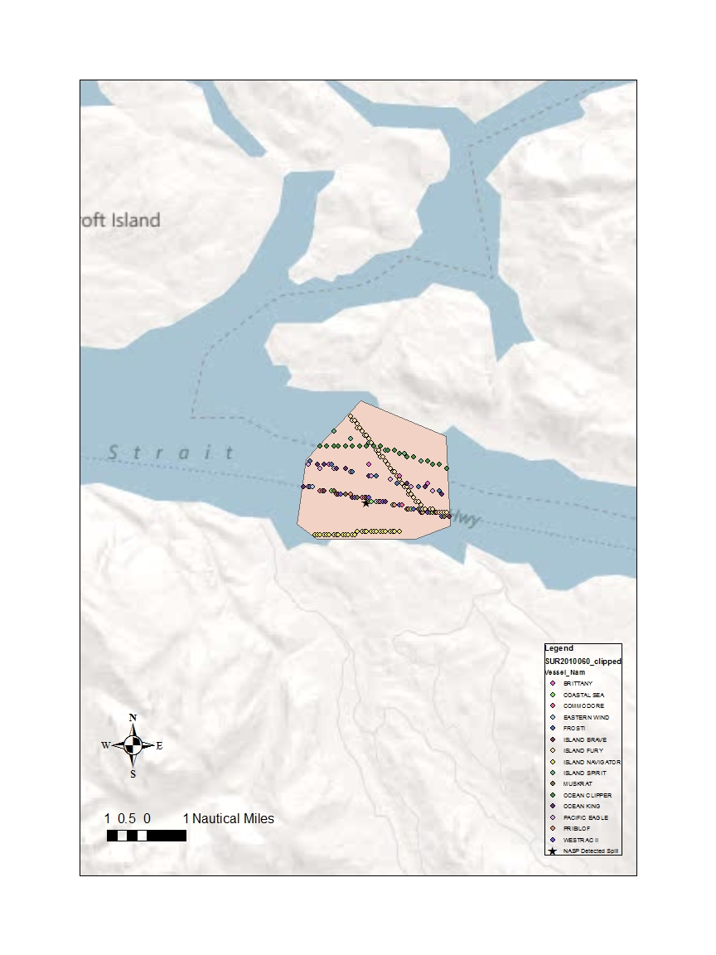
Intersection of traffic and spill

Slide 12
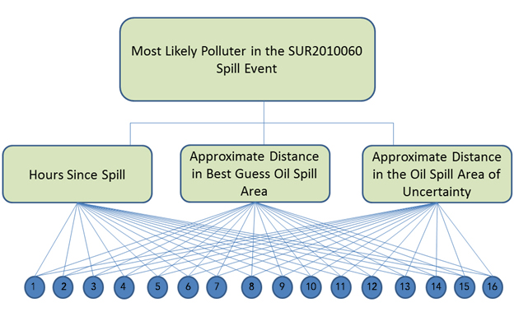
Multi-criteria assessment to rank spill source

Slide 13
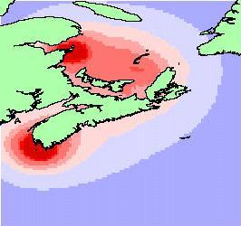
Fishing Incidents Density

Slide 14
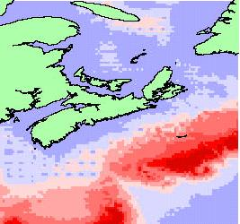
Fishing Incident Rate Distribution

Slide 15
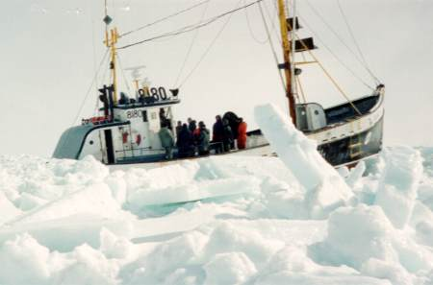
Example How are the fishing incident rates related to weather conditions?
Results 2 of these 6 factors are related to incident severity Wave Height (m) Ice Concentration (%) Air Temperature (ºC) Amount of Precipitation (mm/day) Sea Surface Temperature (ºC) Fog Existence Indicator

Slide 16
Weather drivers of incident rate

Slide 17
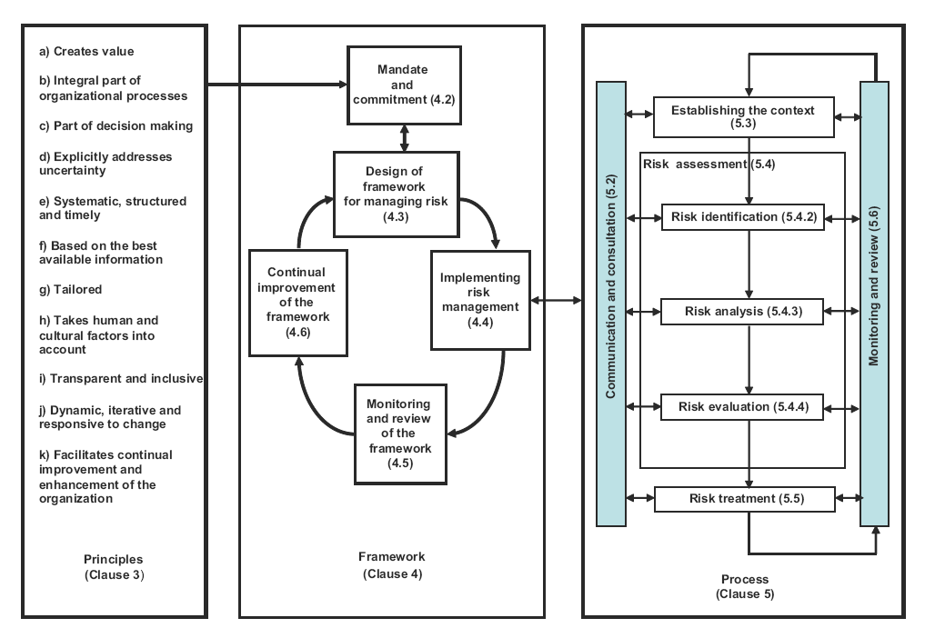
AS/NZS ISO 31000:2009 Risk management—Principles and guidelines

Slide 18
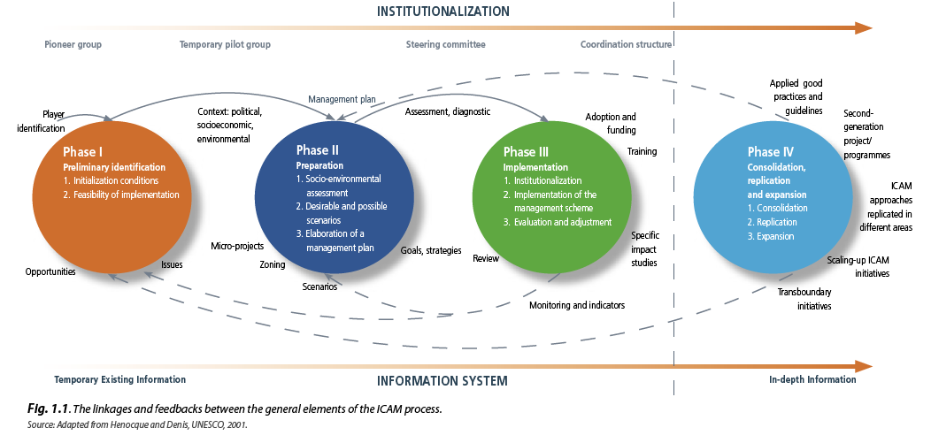
HAZARD AWARENESS AND RISK MITIGATION in INTEGRATED COASTAL AREA MANAGEMENT
Intergovernmental Oceanographic Commission
Manuals and Guides No 50
ICAM Dossier No 5, 2009
http://ioc-unesco.org/

Slide 19
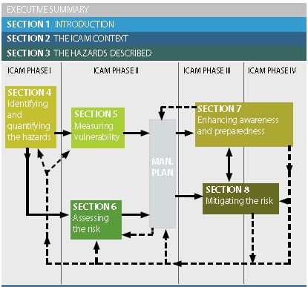
Risk Management in ICAM

Slide 20
MEOPAR: Spatial Risk and MCDM
Receptors, vulnerability
Rapid assessment of SE values and impacts during an emergency
Risk perception; uncertainty
Risk communication

