Slide 1

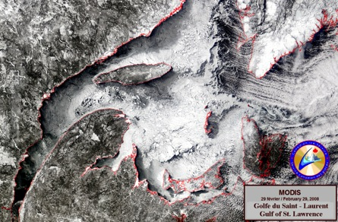
Update on CONCEPTS Global and Regional Systems
Gregory Smith
Meteorological Research Division, Environment Canada
Institute of Ocean Sciences, October 22-23, Sidney, BC
Notes:
1

Slide 2
Overview of environmental prediction systems
Current systems:
Gulf of St. Lawrence Coupled Forecasting System
Regional Ice Prediction System for North America
Global Ice-Ocean Prediction System
Systems in development
Regional Ice-Ocean Prediction System
  CREG36 East and West
  FVCOM west
Coupled Regional Ensemble Prediction System
Coupled Global Ensemble Prediction System
Monthly forecasting system
Seasonal forecasting system

Slide 3
Overview of environmental prediction systems
Current systems:
Gulf of St. Lawrence Coupled Forecasting System
Regional Ice Prediction System for North America
Global Ice-Ocean Prediction System
Systems in development
Regional Ice-Ocean Prediction System
  CREG36 East and West
  FVCOM west
Coupled Regional Ensemble Prediction System
Coupled Global Ensemble Prediction System
Monthly forecasting system
Seasonal forecasting system

Slide 4
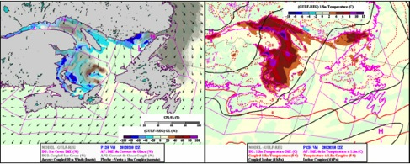
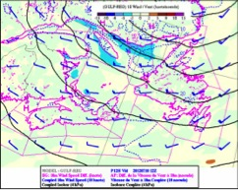
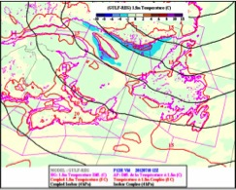
Gulf of St. Lawrence Coupled Atm-Ice-Ocean Forecasting System
Coupled – Uncoupled differences
Operational since June 2011
  48 forecast daily at 00Z
Coupled system:
  Atm: GEM (10km)
  Ice: CICE (5km)
  Ocean: MoGSL (5km)
New system (in development):
  GEM (2.5km)
  NEMO-CICE-WW3 (1km)
  Including Great Lakes
Mar. 10, 2012
Sea Ice
2m Temperature
Jul. 10, 2012
10m Winds
2m Temperature
15km, 58 levels

Slide 5

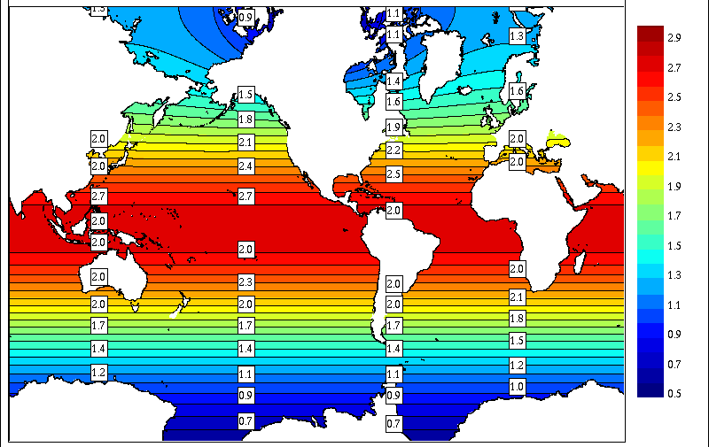
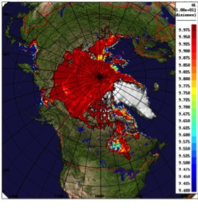
CONCEPTS Global Ice-Ocean Prediction System
Mercator Ocean Assimilation System (SAM2):
  Sea surface temperature (CMC analysis)
  Temperature and salinity profiles
  Sea level anomaly from satellite altimeters
3DVar Ice analysis:
  SSM/I, SSM/IS, ASCAT, CIS charts, Radarsat image analyses
Daily blended ice-ocean analysis and 10day forecasts
Model configuration:
  ORCA025 (~1/4°), 18km around Kitimat
  NEMOv3.1++, CICEv4.1
Accepted for experimental implementation in June 2013
Purpose:
  Boundary conditions for regional METAREA system
  Initialize seasonal forecasts
  Emergency response
  Global coupled forecasting

Slide 6
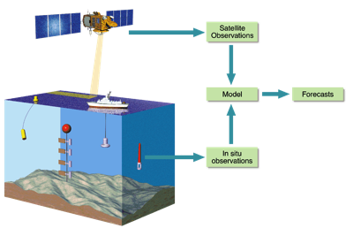
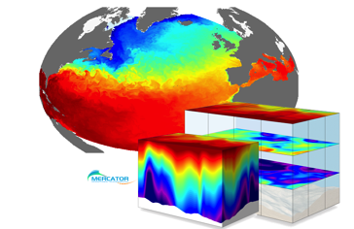
Mercator-Océan
1/4° Global system (PSY3)
  Operational since April 2008
1/12° Global system (PSY4)
  Operational since Feb. 2011
Produces weekly analysis and 10 day forecasts
Global Forecasting Centre for EU MyOcean project.
Lead member in MyOcean2 to develop European Centre for Ocean Modelling and Prediction (ECOMP)

Slide 7

Ocean data assimilation
Système d’Assimilation Mercator (SAM) v2
SAM2 assimilates :
  Sea surface temperature (from both satellite and in situ observations)
  Subsurface temperature and salinity (from Argo, CTD, XBT, moorings, marine mammals)
  Sea level anomalies from satellite altimeters (AVISO)
Altimeters:
Jason 2
Cryosat2
Altika
Notes:
7
L'assimilation des données océanographiques est l'une des faiblesses du « PA » du golfe du Saint-Laurent.
En collaborant avec Mercator, nous aurons à notre disposition un système d'analyse océanique parfaitement au point et à la fine pointe de la technologie.
De plus, on aura un cadre de collaboration en vue des développements futurs (p. ex., nouvelles sources de données).
Maintenant : Montre quelques diapositives sur Mercator pour illustrer les types d'activités qu’on aimerait réaliser au Canada dans le cadre de CONCEPTS.

Slide 8
Mercator SAM2v1 Assimilation System
Reduced-order Extended Kalman Filter (~SEEK)
Error covariance matrix is represented by an ensemble of anomalies from a reference simulation:
  240 multivariate modes with SSH, T, S, U, V
Adaptivity:
  Background error variance adjusted at each assimilation cycle to be consistent with innovation statistics (Talagrand, 1998)
Localization applied
  e.g. Houtekamer and Mitchell, 2001
  Spatially-varying decorrelation radii used
Spatially varying representivity error for all observation types

Slide 9
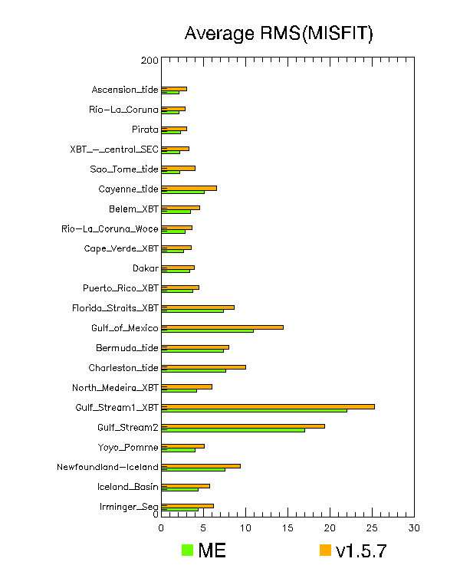
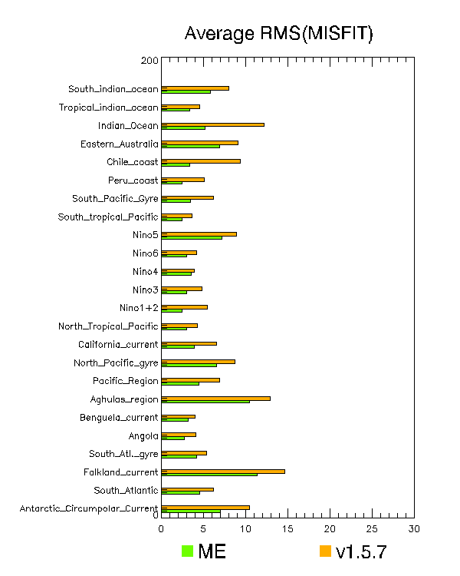
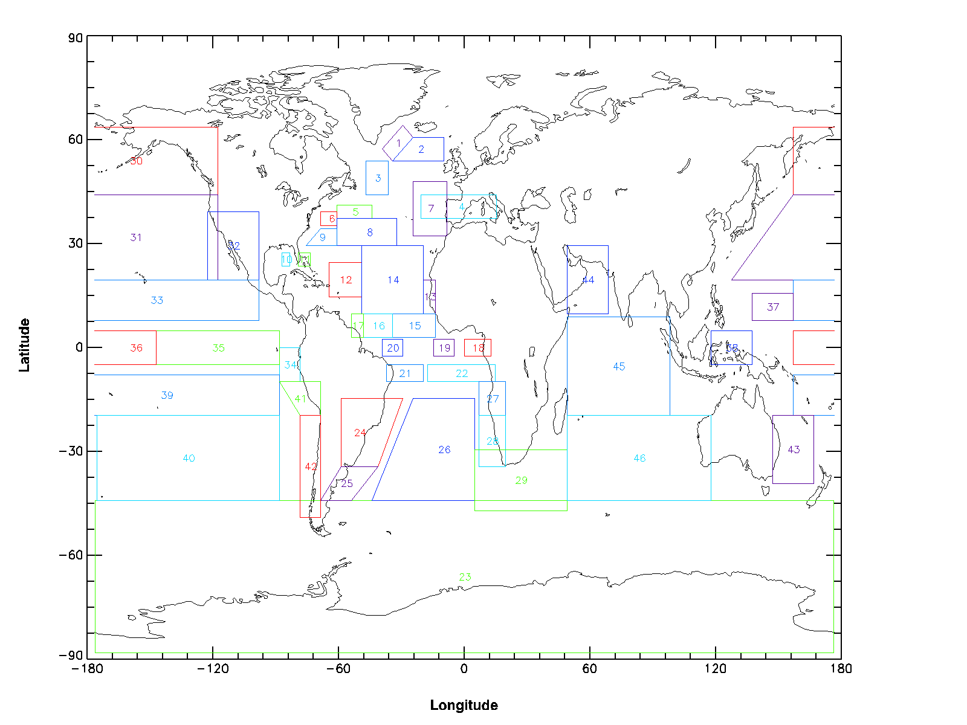
Evaluation of innovation statistics
Obs-trial sea level anomaly misfits for 2011
Comparison of statistics for GIOPS and Mercator PSY3V3
  iweb/~afsgdsc/sam2diag_validation.html
Notes:
Add QuoVadis comparison of PSY3V3 and PSY3V2

Slide 10
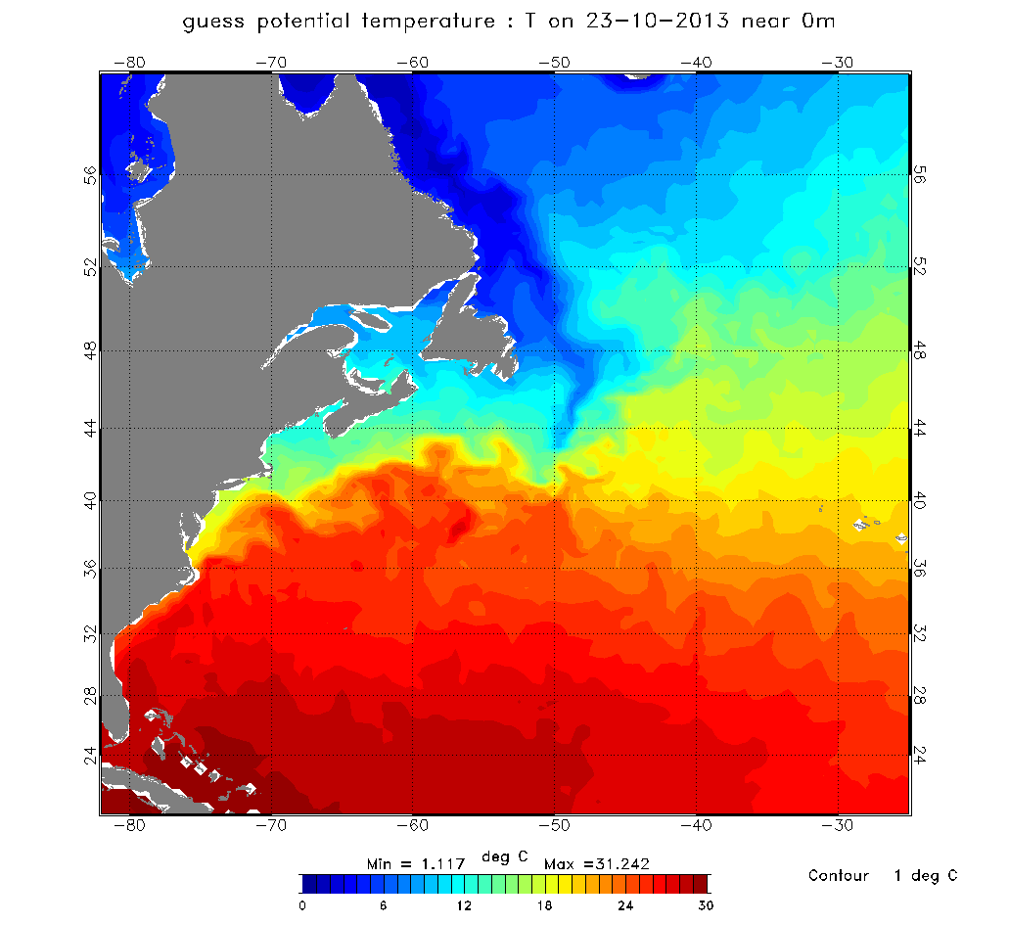
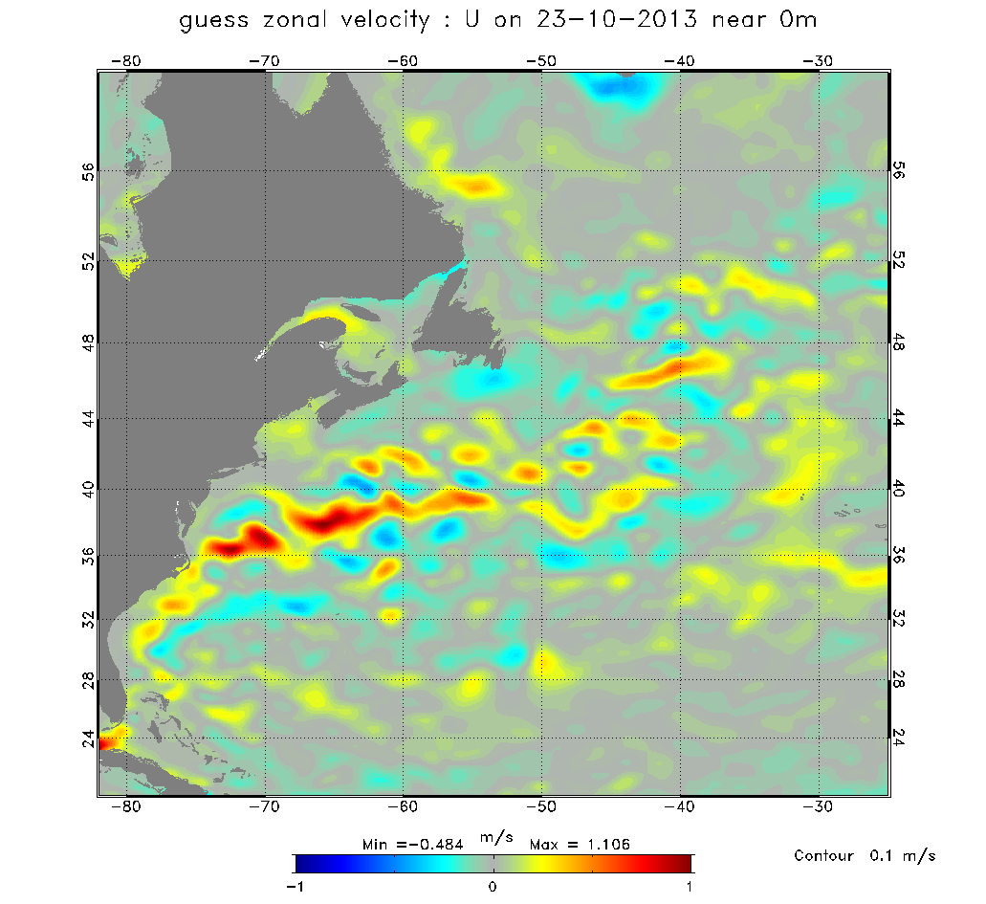
GIOPS Monitoring site
http://iweb.cmc.ec.gc.ca/~afsgdsc/TEP_BUL/20131023/giops100/

Slide 11
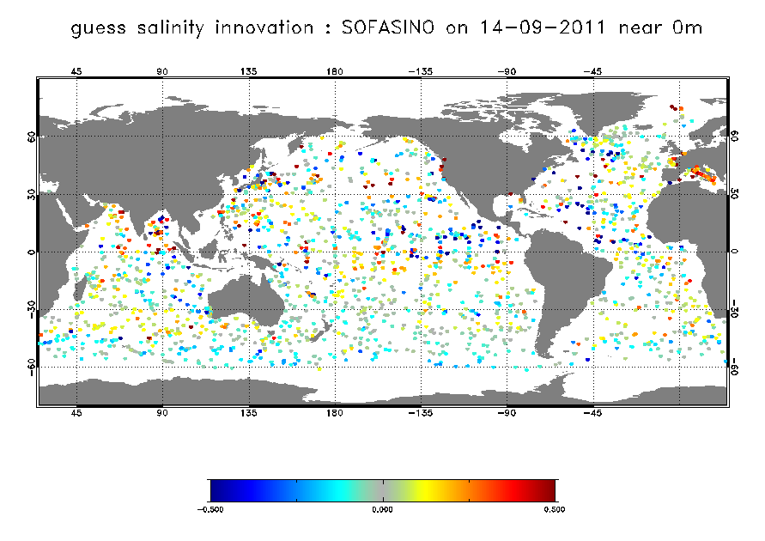
Evaluation of innovation statistics
Obs-trial salinity misfits for 20110914
Notes:
Add QuoVadis comparison of PSY3V3 and PSY3V2

Slide 12
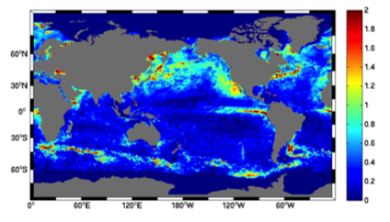
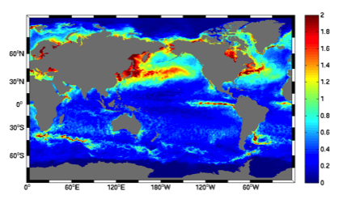
Evaluation against GIOPS analyses
RMS differences for 2011-06-01 to 2011-08-31
Mean differences after 7 days for boreal summer
  Other seasons show smaller differences
Forecasts better than persistence almost everywhere
Particular skill in northern midlatitudes
Fcst
Pers

Slide 13
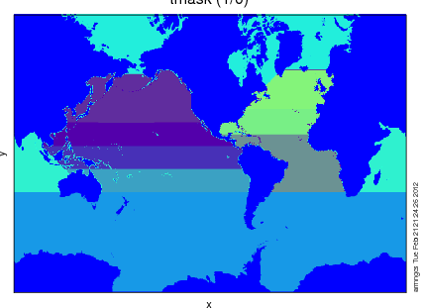
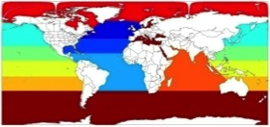
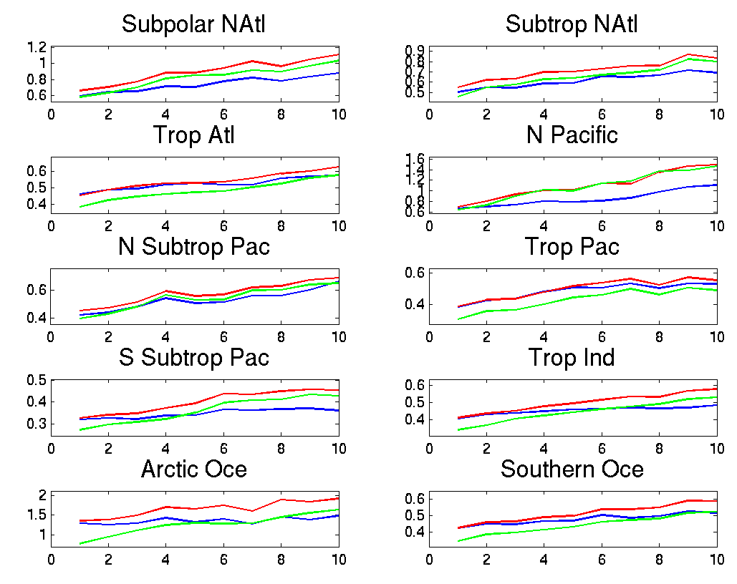
Regional RMS differences with AVHRR SST
Evaluated using forecasts for 2011-06-01 to 2011-08-31
Forecasts
Persistence of GIOPS analyses
Persistence of CMC analyses
Forecasts beat persistence of SAM2 analysis for all regions
Forecasts have lower RMS than persistence of CMC for most regions
Challenge to better constrain SST in polar regions
Bias correction may be required to improve tropical forecasts
Notes:
New version

Slide 14
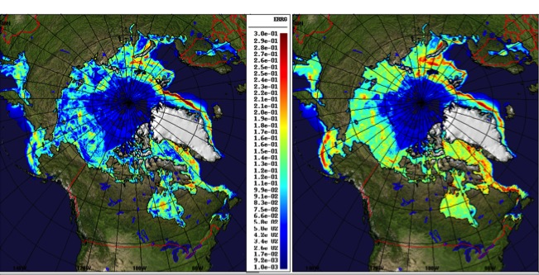
Evaluation against 3DVAR ice analyses
Weekly forecasts for 2011 (50 total), lead time of 168h
GIOPS
3DVAR Pers
Forecasts show lower RMS errors than persistence over most regions
Largest forecast errors East of Greenland, Baffin Bay, Hudson Bay and Barents/Kara Sea
Notes:
V1.5.7

Slide 15
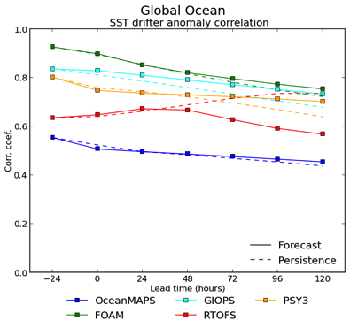
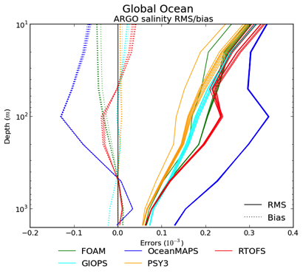
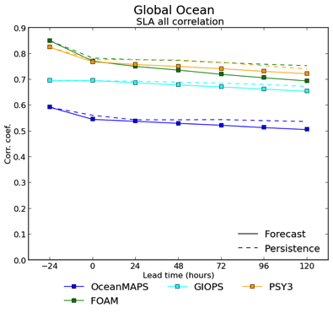
GODAE Oceanview Intercomparison
Intercomparison of various global systems:
  UK Metoffice (FOAM)
  Mercator (PSY3)
  CMC (GIOPS)
  US Navy (RTOFS)
  Aus BofM (OceanMAPS)
Near real-time comparison against shared data sets:
  Sea level anomaly
  In situ obs (T&S)
  Sea surface temperature

Slide 16
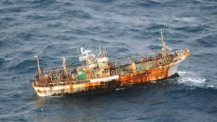
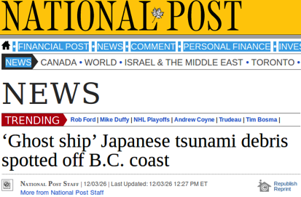
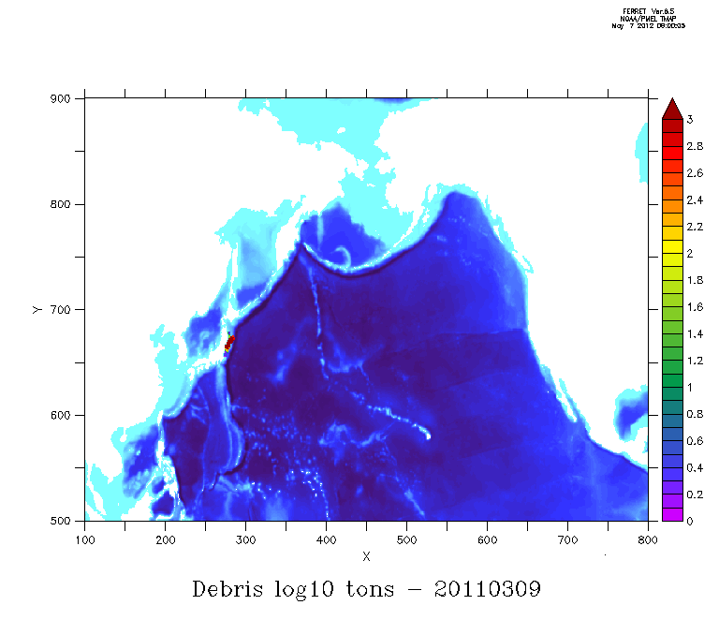
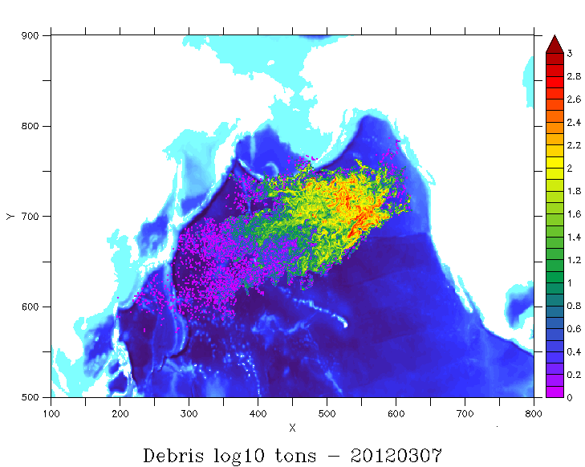
Environmental Emergency Response
Search and Rescue
Oil spills
Drift of pollutants
Risk assessment
  « What if? » scenarios
Example:
  Drift projection of debris from 2011 Japanese Tsunami

Slide 17
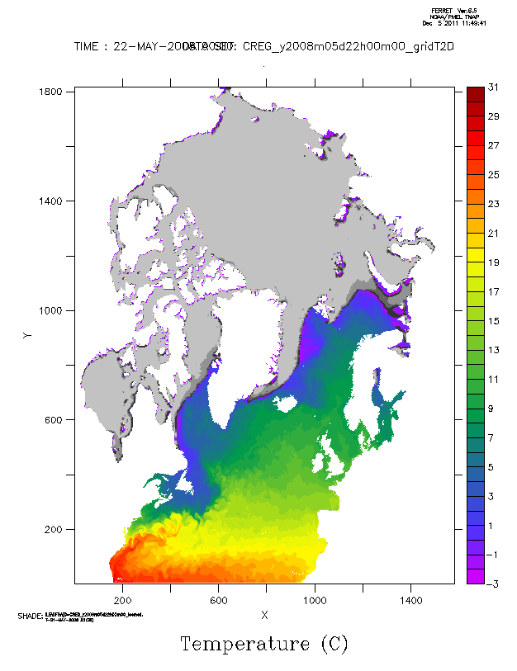
Regional Ice-Ocean Prediction System
Couple RIPS to NEMO
  3-8km Arctic/N.Atl configuration (CREG12)
SAM2 ocean assimilation (SEEK) with 3DVar ice assimilation
Expected experimental implementation of forecast system for March 2014

Slide 18
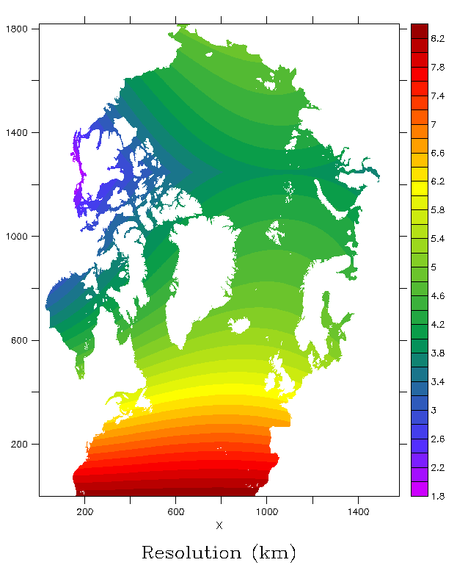
Regional Ice-Ocean Prediction System
Couple RIPS to NEMO
  3-8km Arctic/N.Atl configuration (CREG12)
SAM2 ocean assimilation (SEEK) with 3DVar ice assimilation
Expected experimental implementation of forecast system for March 2014

Slide 19
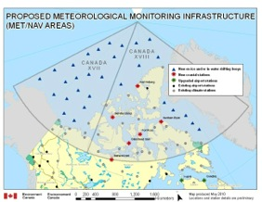
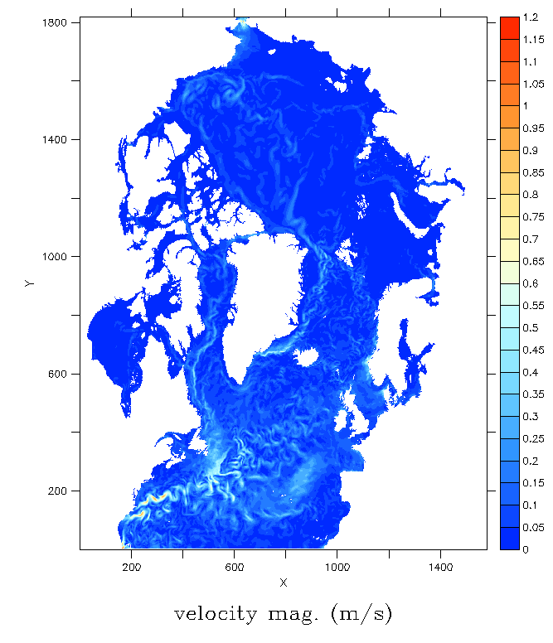
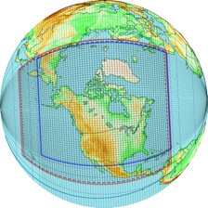
METAREA Integrated Marine Prediction System
Coupled atmosphere-ice-ocean-wave-snow model
  GEM (15km), NEMO-CICE(3-8km), WW3
  2-3 day forecasts
Expected implementation:
  March 2015
GEM REPS
15km
CREG12

Slide 20
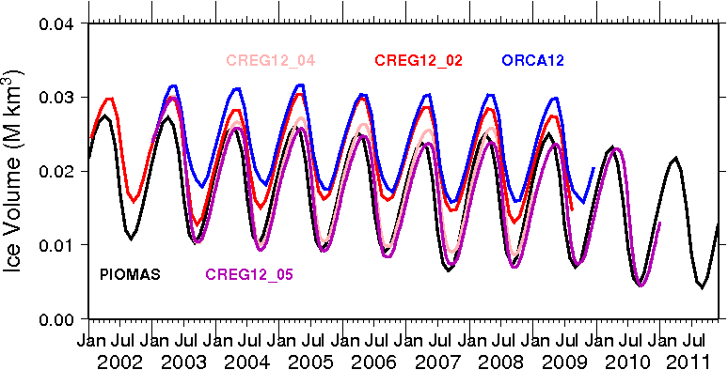
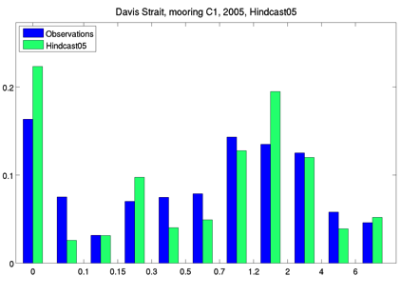
Multi-annual forced runs
5 Hindcasts over 2002-2011 now completed
Detailed evaluation of:
  water mass properties
  freshwater storage
  circulation
  ice area, thickness and drift
Beginning work on high-resolution analysis system for CREG12 in collaboration with Mercator

Slide 21
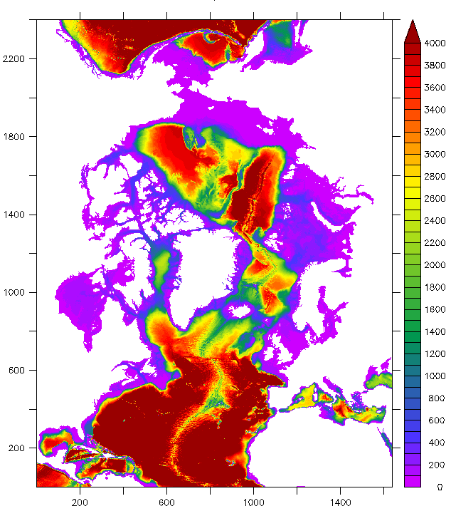
CREG12 Extension
Considering how to extend the CREG12 grid into Pacific
  How far south is required?
Possible extension in Atlantic as well
  Improve Gulf Stream separation

Slide 22
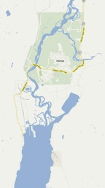
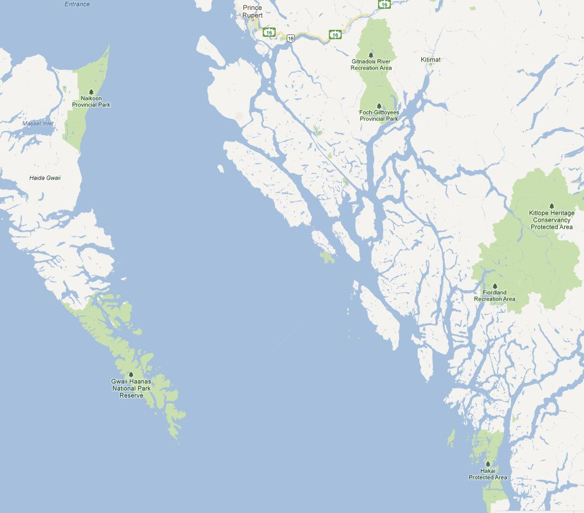
FVCOM Region of Interest….
Dixon Entrance
Coast pilot station at triple Is
Kitimat
Douglas Channel (90km long)
Principe Channel
Wright Sound
Kemano
Hecate
Strait
Proposed main route (northern)
Proposed alternate routes (southern)
Coast pilot station at Pine Is. Or Cape Beale
Notes:
Roughly show region for the initial FVCOM grid
Point out Kemano for future reference

Slide 23
Products available
GIOPS
  Weekly analyses and 10day forecasts (2010-present)
  Daily analyses and 10day forecasts (2011, 2013-present)
Mercator Glorys2v3 reanalysis
  3day (or monthly) mean fields for 1992-2011
RIOPS
  Standard grid hindcasts 2002-2011
  Weekly forecast trials for 2011
  Extended grid hindcast could be started at any time

Slide 24
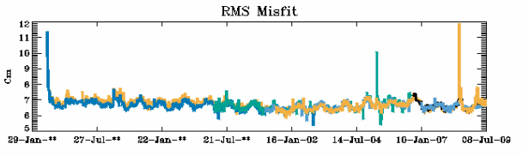
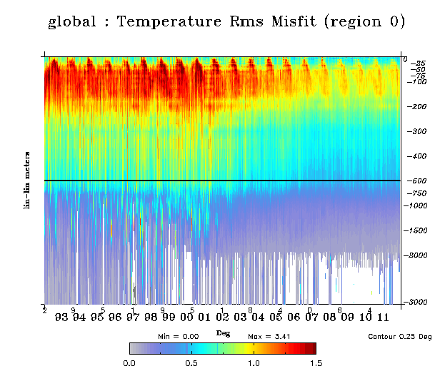
Glorys2v3 Ice-ocean Reanalysis (1992-2011)
Altimetry
Rms misfit
Reanalysis produced using full SAM2 assimilation system
Essentially the same system as GIOPS with a few added features
Forced by ERAInterim with corrections to radiation and precipitation
ARGO is getting in
In-situ
Temp
Notes:
24

Slide 25
Timeline
GIOPS Operational (2014)
RIOPS Forecast System Experimental (2014)
RIOPS Analysis System Experimental (2015)
RIOPS-REPS Coupled Ensemble Forecasts (2015)
CREG36 East (2015)
CREG36 Pac-Arc-Atl ~2018
FVCOM west (~2018)

Slide 26
