Slide 1
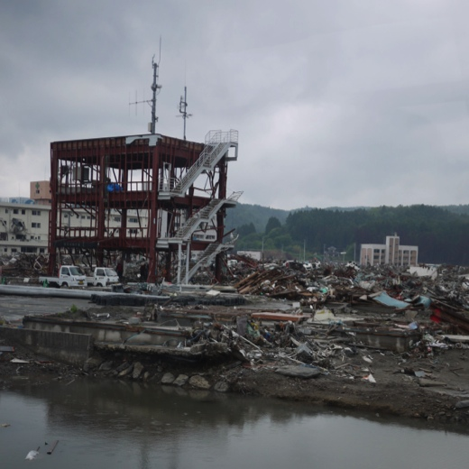
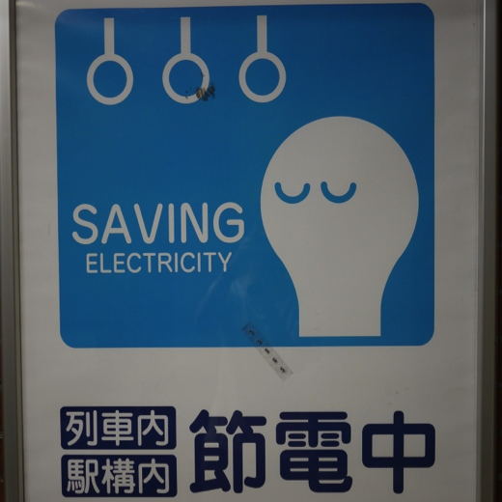
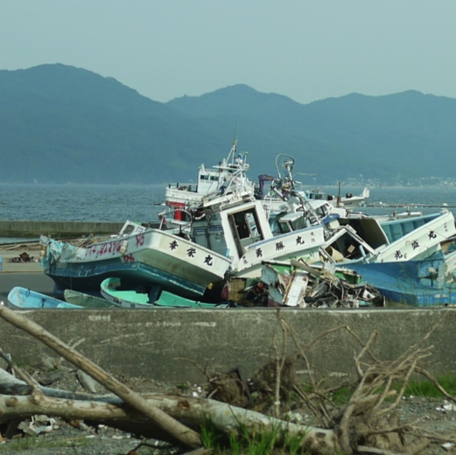
Stephanie E. Chang
Professor, SCARP and IRES, UBC
Interim director, School of Community and Regional Planning (SCARP)
Canada Research Chair (T2) in Disaster Management and Urban Sustainability
Recovery
Decisions
Change
What happens in disasters,
and why?
Recovery
Risk Dynamics
What can we anticipate in the future?
How can we best
reduce disaster risk?
1
MEOPAR Planning Meeting, January 23, 2013

Slide 2
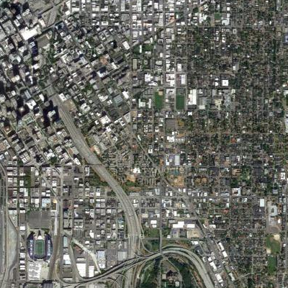
Communities and Risk
VULNERABILITY
& RESILIENCE
socio-demographics,
infrastructure,
building codes,
land use,
resources,
planning, etc.
RISK
HAZARD
earthquakes
extreme rainfall, etc.
2

Slide 3
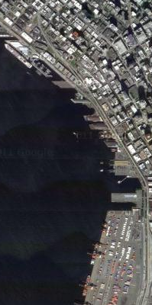
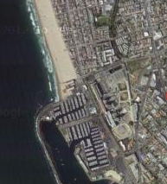
Marine-Related Risk
COASTAL...
VULNERABILITY
& RESILIENCE
migration to coasts,
coastal resource depletion,
coastal industries, etc.
socio-demographics,
infrastructure
building codes,
land use,
resources,
planning, etc.
RISK
tourism
fisheries
marine transport-related
COASTAL...
HAZARD
tsunami
storms and storm surge
sea level rise
marine oil spills, etc.
earthquakes
extreme rainfall, etc.
3

Slide 4
Scope and Contribution
Project 1.2c Analysis of risk and delivery of information to key stakeholders and the public for the two regions
Prediction Core: Socioeconomic risk indicators
The Prediction Core will provide models that translate particular outputs of the atmosphere-ocean and ocean biogeochemical models in Themes 1 and 2 into socioeconomic impacts. This service will facilitate the use of Theme 1 and 2 models for planning and decision-making by end-user groups such as coastal infrastructure organizations or emergency managers.
Resources
Year 1 | Year 2 | Year 3 | Year 4 | Year 5
0.5 PhD | 1 PhD 1 PDF | 1 PhD 1 PDF | 1 RA | 1 RA
4

Slide 5
Year 1 (tentative)
Year | Milestones | Deliverables
1 | Workshop with regional partners to coordinate planning, and identify user needs and forms of communicating expected research results Compilation of resource catalog of information sources on coastal risks, focusing on socioeconomic impacts of rapid-onset hazards Literature review on socioeconomic impacts of oil spills: empirical analyses and models | Contribution to Project 1.2b workshop report Literature review on socioeconomic impacts of oil spills
5

Slide 6
Year 2 (tentative)
Year | Milestones | Deliverables
2 | Expanded literature review to other hazard(s) selected: empirical analyses and models Mapping of coastal uses relevant to hazards and impacts selected (Strait of Georgia) Other data collection | Literature review on socioeconomic impacts of selected other coastal hazard(s) Baseline GIS database of coastal uses in Strait of Georgia region
6

Slide 7
Year 3 (tentative)
Year | Milestones | Deliverables
3 | Development of suite of socioeconomic risk indicators Semi-structured interviews with experts (e.g., port managers) to gather data on vulnerabilities and input on risk communication Other data collection Pilot-testing of selected socioeconomic risk indicators (Strait of Georgia) | Suite of socioeconomic risk indicators Pilot-tested version of selected socioeconomic risk indicators for Strait of Georgia region
7

Slide 8
Years 4 & 5 (tentative)
Year 4: Develop and apply socioeconomic risk indicator models for SoG and HH cases
gather data, build models, build in links to results from other MEOPAR tools
Year 5: Develop planning scenarios
integrate risk indicators into MEOPAR tools
help develop scenarios of risk events for partners’ planning exercises for emergency response and recovery
8

Slide 9
Questions and Collaborations
IP 1.2 SoG: Workshop with regional partners – who is leading?
Which hazards? Oil spill focus (year 1) useful?
Where are the points (variables) of interface between hazard and socioeconomic risk models?
Need to understand other models, esp. outputs
Which socioeconomic risk dimension(s) to focus on? Which sector(s)? What problem?
Collaboration amongst social scientists in different projects?
9

