Slide 1

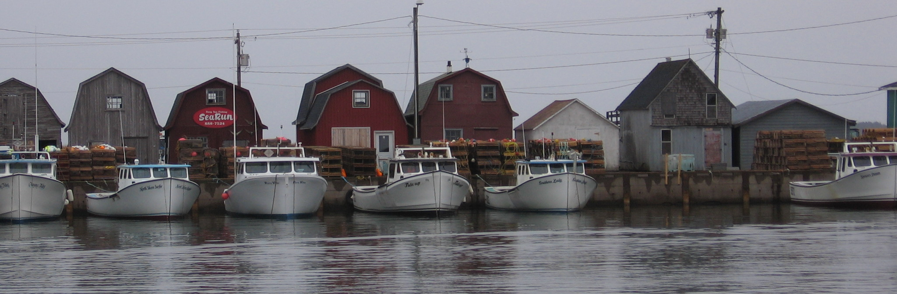
MEOPAR and Human Dimensions
Tony Charles
tony.charles@smu.ca

Slide 2
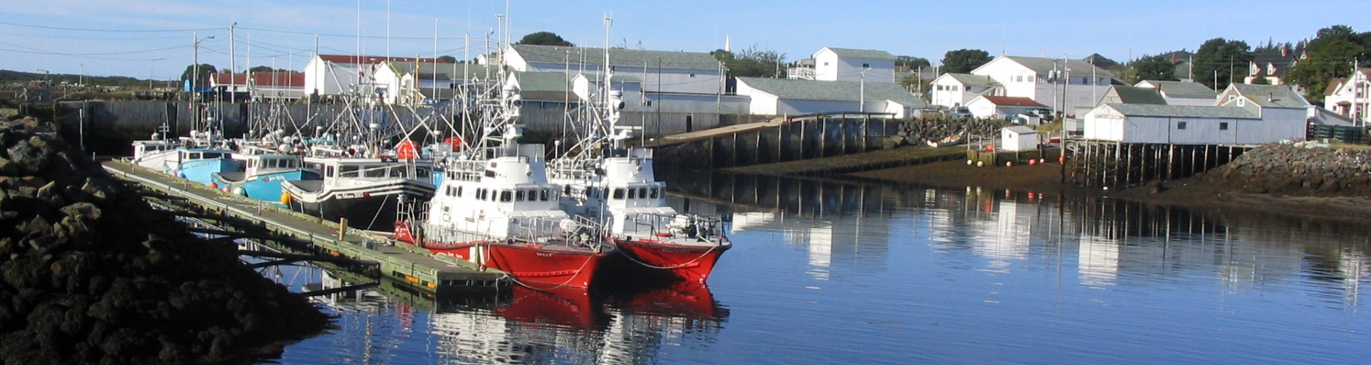
The Coastal Community Perspective
Coastal communities worldwide are increasingly needing to respond to extreme events, hazards, emergencies and longer-term changes
What information products could be useful for coastal communities?
What human dimensions need to be assessed and monitored to better respond to climate change impacts on the coast?
Communities do not separate the short-term and the long-term as MEOPAR does with IP 1 and IP 2… so integration is crucial
e.g., need a ‘tool’ that combines long-term planning and preparation for more extreme events, incorporating short-term response to these

Slide 3
1.1: “Human dimensions rapid diagnostic system”
Responding to
Marine Hazards
Need to understand human values and forecast human impacts of marine emergencies
Need to understand and predict coupled marine dynamics to respond to marine emergencies
Relocatable system
Human dimensions rapid diagnostic system
Basic question: How does the ‘marine processes & impacts’ box
link to the ‘humans on the coast’ box?

Slide 4
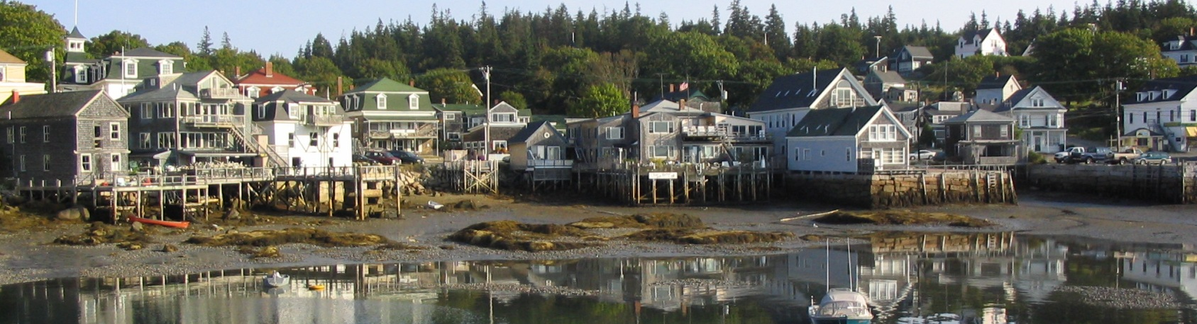
“Human dimensions rapid diagnostic system”
Main Focus: developing and providing a ‘tool’ useful at a local community or regional scale, in Canada and potentially beyond
To provide rapid appraisal of socioeconomic values, vulnerability and risks, associated with an emergency, on a spatially-explicit basis and including local-level community-based approaches
Need to understand human values, socioeconomic structures and dynamics, to forecast human impacts of marine emergencies
Need spatially-explicit data on social, economic, cultural and values along coastlines… this is a connection to Observation Core

Slide 5
“Human dimensions rapid diagnostic system”
Is there a ‘generic’ set of data that can be compiled and maintained coast-wide to be prepared for disasters and hazard response?
Alternatively, is there a process for ‘rapid response’ that includes minimal assessment of ‘human dimensions’?
How can these questions be addressed in the Strait of Georgia, Halifax Harbour, the Scotian Shelf, and beyond?
Note about stakeholders: Add “coastal communities” (partners?)
There are useful links to related research projects (as follows)

Slide 6
Methods
Goal: assess (a) short-term data needs and (b) analytical tools, for evaluating risks and values, to choose priority locations/sectors for emergency response & response mechanisms
Compilation of local-level cases across Canada & globally, including:
  examples of disaster/hazard/emergency response and climate adaptation initiatives in marine/coastal areas, and
  case studies of related coastal community-based planning and response arrangements (e.g., frameworks for decision-making)
Surveys, focus groups, community-based participatory methods
Models: coupled ‘social-ecological’ models & scenario analysis
Links to related coastal research projects (e.g., ParCA, CCRN).

Slide 7
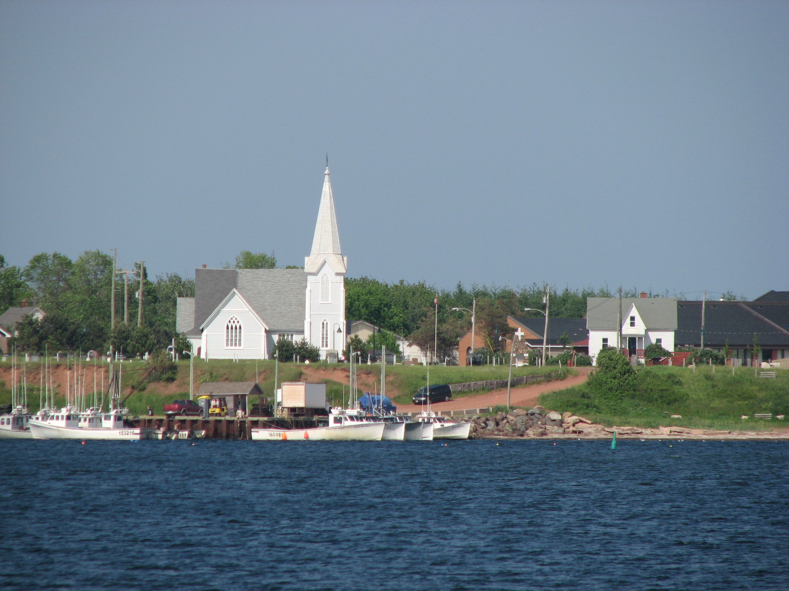
Links to Partnership for Canada-Caribbean Community Climate Change Adaptation (ParCA)
Five-year project focused on climate change adaptation in Maritimes (PEI, Nova Scotia) and Caribbean (Trinidad and Tobago, Jamaica)
Including (1) Community-Based Vulnerability Assessment, and (2) policy and governance analysis, leading to relevant policy changes
Partners: University of Waterloo, Saint Mary’s University, University of PEI, Ecology Action Centre, Mi’kmaq Confederacy of PEI, and Caribbean partners (Funding: SSHRC and IDRC)

Slide 8
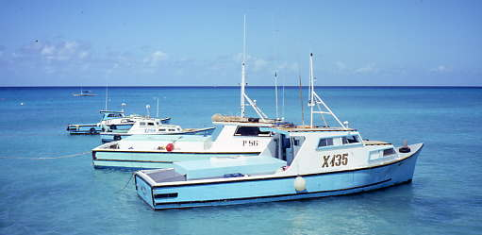

ParCA: Climate & Human Dimensions
Social. Vulnerability of fishers and communities; adaptive capacity will reduce the vulnerabilities.
Economic. Climate ‘benefits’ and ‘costs’, with winners and losers; links with economic change.
Governance. Policy, institutions & participants in decisionmaking; re-designing governance systems
husky1.smu.ca/~charles

Slide 9
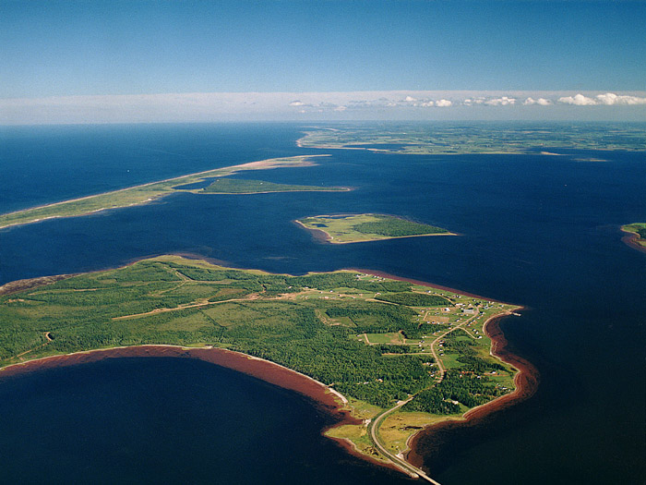
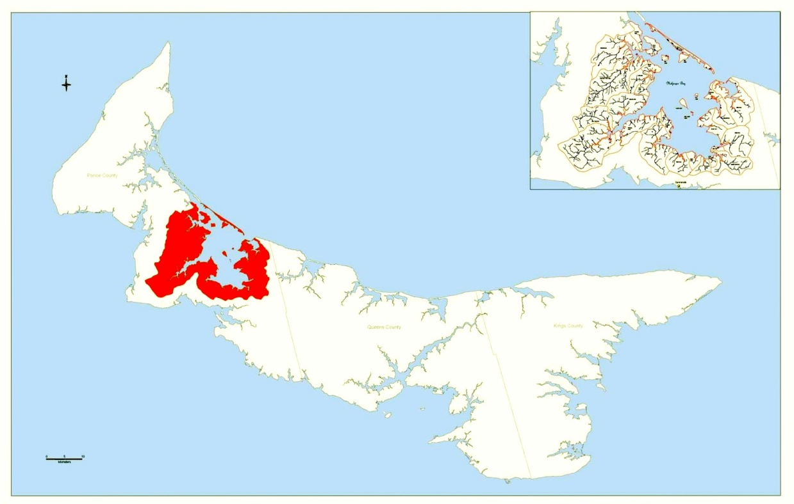
ParCA: Climate Adaptation for Prince Edward Island
Malpeque Bay
saltwater intrusion
archaeological sites threatened
Entry point: culture/biodiversity
Figures: Mi’kmaq Confederacy of PEI
husky1.smu.ca/~charles

Slide 10
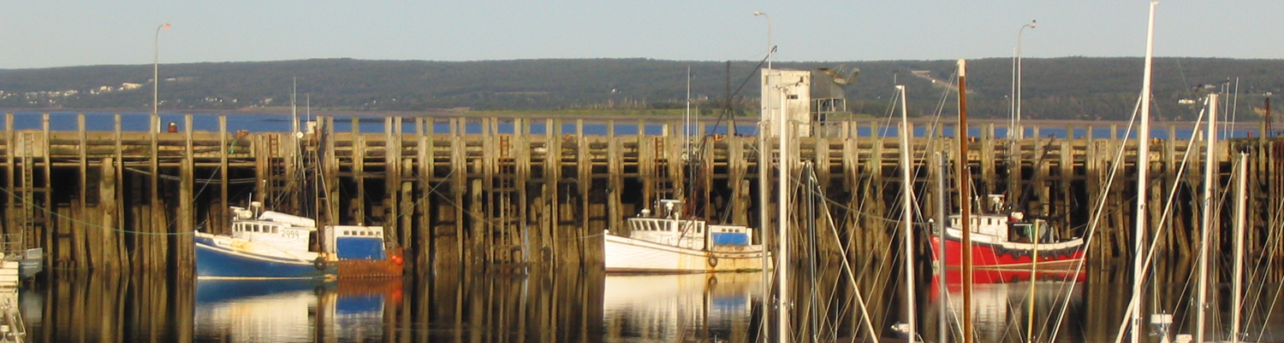
Links to Community Conservation Research Network
A 6-year cross-Canada multi-national initiative (SSHRC) with goals:
(1) To determine how to improve links of local-level conservation with large-scale policy drivers, for effective environmental governance.
(2) To determine best practices in community-based environmental problem solving, on the coast, and high-level policy support for these.

Slide 11
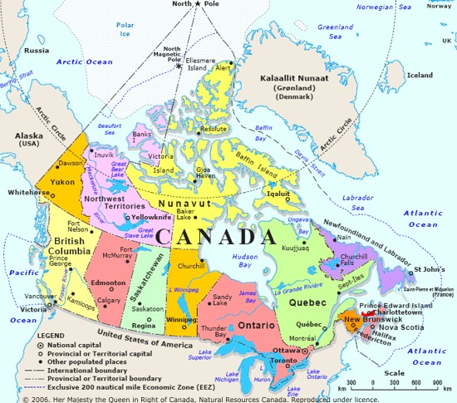

CCRN Partners Study Sites in Canada
Nuu-chah-nulth Tribal Council in B.C.
Innu Nation in Labrador
Ecology Action Centre in Nova Scotia
West Coast Aquatic, BC
Environment Canada
Policy Horizons Canada
Canadian Biosphere Research Network
Saint Mary’s University (Host Institution)

Slide 12
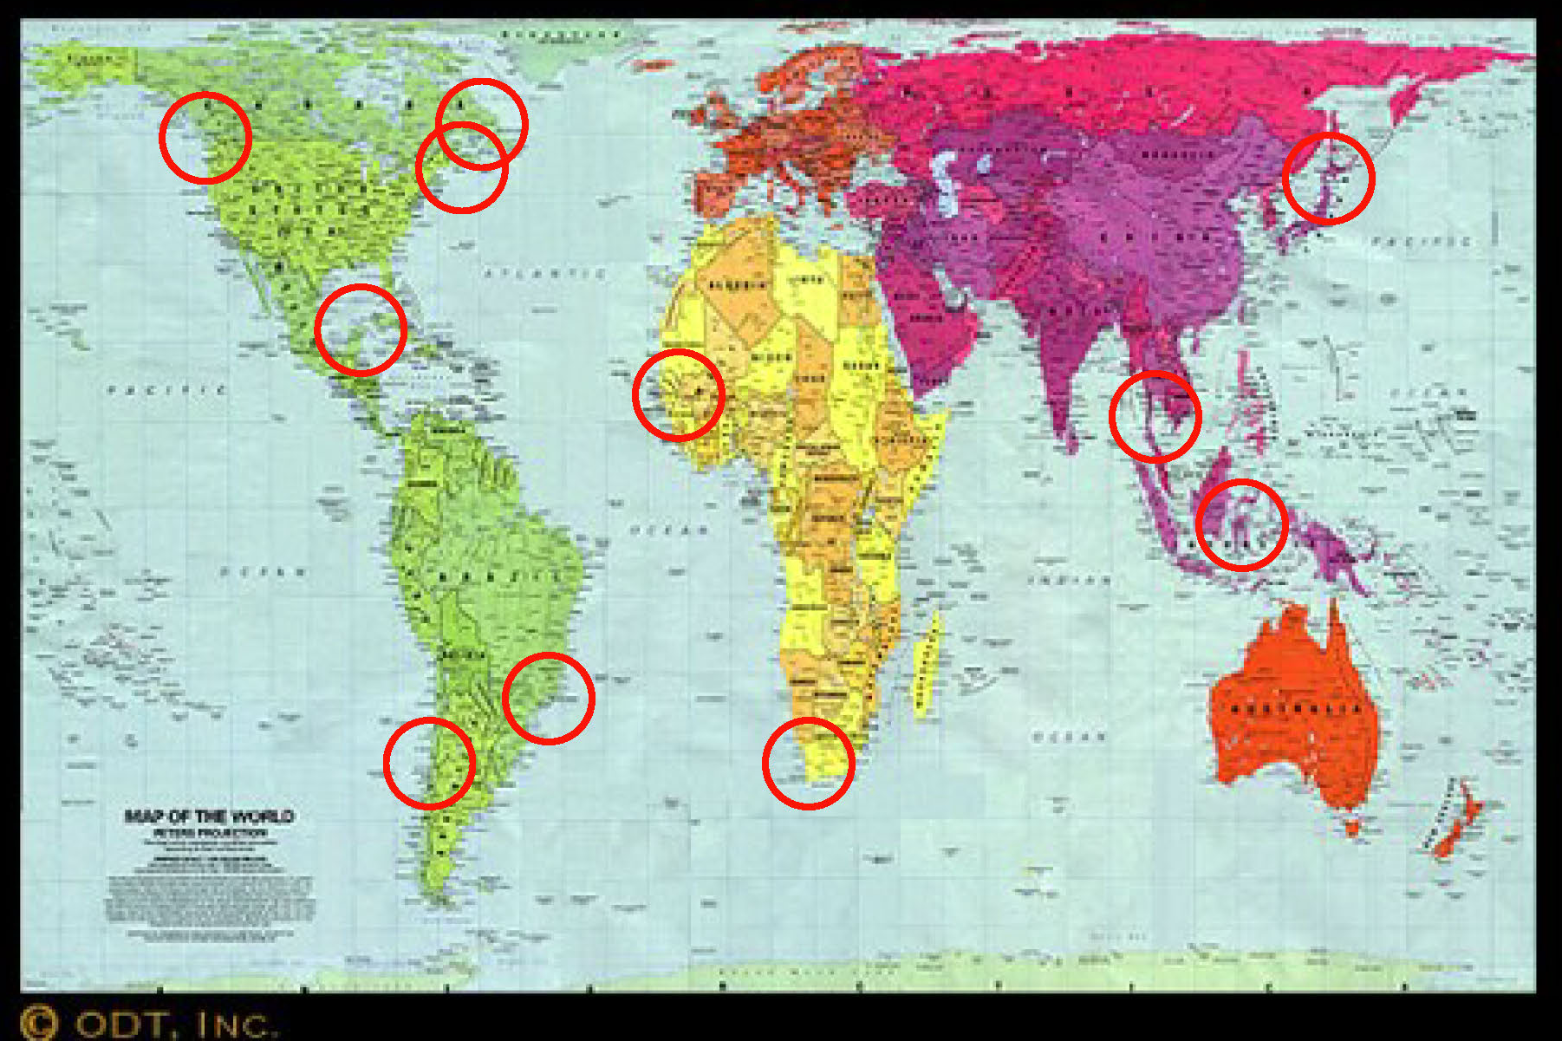
CCRN’s Study Sites Globally
Brazil
Canada
Chile
Mexico
Gambia
S. Africa
Thailand
Indonesia
Japan

