Slide 1
Halifax Harbour Wave Models
Will Perrie
BIO

Slide 2
Schedule/Milestones
Year 1:
Optimize configuration of existing circulation and wave models for Halifax Harbour (coupled within large scale East Coast system).
Drive with regional GEM forecast fields.
Year 2:
Continue development of prediction system and start real-time forecasts. Test forecast skill of system using physical oceanographic observations for Harbour.
Deploy and test parallelized version of new wave model system based on WW3 and unstructured SWAN.
Year 3:
Together with Prediction Core, evaluate analyses and predictions from the initial analysis and modelling system.
Refine unstructured wave forecast system.
Start development of two-way coupling of circulation and wave models.
Make results available to partners on a trial basis.
Year 4:
Continue real-time evaluation of forecasts from prediction system.
Optimize unstructured grid wave forecast system.
Continue development of two-way coupling of circulation and wave models.
Year 5:
Finalize tests and verification of new wave/run-up model.
Transfer system to private sector for commercial operation.

Slide 3
1. Previous Halifax Harbour Wave Model
Motivation
To simulate wave contributions to flood in Halifax Harbour during hurricane Juan
2. To simulate wave contributions to inundation, for the climate change scenarios used for 100 - year planning horizon
Xu, F., and Perrie, W., 2012: Atmosphere-Ocean.

Slide 4
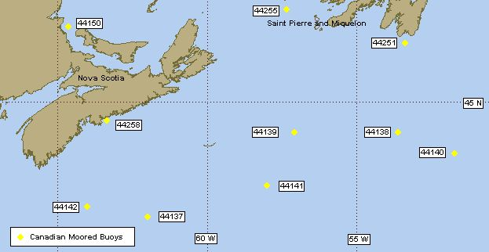
Extreme Waves in Halifax Harbour during Hurricane Juan (2003)
Hurricane Juan was Nova Scotia’s 100-yr damaging storms
Harbour area is on right side of Juan’s track at the radius of maximum wind
Recorded waves at 44258: Hs - 9.0m (perhaps 11m) , Max. waves - 19.9m
Recorded winds at 44258: max - 27.5m/s
Observed sea elevation at 44258: 1.9m MSL, 2.91m CD
Recorded high water marks above max. recorded water level:
1.64m at Point Pleasant Park
1.1m at Bishops Landing

Slide 5
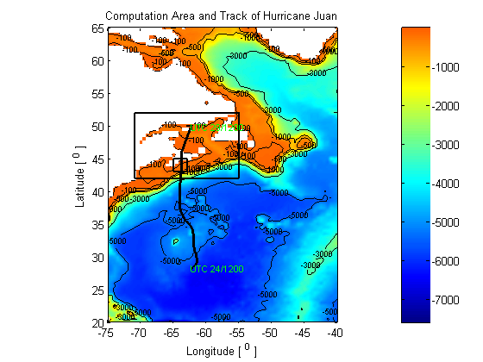
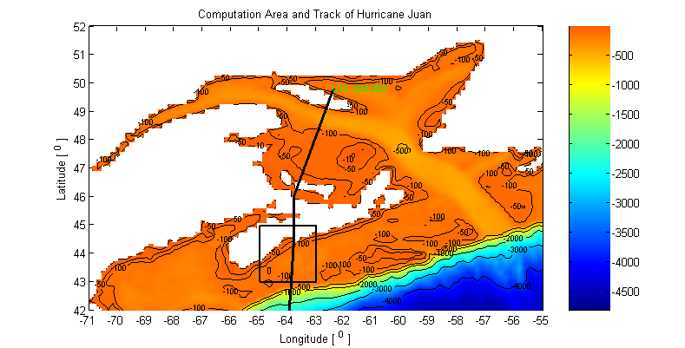




GRIDS: multi-nested computation domains
Large !
$$∆t=10min$$
$$∆t=5min$$
$$∆t=10min$$
$$∆t=10min$$

Slide 6
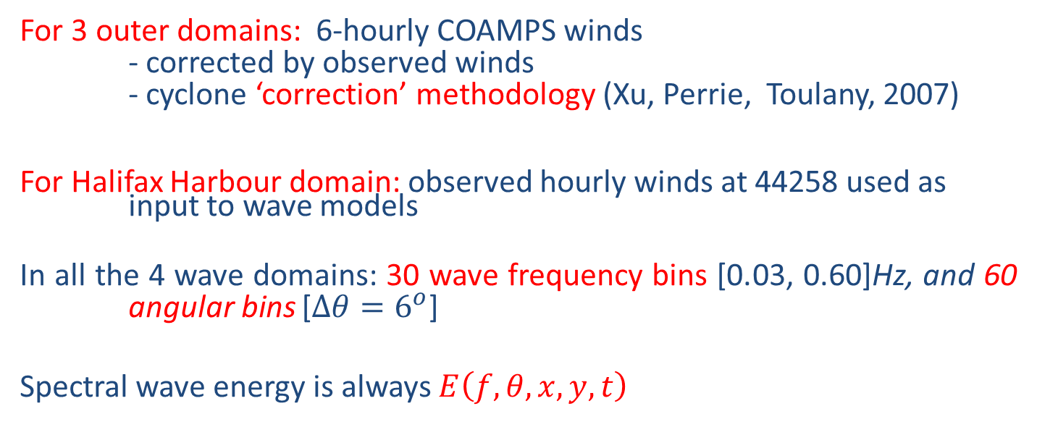
Winds and Waves for hurricane Juan
For 3 outer domains: 6-hourly COAMPS winds
- corrected by observed winds
- cyclone ‘correction’ methodology (Xu, Perrie, Toulany, 2007)
For Halifax Harbour domain: observed hourly winds at 44258 used as input to wave models
In all the 4 wave domains: 30 wave frequency bins [0.03, 0.60]Hz, and 60 angular bins [$∆θ=6^{o}$]
Spectral wave energy is always $E\left(f,θ,x,y,t\right)$

Slide 7
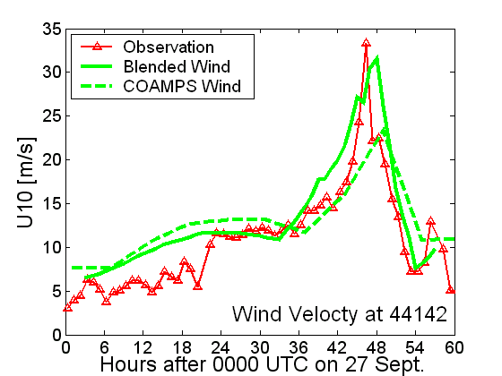
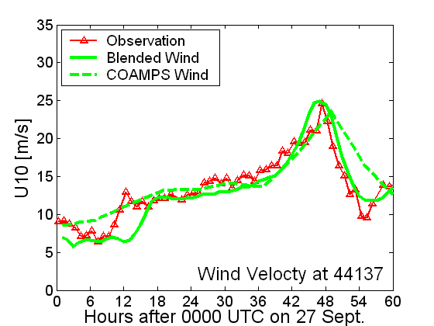
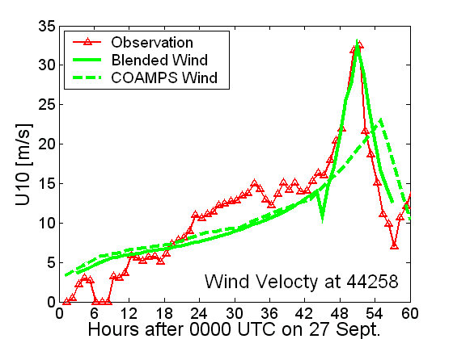
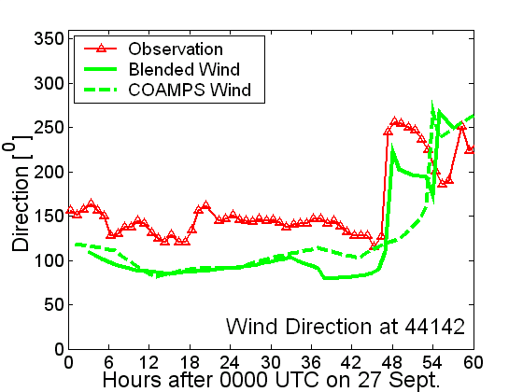
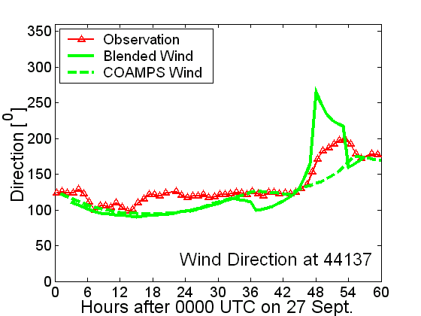
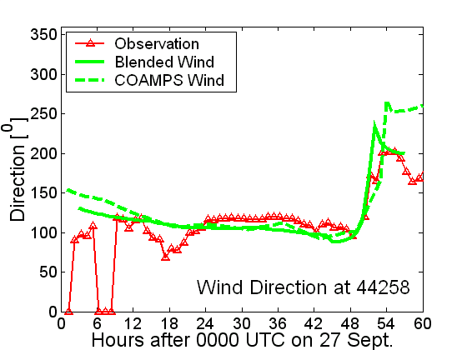
Wind calibrations
Comparison of operational forecast winds (COAMPS) from US Navy [other BIO projects], to our blended winds, with observations

Slide 8
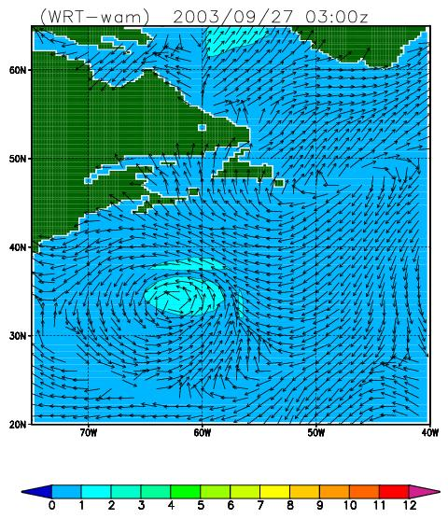
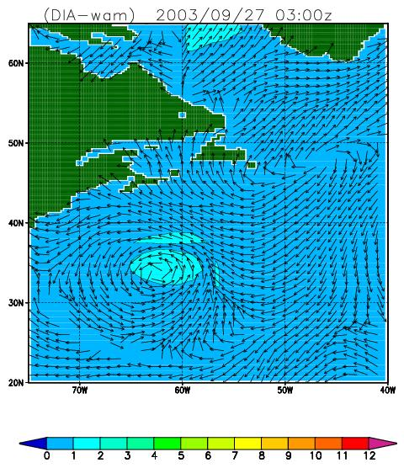
Hurricane Juan
“EXACT-nonlinear waves”
“Discrete interaction approximate”

Slide 9
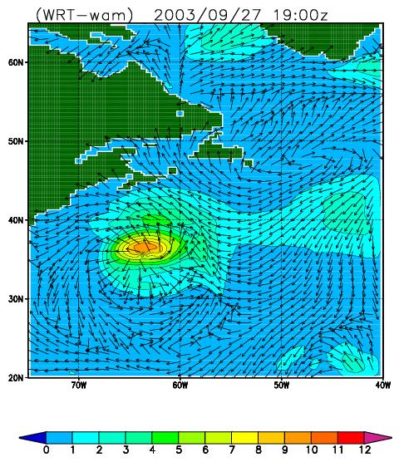
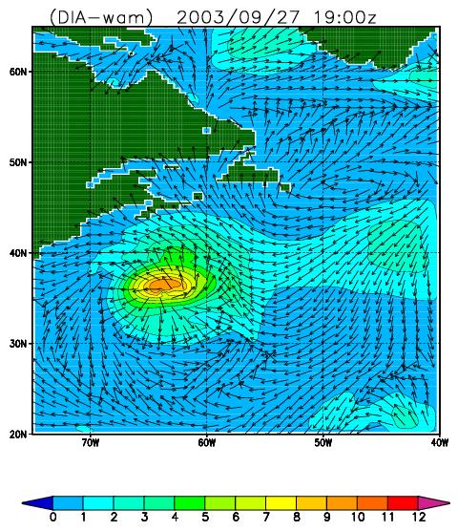
Hurricane Juan
“EXACT-nonlinear waves”
“Discrete interaction approximate”

Slide 10
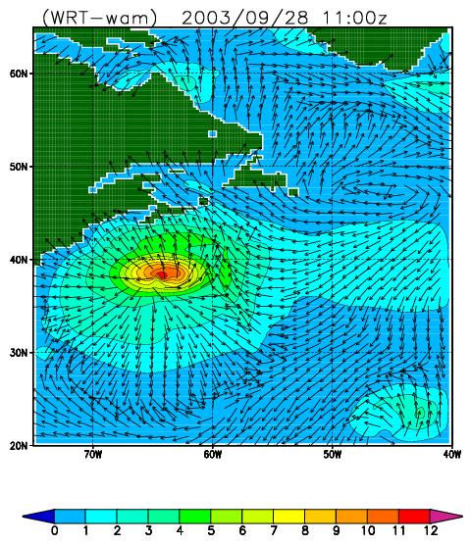
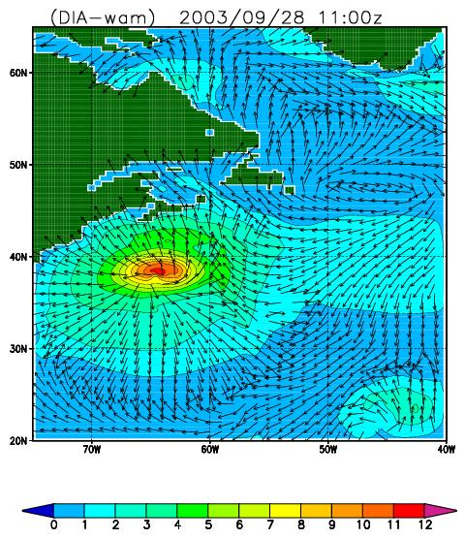
Hurricane Juan
“EXACT-nonlinear waves”
“Discrete interaction approximate”

Slide 11
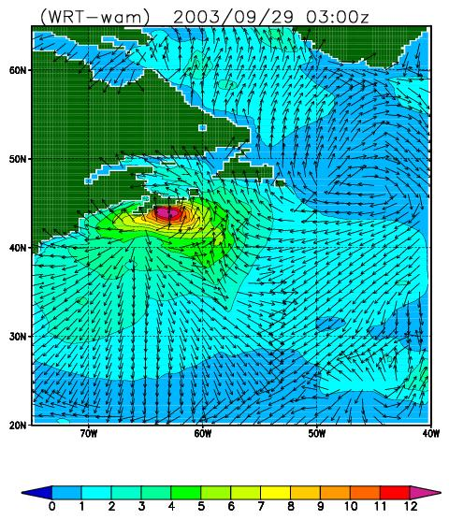
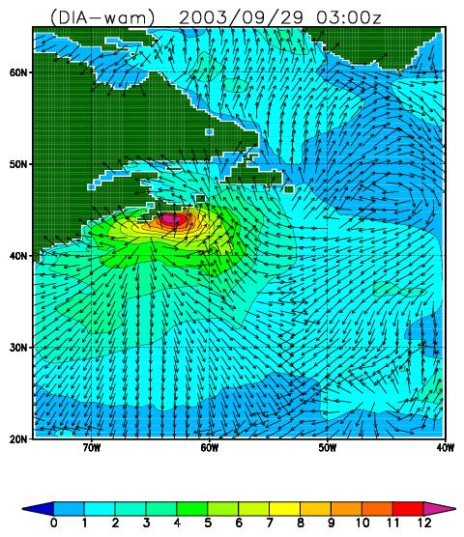
Hurricane Juan
“EXACT-nonlinear waves”
“Discrete interaction approximate”

Slide 12
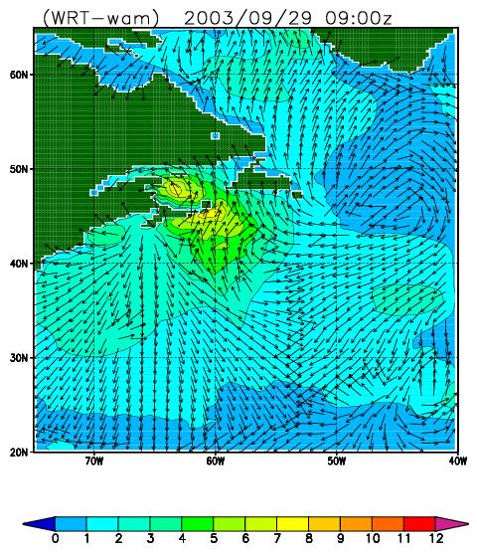
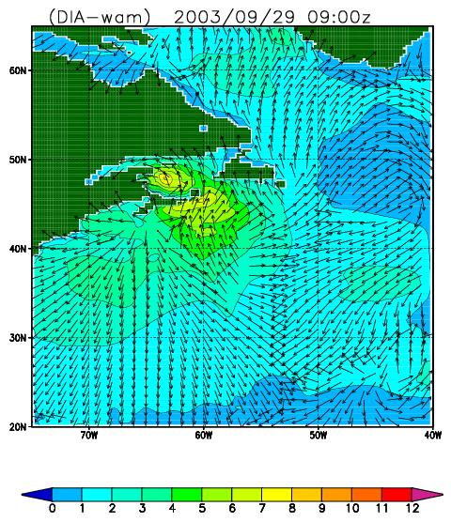
Hurricane Juan
“EXACT-nonlinear waves”
“Discrete interaction approximate”

Slide 13
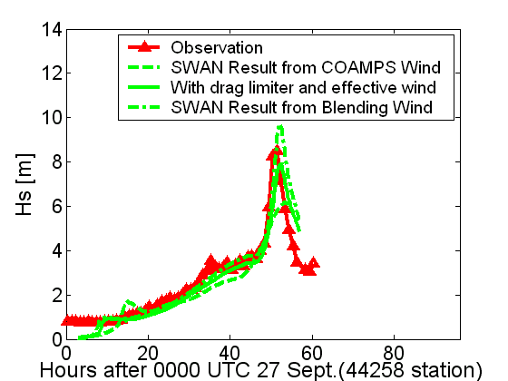
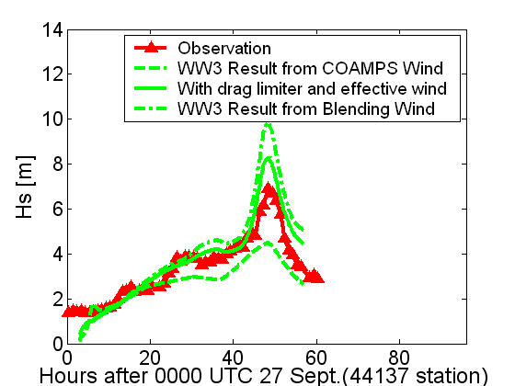
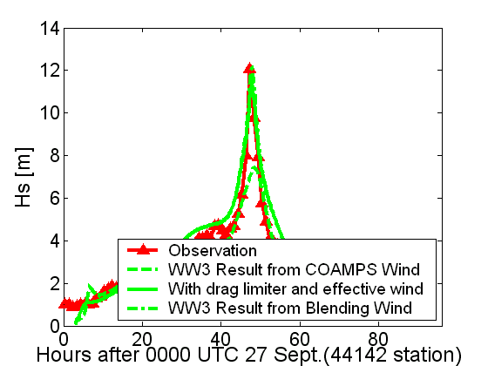
Wave simulation results
Computation conditions:
1) Blended / interpolated wind fields
2) Drag coefficient limited
3) Swell correction → effective wind

Slide 14
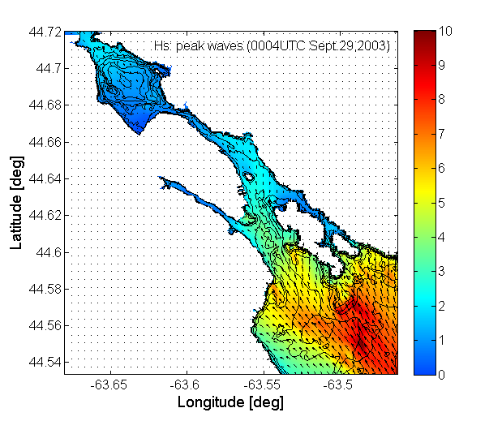
Simulated Results at Juan’s peak intensity

Slide 15
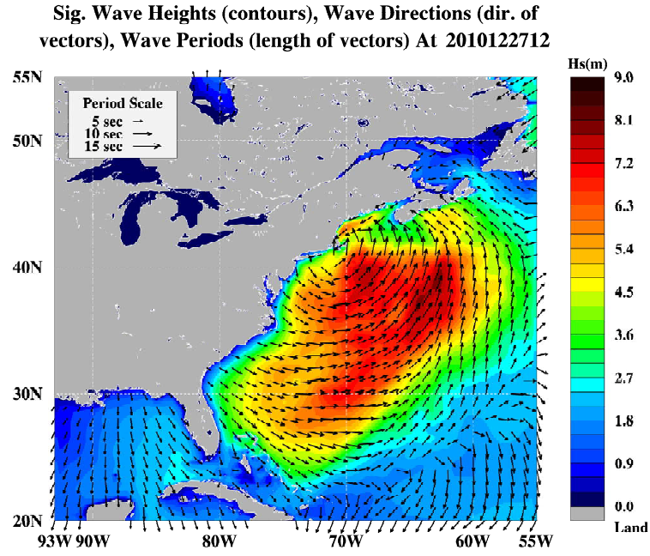
Boxing Day Storm 2010
2. GoMOOS operation wave forecast system (WW3)

Slide 16
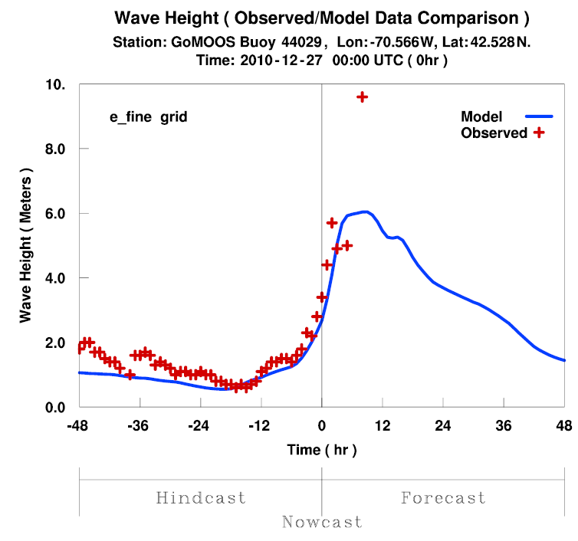
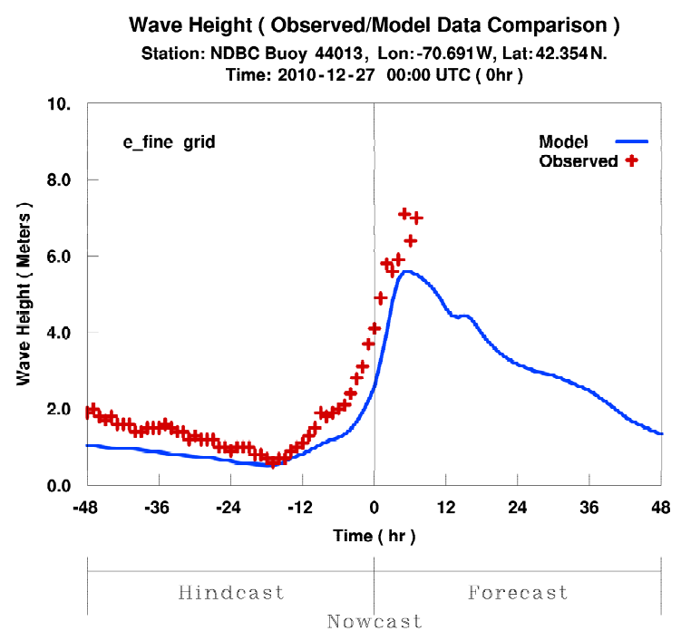
WW3-DIA version 3.14

Slide 17
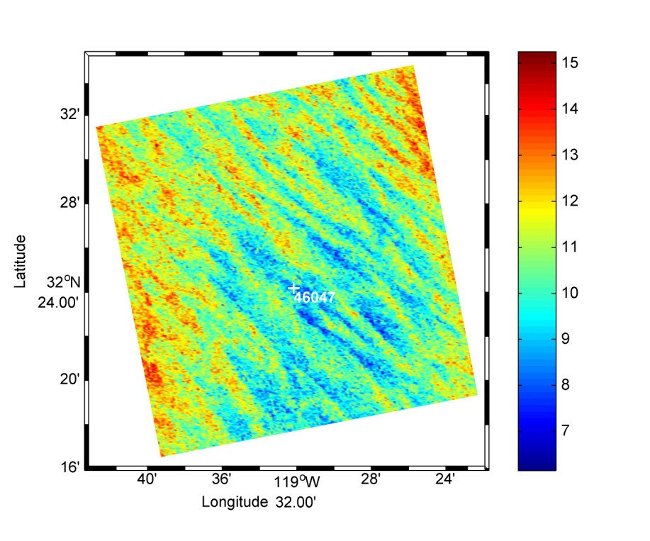
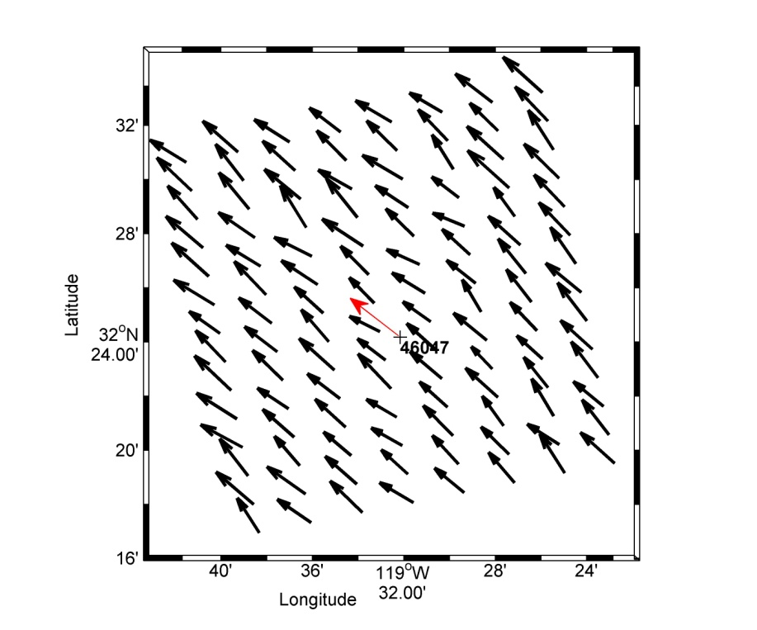
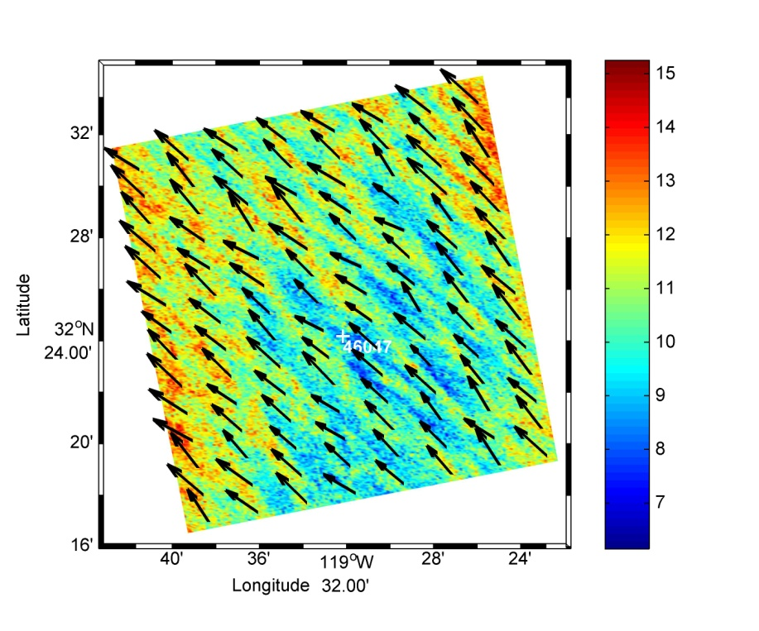
the winds… itws
Buoy-measured wdir=311º
Our Retrieved wdir=323º
Buoy-measured wspd=11.1m/s
Our Retrieved wpsd=10.3 m/s
Polarimetric SAR from RADARSAT-2 with our C-2PO wind model
Zhang, Perrie et al., 2012

Slide 18
3. Wave-ocean coupling: the NOAA/SURA Testbed project
Chen, C.S. +11 others, Perrie, Toulany, 2012: JGR, submitted

Slide 19
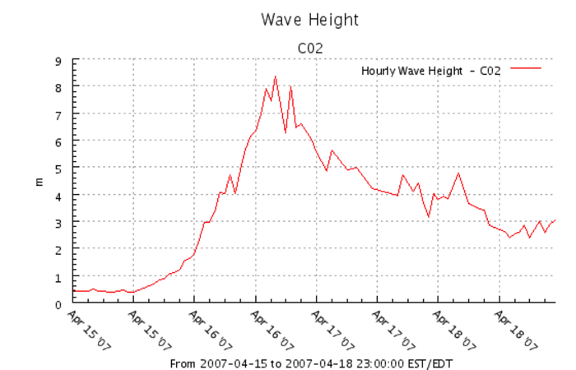
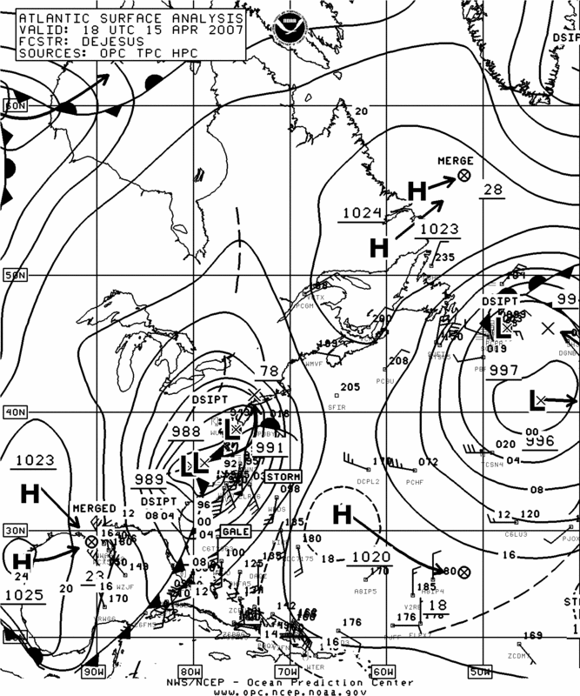
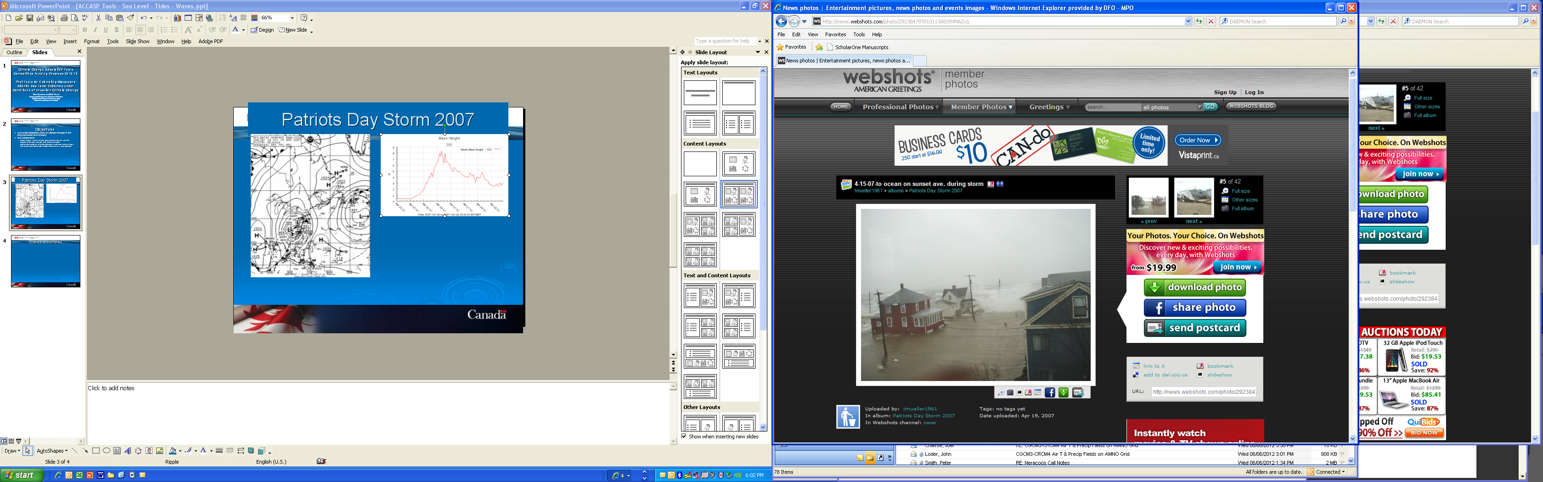
Patriots Day Storm 2007

Slide 20
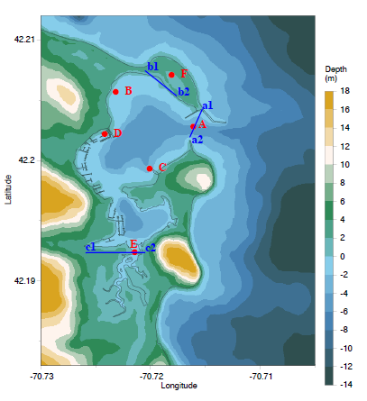
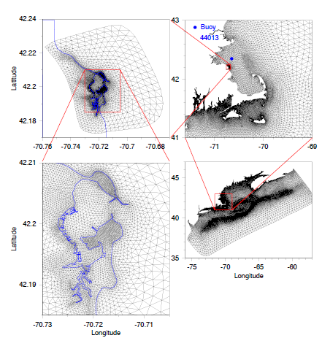
Scituate Harbour bathymetry + grid
Shallow water !
Unstructured FVCOM - SWAVE

Slide 21
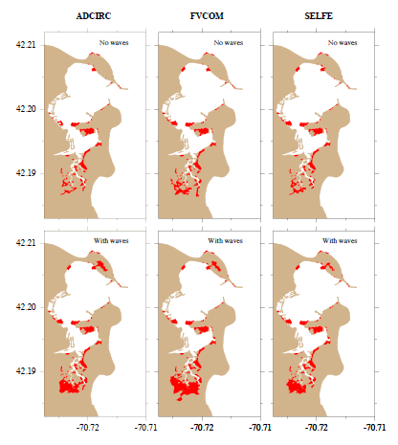
inundation
No wave model…
Total inundation…
With wave model…

Slide 22
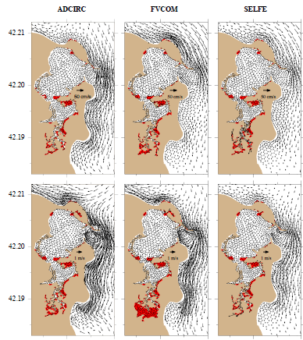
vertically averaged currents + inundation
No wave model…
Snapshot at
04:00 GMT, April 18, 2007
With wave model…

Slide 23
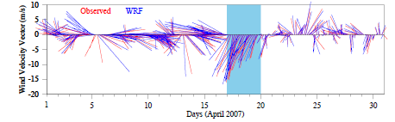
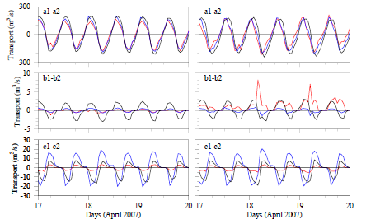

Transports and winds
At buoy 44013
→ tidal-dominated c +wave influence…

Slide 24
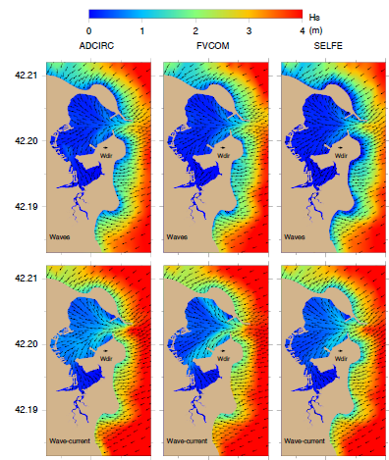
waves
wave direction
Snapshot at
04:00 GMT, April 18, 2007
No ocean model…
→ effects of elevation + currents ?
With ocean model…

Slide 25
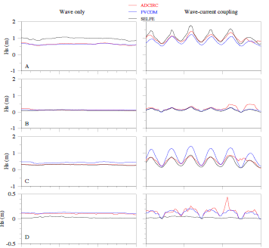
waves…
Wave model only
Wave-current coupling
A
B
C
D
→ effects of elevation + currents ?

Slide 26
Summary
In simulating waves in Juan, we used 4 nested grids and 2 wave models (WW3-WW3-SWAN-SWAN) for Harbour
Big waves can propagate from Harbour entrance to parts of Halifax and Dartmouth waterfronts
Need mosaic grid approach – 2-way nesting fine- and coarse grids
Importance of comparisons with observations
Wave and ocean models – examples/tests:
Hurricane Juan
Patriot’s Day 2007 storm
Other storms
Komen et al (1994) suggest ~ 10 % effect for big waves crossing the Gulf Stream

